Slide 1
Research Administration Forum
October 20, 2015

Slide 2
Agenda
Uniform Guidance Update (Dick)
Proposals for Postdoctoral Fellowships (Dick)
NSF 2016 PAPPG (Dick)
Travel Services Update (Muriel)
Export Compliance Update (Adilia)
Post Award Administration (Rochelle)
Visa Costs (Rochelle)

Slide 3
Uniform Guidance Update
FAQs Update As Of September, 2015
Clarification of the treatment of salary costs above the NIH salary cap.
These costs are not cost sharing
However the costs must be tracked and included in our indirect cost rate calculations
What does this mean for Caltech?
NIH Salary Cap PTAs will still have to be created for faculty who have NIH grants and whose salary exceeds the cap.
Post Award Administration will continue to monitor these PTAs.

Slide 4
Uniform Guidance Working Group
Continuing the review and revision of Caltech policies and procedures dealing with research administration
Policies Issued
Institutional Base Salary
Charging Administrative and Clerical Costs as Direct Costs on Federal Awards
Principal Investigators on Leave: FAQs
Cost Transfer Policy
Cost Sharing on Sponsored Projects
Recruiting Costs: Short-Term Visa Fees

Slide 5
Proposals for Postdoctoral Fellowships
Clarification from Vice Provost for Research, Mory Gharib
Proposals for Postdoctoral Fellowships are processed in accordance with all of Caltech’s proposal review and submission requirements
Identification of a Caltech faculty member to serve as the Postdoc’s sponsor/mentor
Confirmation by Division Administration that the postdoc has a current Conflict of Interests Disclosure
Division Chair signs Division Approval Form (DAF)
BUT, if the proposal is for a Postdoctoral Fellowship, the DAF doesn’t require the review and approval of the Vice Provost for Research

Slide 6
What is a postdoctoral fellowship?
Frequently called a “Fellowship”
Must have a Ph.D. and not hold a faculty position
Provides support for the postdoc, generally in the form of stipend
Very limited funds for other expenses
Does not support an independent research project
When in doubt, call the Office of Sponsored Research

Slide 7
NSF Proposal & Award Policies & Procedures (PAPPG)
New edition. Effective January 25, 2016
Significant changes:
Uniform proposal deadline: 5:00 PM submitter’s local time.
Late proposals will not be accepted. Program Officer will no longer have the ability to allow exceptions and accept a proposal that was submitted after the 5:00 PM deadline.
Biosketches and Current and Pending Support for Senior Personnel: Each individual’s biographical sketch and current and pending support must be uploaded as a single PDF file.

Slide 8
Caltech’s New Travel Agency
Corporate Travel Planners (CTP)
Notes:
Add OSU logo
8

Slide 9
Collegiate Experts
Notes:
9

Slide 10
Account Structure & Services
Passport & Visas
Unused Ticket Management
Dedicated Travel Consultants
After-Hours Support
Online Booking Including Web Fares
5 dedicated agents for online support
Domestic & International Agents
CTP Online Help Desk

Slide 11
Fee Structure
Service Requested | For Service Booked through Concur | For Service Booked through Full Service
Issue a domestic airline ticket | $7.00 | $20.00
Issue an international airline ticket | $7.00 | $22.00
Make a domestic hotel reservation | NO CHARGE | NO CHARGE
Make an international hotel reservation | NO CHARGE | NO CHARGE
Make a domestic car rental reservation | NO CHARGE | NO CHARGE
Make an international car rental reservation | NO CHARGE | NO CHARGE
Void an airline ticket | NO CHARGE | NO CHARGE
Cancel an airline reservation | NO CHARGE | NO CHARGE
Refund an airline ticket | NO CHARGE | NO CHARGE
Reissue a domestic airline ticket | $7.00 | $20.00
Reissue an international airline ticket | $7.00 | $25.00
Page 11
Notes:
11

Slide 12
Why use CTP
Higher-Ed experienced Travel Team
Customized agent training include
Fly America Act
Grant Funds
Research
Institute Travel Policy
VIP Services available
Group Travel Specialists

Slide 13
Why use a Travel Agency
PROGRAM CONSOLIDATION DRIVES SAVINGS:
Vendor negotiations
Airlines
Hotels
Rental Car
Parking
Group travel discounts
Travel policy compliance
Online booking adoption
Reduced staff time spent on travel
Improved expense reporting

Slide 14
Some of the services CTP offers
Significantly lower booking fees/ No fees for car and hotel bookings
Only place where negotiated airline/hotel and car discounts are applied
Guaranteed competitive fares
Tickets voided within 24 hours for no additional cost
One stop shopping
Direct Connect to Southwest Airlines
Dedicated phone line and e-mail address

Slide 15
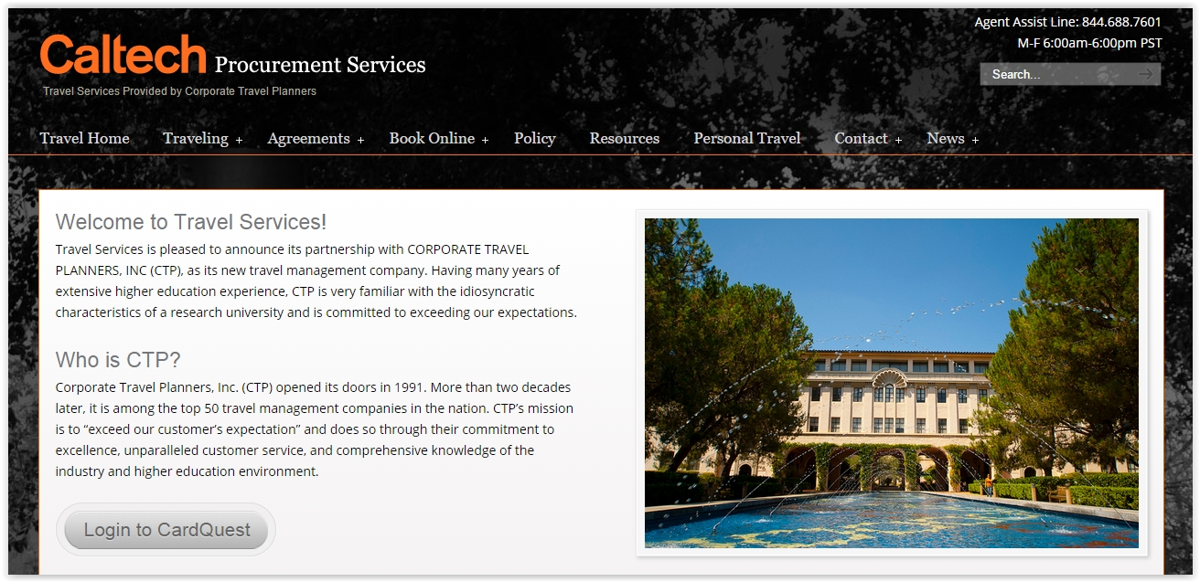
CardQuest
To log-In to Concur:
Access the Institute Travel Service Page
Select Login to CardQuest
Sign-In with your access.caltech Credentials
Notes:
15

Slide 16
CTP Booking Incentive
Prize: A pair of airline tickets for travel within the 48 contiguous United States.
Entry: Each ticket purchased, either Full Service or online via Concur, will be placed in a drawing. There will be 3 separate drawings.
Winner: The person that booked the winning ticket.
Booking Start Date | Booking End Date | Drawing Date
September 1, 2015 | October 30, 2015 | November, 2, 2015
October 31, 2015 | January 8, 2015 | January 11, 2015
January 9, 2015 | February 26, 2015 | February 29, 2015

Slide 17
Export Compliance Website Update http://researchadministration.caltech.edu/export
Check out the new video!

Slide 18
Export Compliance International Shipments Website Update http://researchadministration.caltech.edu/export/shipments
Check out the shipping video!

Slide 19
Post-Award Administration News
Rochelle Athey
PAA Staff Updates
Plans for the future

Slide 20
Short Term Visa Costs Guidelines for Charging to Federal Awards and Federal Flow Through Awards
Presenter: Rochelle Athey, Senior Director, Post Award Administration
Co-authored with:
Virginia Baker, Senior Director, Cost Studies and Property Management
and
Ilana Smith, Director, International Offices

Slide 21
What Are Short Term Visa Costs?
Costs related to nonimmigrant petitions and applications filed with the US Citizenship and Immigration Services
Costs related to nonimmigrant visa applications submitted to the US Department of State
Fees for Student and Exchange Visitor Information System (SEVIS)
Examples: H-1B, TN, E-3, O-1, J-1
(NOTE: Although allowable, Caltech does not typically pay for visa applications or SEVIS fees)

Slide 22
What Are Not Short Term Visa Costs?
Costs related to labor certifications filed with the US Department of Labor
Immigrant visa petitions and adjustment applications filed with the US Citizenship and Immigration Service
Immigrant visa applications submitted to the US Department of State
Attorney fees
Examples: Form I-140, I-485

Slide 23
Allowability of Short Term Visa Costs on Federally Funded Awards
Before the Uniform Guidance
NSF
NIH
Other Federal Agencies
After the Uniform Guidance

Slide 24
Allowability of Short Term Visa Costs on Federally Funded Awards- Before Uniform Guidance
NSF - http://www.nsf.gov/pubs/policydocs/pappguide/nsf14001/aag_5.jsp#VC (scroll down)
Must be critical and necessary for the conduct of the project
Allowable under the applicable cost principles (OMB Circular A-21)
Consistent with Caltech’s cost accounting practices and policies
Meet the definition of “direct cost” as described in OMB Circular A-21

Slide 25
Allowability of Short Term Visa Costs on Federally Funded Awards- Before Uniform Guidance (cont.)
NIH – NIH Grants Policy Statement, effective October 2013 Chap 7.9/1 Selected Items of Cost (scroll to bottom)
Caltech and individual must have an employee/employer relationship
Short term visa costs associated with initial recruitment, fraud fees and fees associated with SEVIS Form I-901 are allowable
Short term visa costs associated with renewals, and expedited processing fees are unallowable
Other Federal Agencies – short term visa costs are allowable as direct charges to those awards if they meet the other criteria for allowability and direct charges in the applicable federal guidance and the specific terms and conditions of the award.
Short term visa expedited processing fees are unallowable

Slide 26
Allowability of Short Term Visa Costs on Federally Funded Awards – After Uniform Guidance
Must be a recruitment cost
A recruitment is the process of finding and hiring a candidate from within or outside the organization for a job opening. Typically, the recruitment process includes determining the requirements of a job, attracting applicants to the job, screening and selecting applicants, and hiring an applicant for the position.
Critical and necessary for the conduct of the project
Allowable under applicable cost principles
Consistent with Caltech’s cost accounting practices and policies

Slide 27
Allowability of Short Term Visa Costs on Federally Funded Awards – After Uniform Guidance (cont.)
Meet the definition of a direct cost as described in 2 CFR Part 200
Costs associated with renewals that did not arise from a recruitment and premium processing fees are unallowable.*
When short term visa costs are associated with the relocation of a new employee and the newly hired employee resigns for reasons within the employee’s control within 12 months after hire, all relocation costs including short term visa costs become unallowable on Federal awards and must be transferred to a non-Federal PTA.
*Premium processing fees and renewal visa costs may be allowable if the federal agency provides written approval of such costs (specific budgeting of such costs is considered allowable)

Slide 28
Process of Charging Short Term Visa Costs
International Scholar Services determines that a petition is necessary;
International Scholar Services requests a PTA and provides checklist to Division partner;
Division partner contacts Grant Manager;
Grant Manager completes checklist only when charging short term visa costs to a Federally funded award or Federal flow through award;
Grant Manager/Division partner submits completed checklist to International Scholar Services;
International Scholar Services forward checklist and payment request to Payment Services to charge costs to PTA.

Slide 29
Expenditure Types
Document Fees
Use to charge short-term visa fees that are allocable
Document Fees – Unallocable
Use to charge short-term visa fees that are not allocable
Short-term, travel visa costs for staff that were not hired through a ‘recruitment’ as defined by Caltech
Renewal visa costs

Slide 30
Checklist
In development – questions will most likely include:
Is the cost a recruitment cost?
Is the PTA to be used subject to Federal-Wide Research Terms and Conditions and/or the Uniform Guidance?
Is the cost specifically referenced in the award budget?
Has the PI received written approval for the cost from the agency?

Slide 31
Slides from today’s presentation will be available at our website:
http://researchadministration.caltech.edu/training

