Slide 1

Research Administration Forum
June 17, 2015

Slide 2
Agenda
Tuition Costs (David)
Conflict of Interest Disclosures (David)
Revised Division Approval Form (David)
Caltech’s OMB Circular A-133 Audit for FY2014
  Results and Findings (Estella)
  Management’s Views and Corrective Action Plan (Felicia)
  Resources for Corrective Action Plan Compliance (Felicia)
Uniform Guidance Update and Revised Caltech Policies (Dick)

Slide 3
Tuition Costs
COI Disclosures
Division Approval Form
David Mayo

Slide 4
Tuition costs – NSF SBIR/STTR
NSF now prohibits the inclusion of tuition costs in SBIR/STTR proposals
  Restriction includes university collaborators
  OSR has confirmed restriction with NSF policy office
If students will be included in a NSF SBIR/STTR proposal, tuition will have to be covered from non-sponsored, Caltech sources
Caltech’s payment of tuition costs cannot be mentioned in the NSF budget or budget justification, since doing so would commit cost sharing to the project, which NSF does not allow.

Slide 5
COI Disclosures and Proposal Submission
OSR is not permitted to submit any proposal for which Caltech principals (PI, co-PI or co-I) are late in disclosing financial interests.
The Division is responsible for ensuring that required disclosures have been made.
The Division Chair’s signature on the DAF will inform OSR that all required disclosures have been made.
OSR has no discretion to make exceptions, even to meet a proposal deadline.

Slide 6
COI Disclosures and Proposal Submission
(cont.)
Please Note:
  OSR must receive the DAF, signed by the Chair in order to submit a proposal; it is no longer possible to collect approvals after submission.
  If the Division Chair is not available to sign the DAF, an e-mail from the Division Chair will be sufficient, with the signed DAF to follow upon the Chair’s return.
  If a chair normally delegates signature authority to Division officers during the Chair’s absence, those officers can sign for the Chair in this situation.
  The Chair is ultimately responsible for this requirement, regardless of who signs on behalf of the Chair.

Slide 7
Division Approval Form (DAF)
The DAF has been updated to reflect:
  Additional wording at the beginning of the Financial Interests section regarding COI disclosures (Section F)
    I, the PI, certify that I have completed my annual Conflict of Interest disclosure for this year and have updated it as necessary…
  Expansion of G.3 to include “synthetic nucleic acids”
  Addition of G.4 to address stem cells
  Modification of PI certification (Section H) :
    I agree…to abide by my obligations under the relevant award, including those relating to confidential information.

Slide 8
Post-Award Administration
Updates
Felicia Beanum
Estella Venegas

Slide 10
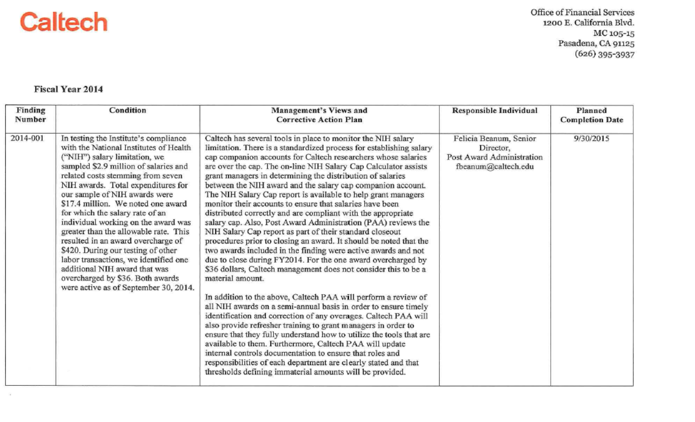
Management’s Views and Corrective Action Plan
For the Year Ended September 30, 2014

Slide 11
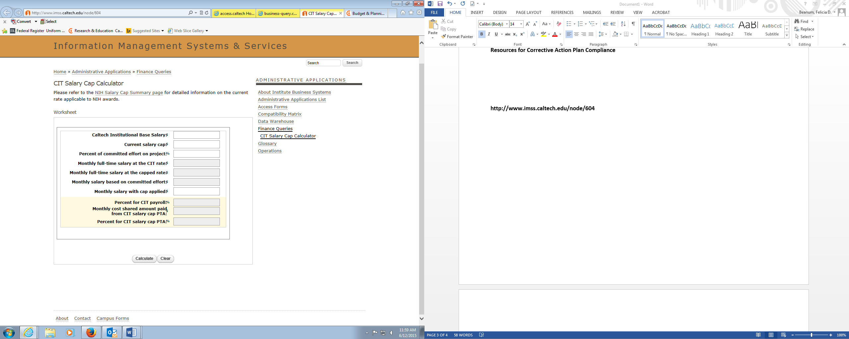
CIT Salary Cap Calculator Tool http://www.imss.caltech.edu/node/604

Slide 12
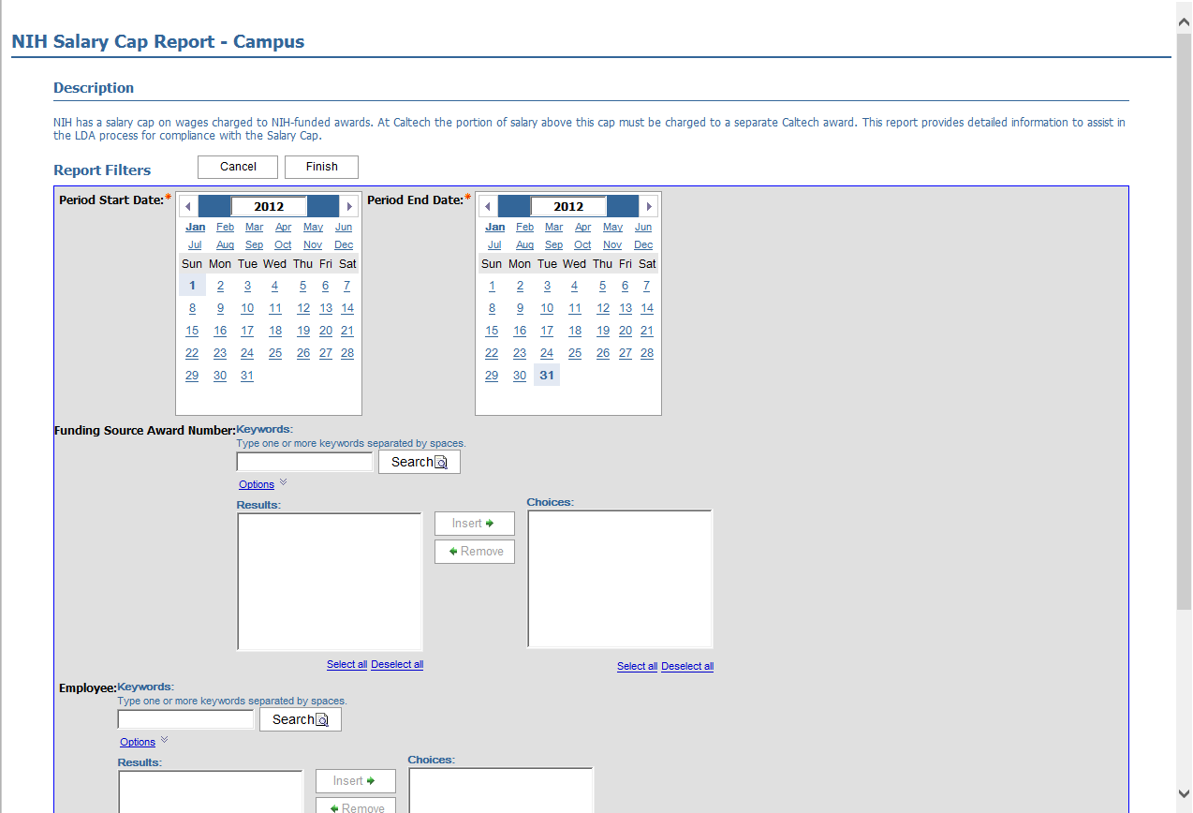
COGNOS: NIH Salary Cap Report -Campus

Slide 13
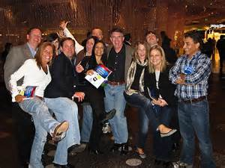
PAA Grant Accountant:
1. Monitoring reports quarterly
2. Contacting Grant Managers with any adjustments and questions
3. Available to provide training on running and reviewing the NIH Salary Cap Calculator and Cognos Report
Division | Primary Contact
CCE, EAS, HSS | Rosemary Nomura, Lead, x2695
EAS | Eduardo Villalobos, Accountant, x6683
CCE & HSS | Sandie Glaze, Accountant, x2697
BBE, PMA, GPS | Karel Zumbrunnen, Lead, x8545
BBE | Christa Albanez, Accountant, x6756
PMA | Mary Kostikyan, Accountant, x1798
GPS | Devine Baquiran, Accountant, x5779

Slide 14
Uniform Guidance Update and Revised Caltech Policies
Dick Seligman

Slide 15
Uniform Guidance Update and Revised Policies
UG Current Status
Awards are being received and identified as subject to the UG
For some on-going awards that are being modified, some portions will be under the “old” rules (OMB Circulars) and some portions under the UG.

Slide 16
New implementation publications:
NIH Grants Policy Statement - March 15, 2015
NSF Proposal and Award Policies and Procedures Guide (PAPPG) – December 26, 2014
Good news: Both NSF and NIH have extended the deadline for final financial reports to 120 days after the end date of the grant.
Be on the lookout for agency “deviations”

Slide 17
Revised Policy:
Institutional Base Salary
• Use Institutional Base Salary in grant proposal budgets
• Use Institutional Base Salary when charging salaries to grants
• At Caltech, the IBS is contained in the appointment letters issued by the Provost

Slide 18
Revised IBS Policy includes a section on “allowable activities” that is taken from the Uniform Guidance.
• Delivering special lectures about specific aspects of the project
• Writing reports and articles
• Developing and maintaining protocols
• Managing substances and chemicals
• Participating in appropriate seminars
• Consulting with colleagues and graduate students
• Attending meetings and conferences

Slide 19
Revised Policy:
Principal Investigators on Leave FAQs
Two sections: For awards that are under the OMB Circulars; for awards that are under the UG
For awards under the UG, no prior approval is required if the PI remains “engaged” in the project. If the PI will not be engaged for more than 90 days, prior approval is required.

Slide 20
New Policy: Charging Administrative and Clerical Costs as Direct Costs on Federal Awards
These costs are normally treated as indirect costs
May be charged directly, IF
  “integral” to the project
  Individuals can be specifically identified
  Included in the budget and justification or have prior written approval from the sponsor
  Are not recovered in the indirect cost rate

Slide 21
New Policy: Charging Administrative and Clerical Costs as Direct Costs on Federal Awards
NOTE: NIH has waived the requirement for prior approval of clerical and administrative costs being charged directly to a grant. BUT, they must still be spelled out in the budget and documented if not in the proposal budget or award.

Slide 22


