Slide 1
Research Administration Forum
February 11, 2016

Slide 2
Agenda
FY 2015 Proposal and Award Statistics – Dick
NIH Update for 2016– Dick
NIH Payment Transition to Subaccounts – Rochelle
Updates on Shipping and I-129 Certifications – Adilia
Committed Effort Refresher – David

Slide 3
Award and Proposal Statistics for FY2015
Overall funding - $303 Million. 6.6% decline over FY 2014
Federal Award Dollars - $258 Million. Down by 12%
Non-Profit Organizations - $20 Million. Up by 210%
For-Profit Organizations - $11 Million. Up by 66%
Proposals Submitted – 1,174. Up by 16%

Slide 4
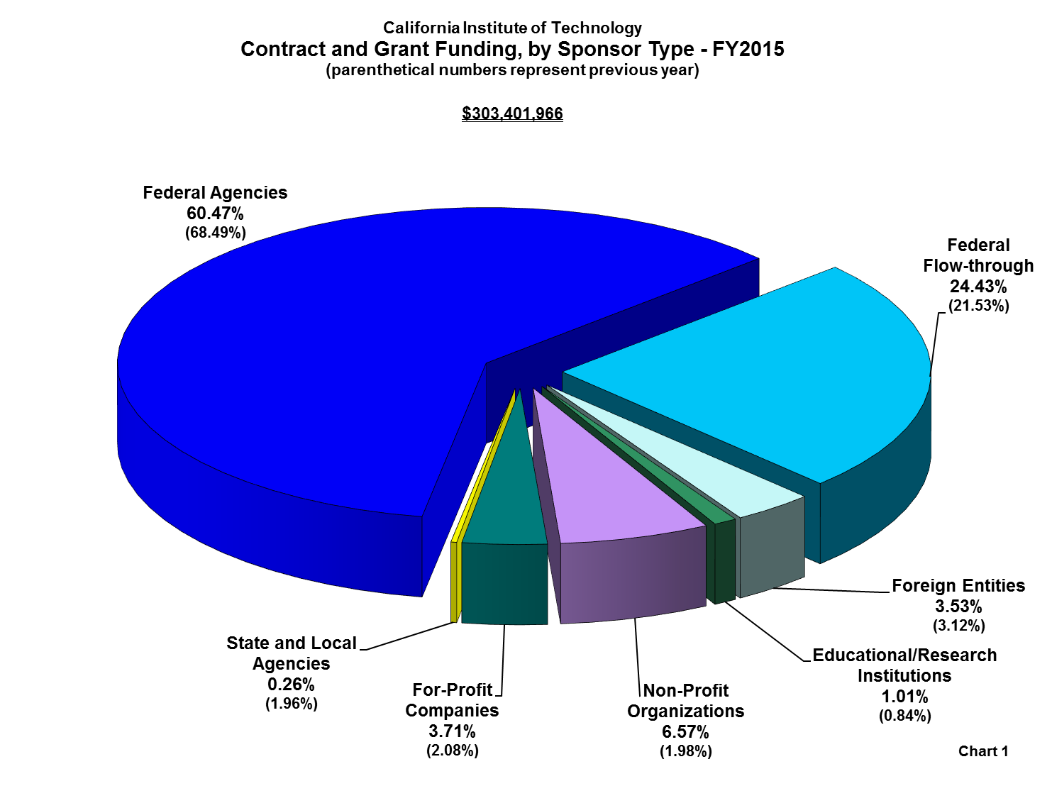

Slide 5
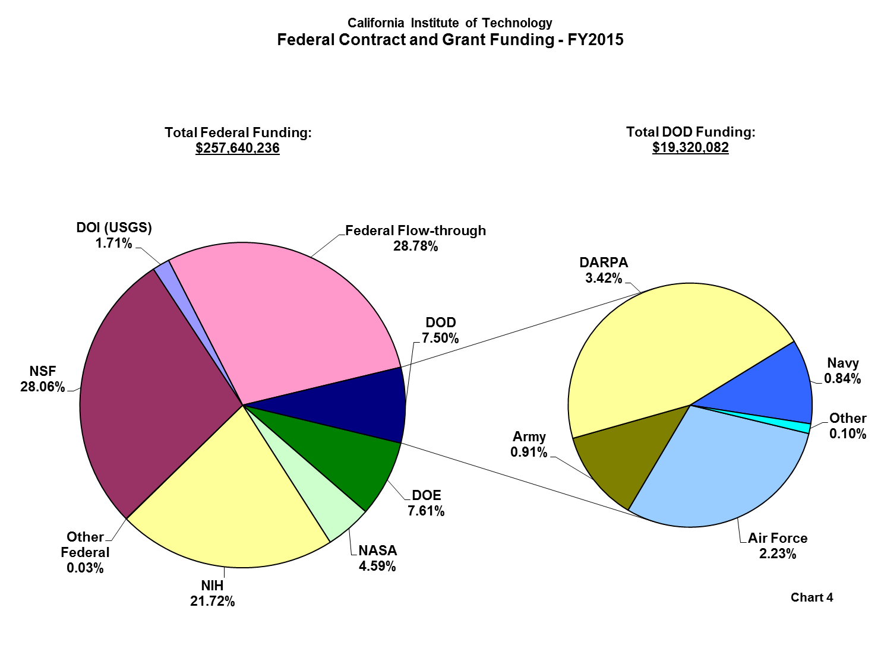

Slide 6
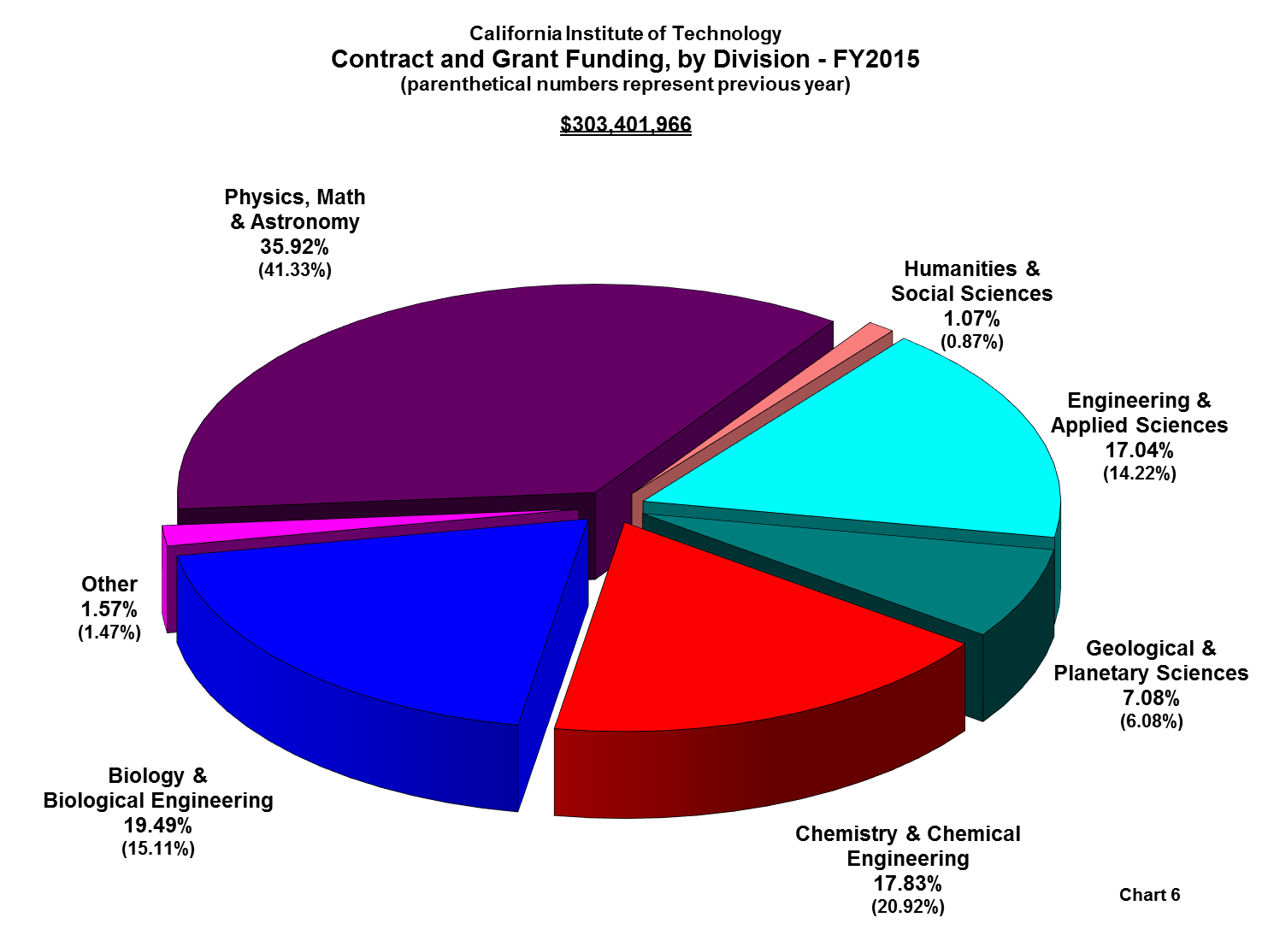

Slide 7
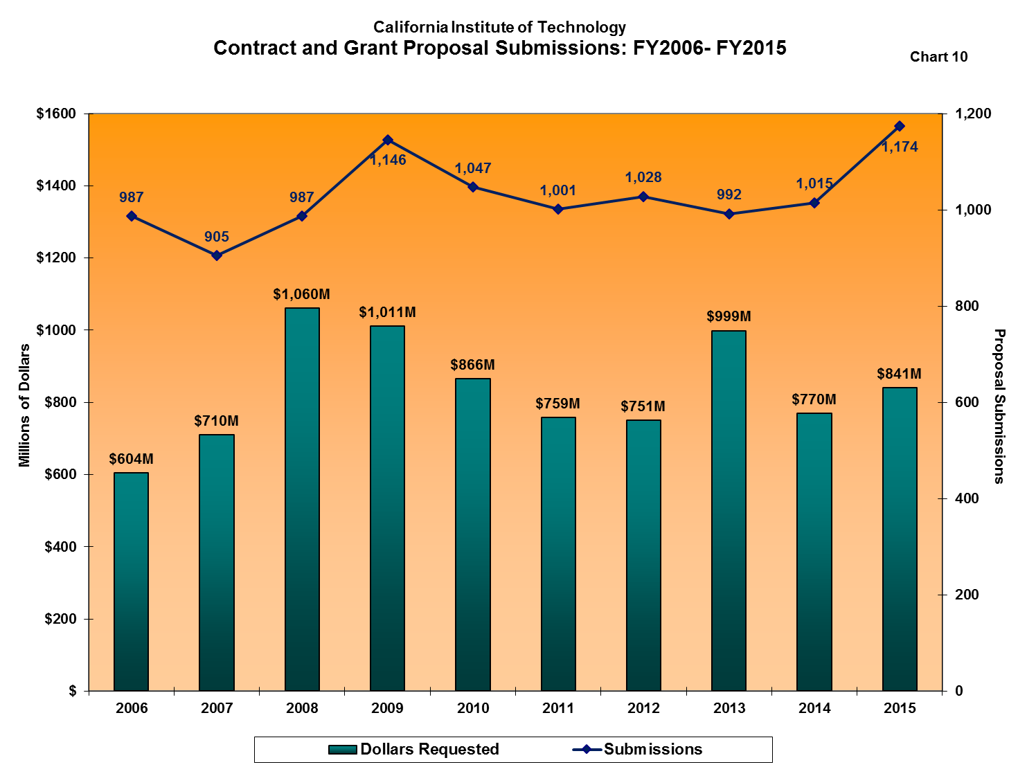

Slide 10
NIH Update for 2016
Salary Cap up from $183,300 to $185,100
The new cap was effective January 10, 2016

Slide 11
FY 2016 Funding Levels
Continuation Awards have been funded at 90% of the previously committed level.
The remaining 10% will be restored.
Continuation Awards made after March 1 (approximately) will be made at 100% of the previously committed level.

Slide 12
New Stipend Levels for NIH Training Grants
Graduate Student Trainees
$1,948 monthly; $23,376 annually
Postdoctoral Fellows
from $43,692 for first year postdocs to $57,504 for postdocs with 7 or more years of experience

Slide 13
Tuition and Fees for Graduate Student Trainees: $16,000
Training Related Expenses on Institutional Training Grants
Graduate Student Trainees: $4,200
Postdoctoral Trainees: $8,850
Institutional Allowance for Individual Fellowships
Graduate Student Fellows: $4,200
Postdoctoral Fellows: $8,850

Slide 14
NIH Payment Transition to Subaccounts
Will the Transition Impact Your NIH Award?
Rochelle Athey, Post Award Administration
rathey@caltech.edu x2585

Slide 15
What Transition?
NIH notified grantees in FY2012 that eventually all NIH grants would transition within the Payment Management System (PMS) from pooled accounts to subaccounts.
Grantees draw award funds from PMS
In the past, all NIH award funds to a grantee were pooled in one account in PMS
NIH is now transitioning all award funds to subaccounts – draws will now be made award by award instead of pooled
Although the timeline has been slowed a few times since then, NIH has indicated that the final group of NIH pooled awards will transition to subaccounts in FY2016.

Slide 16
NIH Awards Impacted
Most new NIH awards are set up by NIH as subaccount (P) awards.
No Impact – awards are already set up in PMS as subaccounts
If your NIH award was issued prior to FY2016, the award may be transitioned to a subaccount before the end of the FY 2016 federal fiscal year.
Possible Impact – your award may transition

Slide 17
Special Cases – Multi-Year Award Types
Multi-year awards are those where the project period and the budget period are the same and longer than one year. All project funding is provided at the start of the award.
All multi-year awards issued prior to October 1, 2013 that do not receive a supplemental award will remain in the PMS pooled account and will not transition to subaccounts.
NIH uses the following codes for multi-year awards: C06, DP2, DP3, DP4, KM1, R15, R55, RC3, RC4, RF1, UA5, UC4, UC6, UF1

Slide 18
Other Exceptions to Transitioning
Fellowships – because fellowships should be close to fully expended by the end of their budget periods, NIH will not carryover any funds remaining in the pooled account for these awards after the award transitions to a subaccount.
Existing Awards and NCEs – NIH will not transition awards that are in a no cost extension period in FY 2016 as long as additional funds or supplements are not added to the award.

Slide 19
Special Cases - Supplements
Conversion to a subaccount will occur with the first award issued by NIH using FY 2016 funds.
Usually the parent award will be funded prior to a supplement and will be used to establish the subaccount in PMS.
However, there may be times when NIH converts the supplement first, and then the parent.

Slide 20
Carryover
NIH rules regarding carryover are still in effect during the transition period for all transitioning awards.
For awards with automatic carryover, the balance of the pooled segment of the award will be reported by PAA via a subaccount transitional FFR 90 days after the end of the pooled segment. NIH will add the carryover balance to the subaccount established for the award after acceptance of the FFR.
For awards requiring NIH authorization to carryover funds, Caltech will not be able to draw any carryover funds from the new subaccount award segment unless a prior approval request has been approved by NIH and a revised NoA has been issued.

Slide 21
Caltech Process for Transitioning Awards
In 2013, Caltech put in place a process to transition NIH awards from pooled (G) accounts to subaccounts (P).
When Caltech has been notified about a transitioning award, the G segment (the pooled segment) of the award will be closed and a new PTA will be established starting with NIHP. The existing award will be copied to make the new P subaccount award.
Grant managers will need to move all commitments (purchase orders, labor distributions, etc.) to the new NIHP PTA.
Caltech will have 90 days to close the G segment. PAA will report expenditures via a subaccount transitional Federal Financial Report (FFR).

Slide 22
Process, continued
OSR and PAA will work together to notify the Division about transitioning NIH awards. OSR will copy and set up the new subaccount (P) segment PTA for the transitioning NIH award. PAA will contact the grant manager to request closeout of the old G segment.
Transitions usually occur at the end of an award’s most recent budget period but NIH occasionally deviates from this practice. If your award transitions in the midst of a budget period, OSR and PAA will work with you to determine the most effective way to reallocate costs from one segment to the other.

Slide 23
More Information
NOT-OD-16-028 Transition to Payment Management System (PMS) Subaccounts: FY 2016 Supplements
http://grants.nih.gov/grants/guide/notice-files/NOT-OD-16-028.html
Frequently Asked Questions – Payment (PMS Subaccount)
http://grants.nih.gov/grants/payment/faqs.htm

Slide 24
Questions?

Slide 25
Caltech Export Compliance Office
Adilia Koch

Slide 26
Sufficient Information and Timely Submission
How to avoid delays – I-129s, JPL Interdivisional Authorizations (IAs), and International Shipments
Provide all the requested information on the forms – sufficient details, not just one-liners
Provide back-up information as necessary:
White paper or publication about the activity
Link to the product specifications
CV for the beneficiary (I-129s)
Correct (unexpired) PTA number(s), especially for renewal I-129s

Slide 27
How can you help?
Have the PI and research team complete their training (JPL IAs)
If applicable, get the Technology Control Plan signed by the PI and the research team
Plan ahead!! - allow sufficient time for reviews, especially for shipments
For most shipments allow at least three days for processing
For complex projects involving multi-lateral collaborations allow at least a week for review. A license can take several more weeks to obtain.
Call us ahead of time if you have questions

Slide 28
Contact Us
Caltech Export Office
export@caltech.edu
(626) 395-2641

Slide 29
Committed Effort Refresher
David Mayo

Slide 30
Caltech PI Effort Policy
Based upon a corrective action plan Caltech submitted in response to 2006 NSF OIG audit findings related to effort and cost sharing
Effective with proposals submitted 4/1/08 and later

Slide 31
Caltech PI Effort Policy (cont.)
Federal Requirement (OMB)
Principal/co-Principal Investigators (PIs) must commit effort to sponsored projects, except for
Instrumentation acquisition or development awards;
Dissertation support, training grant or other awards intended as “student augmentation”;
Limited purpose awards such as travel or conference grants.

Slide 32
Caltech PI Effort Policy (cont.)
Caltech Requirement
When required, all PIs/co-PIs must commit at least 1% time to federally sponsored projects
Committed effort must be charged to the federal award. If it is not, the difference must tracked and report as cost-sharing
Unrecovered overhead on voluntarily cost shared PI effort must be reimbursed to the GB from discretionary funds (does not apply to sponsor-required cost sharing)

Slide 33
Caltech PI Effort Policy (cont.)
Caltech Requirement (cont.)
Exceptions to the Caltech requirement, but not the federal requirement, can be approved by the Provost
Neither Caltech nor the federal agency can approve exceptions to the federal requirement

Slide 34
Practical Impact of PI Effort Policy
Proposals
All PIs must commit at least 1% of their salary in a federally sponsored proposal (does not apply to proposals for: instrumentation; training and fellowships; travel and conference);
There is no such thing as an “administrative PI”
There must be at least one PI for the entire proposed period, for a minimum of 1% time.
Budgeted salaries should only include the base salary, and should never include amounts for Paid Leave

Slide 35
Practical Impact of PI Effort Policy (cont.)
Proposals (cont.)
PI time that is committed but not budgeted is voluntary cost sharing and must be tracked and reported
Unrecovered overhead on voluntarily cost-shared PI effort must be reimbursed to the GB from discretionary funds

Slide 36
Practical Impact of PI Effort Policy (cont.)
Proposals (cont.)
OSR has no access to PI salary information, therefore in proposals OSR will assume that budgeted PI salary accurately reflects the effort committed
Different agencies may request that committed effort be presented in specific ways
1% effort (NIH)
.12 funded person months (NSF)
.01 FTE or work year (NASA)

Slide 37
Practical Impact of PI Effort Policy (cont.)
Awards - upon processing an award, OSR will enter committed effort into OGM
If the proposal was submitted with less than 1% effort for entire proposed period, OSR will enter 1% as the minimum commitment
If the sponsor awards a longer period than Caltech proposed, OSR will pro-rate the committed effort over the sponsor’s period in order to reflect original commitment
OSR data entry will include cost shared PI effort, and whether such effort was voluntary or mandatory

Slide 38
Practical Impact of PI Effort Policy (cont.)
Awards (cont.)
If different levels of effort are committed for an individual for different periods of the award, OSR will enter that effort into OGM, as committed
If the award specifies a different level of effort than was proposed (committed), the award will supersede.
If there are discrepancies between the committed effort described in the proposal (e.g., budget, the budget justification), OSR will attempt to reconcile the PI’s intent; otherwise, OSR will contact the Division for clarification.

Slide 39
Practical Impact of PI Effort Policy (cont.)
Awards (cont.)
Audits are based on Caltech’s committed effort, not on the PI’s intended effort. Therefore, once Caltech receives an award, only the agency can approve a reduction to the commitment (in excess of 25%)
Adjustments to committed effort
On federal awards, PIs/co-PIs may reduce their effort by up to 25% of the original commitment without requesting approval of the sponsor
OSR must be notified in order to adjust the baseline commitment in OGM
Effort cannot go below 1%

Slide 40
Practical Impact of PI Effort Policy (cont.)
Adjustments to committed effort (cont.)
On federal awards, reductions in PI effort over 25% require prior sponsor approval
Request to sponsor must be submitted through OSR
When OSR receives sponsor approval, OSR will adjust commitment in OGM
If the award is extended at no cost, OSR will pro-rate the committed effort to reflect the original commitment
If additional work is awarded (e.g., base on a supplemental proposal), OSR will record in OGM the additional effort commitment.

Slide 41
Practical Impact of PI Effort Policy (cont.)
Adjustments to committed effort (cont.)
If a PI leaves the project before the end date of an award
Either the award is over and must be closed out as of the date of the PI’s departure; or
The sponsor must approve a replacement PI. Unless the sponsor approves otherwise, the replacement PI takes on the original effort commitment; there is no such thing as an “administrative PI”

