Slide 1
Research Administration Forum
June 15, 2016

Slide 2
Agenda
Commitment of Effort Policy Update (Dick)
Off-Campus Overhead Rate (Dick)
Dept. of Labor Regulations (Julia)
Immigration Changes (Ilana)
Program Income (Rochelle)
Pre-Audit Checklist (Rochelle)

Slide 3
Revisions to Caltech’s Policy: Commitment of Effort on Federally Sponsored Projects
Relatively Minor Changes
Deletion of 1% Minimum Effort Requirement
New Language:
PIs should commit the level of effort that is necessary to carry out the research project
Exceptions require approval by the Division Chair

Slide 4
Minimum Effort Commitment
Federal policy states that most federally-funded research programs should are required to have some level of committed PI effort, paid or unpaid by the Federal Government. This effort can be provided at any time within the fiscal year annual budget period of the award, unless the award terms and conditions require otherwise.

Slide 5
Effort Commitment (cont.)
At Caltech, the minimum effort requirement is 1%. However, the paid level of committed PI (and other faculty) participation must generally correspond exactly to the level of effort the PI and other faculty members will spend on the execution and management of the project. Both federal agencies and Caltech require that PIs commit the level of effort that is necessary to carry out the research project. Exceptions require approval by the division chair.

Slide 6
Policy
It is the policy of Caltech that all proposals for federal research funding should include a commitment of PI effort to the project commensurate with the level of effort that the PI intends to devote. Caltech requires that the PI commit at least 1% of their effort in the proposal. Caltech requires most proposals for research funding to include a commitment of PI effort that corresponds to the effort necessary to carry out the project. That effort must be charged to the project to avoid creating a voluntary cost sharing commitment.

Slide 7
What do you need to remember?
An effort commitment greater than 0 is required
The commitment should reflect the effort necessary to carry out the project
Questions about specific situations should be referred to the Division Chair

Slide 8
Off-Campus Overhead Clarification
If Caltech research/technical personnel will be performing project activities off of Caltech-owned premises, the project is eligible for the off-campus rate

Slide 9
Off-Campus Overhead Clarification (cont.)
The off-campus rate should apply only to the portion of the project that will occur off-campus. For example, if 60% of the project will be conducted off-campus, then the off-campus rate can only apply to the costs associated with off-campus work, and the on-campus rate would apply to the remainder.

Slide 10
Off-Campus Overhead Clarification (cont.)
Salaries and benefits may be assessed the off-campus rate only if the individual(s) do not use any campus facilities.

Slide 11
Off-Campus Overhead Clarification (cont.)
Subawards are not considered off-campus for this purpose. The limited overhead assessed on subawards is specifically to cover their on-campus administrative costs.

Slide 12
Off-Campus Overhead Clarification (cont.)
The Provost’s Office reviews/approves all uses of the off-campus rate, even for projects that may have utilized the off-campus rate in the past.

Slide 13
Off-Campus Overhead Clarification (cont.)
When submitted for the Provost’s Office review, the proposal must document the basis for use of the off-campus rate both from a SOW perspective and in a budget that clearly shows the on- and off-campus costs. See sample format.

Slide 14
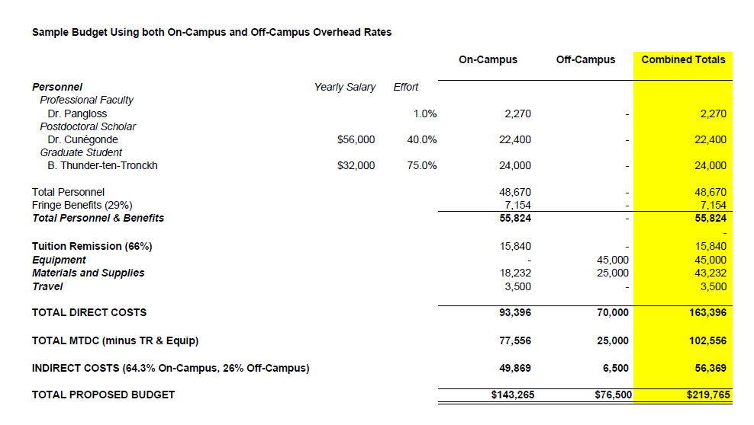

Slide 15
Dept. of Labor Regulations
Julia McCallin
Associate Vice President, Human Resources

Slide 16
Federal Requirements
In May 2016, the Department of Labor (DOL) issued new guidance on the minimum salary threshold for exempt employees under the Fair Labor Standards Act (FLSA)
Effective December 1, 2016:
The salary threshold under which most full-time white collar workers are entitled to receive overtime pay is increasing
From $23,660 to $47,476

Slide 17
Impact on Caltech
Who is included:
Postdoctoral scholars
Administrative employees
Exempt employees
Who is not included:
Graduate Students

Slide 18
Schedule of Increases Salary Test for Exemption
Effective Date | Salary Threshold | Governing Authority
Current | $23,660 | FLSA (Fair Labor Standards Act from the Department of Labor)
12/1/2016 | $47,476 | FLSA (Fair Labor Standards Act from the Department of Labor)
1/1/2019 | $49,920 | State of California (twice minimum wage of $12.00 per hour)
1/1/2020 | $54,080 | State of California (twice minimum wage of $13.00 per hour)
1/1/2021 | $58,240 | State of California (twice minimum wage of $14.00 per hour)
1/1/2022 | $62,400 | State of California (twice minimum wage of $15.00 per hour)

Slide 19
Schedule of Increases – Minimum Wage
Effective Date | Minimum Wage | Governing Authority
1/1/2016 | $10.15 | Department of Labor (for federal contractors)
7/1/2016 | $10.50 | City of Pasadena
7/1/2017 | $12.00 | City of Pasadena
7/1/2018 | $13.25 | City of Pasadena
1/1/2021 | $14.00 | State of California
1/1/2022 | $15.00 | State of California

Slide 20
Changes to F-1 Optional Practical Training: STEM OPT
Ilana Smith
Director, International Offices
June 15, 2016

Slide 21
Changes to STEM OPT
Duration
Extended from 17 to 24 months
Training Plan
Student and Employer Certifications
Training Plan will be followed
Reporting obligations
Relationship between degree and training opportunity
Employment obligations
Employer review of student’s self-evaluation every 12 months
Potential Site Visits

Slide 22
STEM OPT: Potential Issues
Duration
Opportunity for employment, not a commitment
Compensation
Commensurate with funding received by similarly situated U.S. workers
Who signs the Training Plan?
Supervising faculty member

Slide 23
Refresher on Program Income
Rochelle Athey
Post Award Administration

Slide 24
What is Program Income?
The Uniform Guidance definition:
“Program income means gross income earned by the non-Federal entity that is directly generated by a supported activity or earned as a result of the Federal award during the period of performance ….”

Slide 25
Program Income – What is Included?
The federal definition in the Uniform Guidance goes on to state what’s included in the definition of program income – income from:
Fees for services performed
The use or rental of real or personal property acquired under federal awards
The sale of commodities or items fabricated under a federal award
Principal and interest on loans made with federal award funds
License fees and royalties on patents and copyrights*
*However, unless award terms or applicable federal laws or regulations that apply to the award say otherwise, the awardee has no obligation to the federal awarding agency with respect to program income earned from license fees and royalties for copyrighted material, patents, patent applications, trademarks, and inventions made under a federal award to which 37 CFR part 401 applies (the implementation of the Bayh-Dole Act).

Slide 26
Program Income – What is Not Included? (cont.)
Interest earned on advances of federal funds
Rebates, credits, discounts
Interest earned on any rebates, credits or discounts

Slide 27
Program Income – What is Not Included?
Taxes, special assessments, levies, fines and other such revenues raised by a non-federal entity unless the revenues are specifically identified in the federal award or federal awarding agency regulations as program income
Proceeds from the sale of real property, equipment, or supplies purchased with federal funds (The Uniform Guidance and A-110 address this situation – rules do apply to how an awardee must use such proceeds)

Slide 28
Use of Program Income
The Uniform Guidance indicates that if the federal agency does not specify in its regulations or in the terms and conditions of the federal award , or give prior approval for how program income is to be used, the awardee should deduct program income from the award amount.

Slide 29
Use of Program Income (cont.)
However, for federal awards made to institutions of higher education and nonprofit research institutions, if the agency does not indicate how program income is to be used, the program income is additive.

Slide 30
Deduction
The UG states that “ordinarily, program income must be deducted from the total allowable costs to determine the net allowable costs. Program income must be used for current costs unless the Federal awarding agency authorizes otherwise. Program income that the non-Federal entity did not anticipate at the time of the Federal award must be used to reduce the Federal award and non-Federal entity contributions rather than to increase the funds committed to the project.”

Slide 31
Addition
“With prior approval of the Federal awarding agency (except for IHEs and nonprofit research institutions…) program income may be added to the Federal award by the Federal agency and the non-Federal entity. The program income must be used for the purposes and under the conditions of the Federal award.”

Slide 32
Cost Sharing or Matching
“With the prior approval of the Federal awarding agency, program income may be used to meet the cost sharing or matching requirement of the Federal award. The amount of the Federal award remains the same.”

Slide 33
Other Aspects of Program Income
The federal agency may distinguish between income earned by the award recipient and income earned by subrecipients, and between the sources, kinds, or amounts of income.
There are no federal requirements governing disposition of program income after the end of the period of performance unless the award states otherwise.

Slide 34
Will Your Award Generate Program Income?
Will you be charging registration fees for meetings, conferences, symposia, or similar activities that are funded in part by your award?
Will you be making kits, a communication/outreach piece, an item, or any other thing for which you will charge recipients?

Slide 35
Will Your Award Generate Program Income? (cont.)
Will you provide a service supported by the award (like testing, consultations, visits, analyses, etc.) for which you charge the recipient a fee? (Example – charging a fee to external users for use of equipment purchased on a currently active Federal award.)
If your answer is yes to any of the above, your award is or will be generating program income.

Slide 36
Program Income Has to be Tracked
If your award indicates that program income will be Additive (added to award funds) –
At the time of your award PTA, also create a program income PTA. OSR will activate the program income PTA when the main award PTA is activated.
The PTA will consist of the
Project - PI initials.PRG plus your choice – example HBG.PRGCCI
Task number – usually 1
PRGINC.sponsor abbreviation plus your choice – example PRGINC.NSFSOLAR

Slide 37
Program Income Has to be Tracked (cont.)
If your award indicates that program income will be Deductive (reducing award funds) –
OSR will activate the main award PTA under the program income allowability schedule – the funding entered into the PTA will equal award funding but program income will be added to the main award PTA and expenditures against it will be in the main award
If your program income will be used as Cost Sharing –
Create a ZOACS PTA

Slide 38
Reporting
Federal agencies typically require reporting of program income either on a quarterly or annual basis.
Post Award Administration will include program income data in financial reports as required by the agency. For deductive awards, such reporting could result in funding adjustments to the award (i.e. deobligation of federal funds)*.
If program income is being used for cost sharing, Post Award Administration will report as required by the federal agency.
*However, Caltech currently does not generate program income on any awards requiring the deduction approach.

Slide 39
Using Program Income
Program income must be used for the purposes and under the conditions of the federal or federal pass through award. This means -
All expenditures incurred using program income must be allowable, reasonable, and allocable
The cost principles governing the award (the Uniform Guidance Subpart E or A-21) must be followed

Slide 40
Using Program Income (cont.)
As a result, program income generated under a federal award or federal pass though award cannot be used for unallowable costs such as alcohol or entertainment.

Slide 41
If You Have Generated Program Income but Have Not Created a PTA
Create a program income PTA if your award is Additive
If the revenue is in an internal Caltech PTA (OASALE or OACONF typically), inform Post Award Administration that revenue needs to be moved from the internal Caltech PTA into the program income PTA.

Slide 42
If You Have Generated Program Income but Have Not Created a PTA (cont.)
If the revenue is from a third party, forward the check to the Treasury Office and indicate on the deposit form that the funds are for program income and should be deposited to the program income PTA you created. Post Award Administration will credit the revenue to the program income PTA.

Slide 43
After the Federal Award Ends
Typically, federal award terms do not require any additional disposition regarding program income after the end of the period of performance but the federal agency may want to negotiate the use of any remaining program income as the award is closed out.
If there are no requirements at award termination, the program income may be retained by the award manager/Division but the funds should be moved to a discretionary PTA.

Slide 44
Pre-Audit Checklist
A Tool to Prepare for an Audit
Rochelle Athey

Slide 45
Pre-Audit Checklist
Award Terms/Documents
Monitoring of Expenditures
Compliance
Award Termination/Closeout
Other

Slide 46
Award Terms/Documents
Copies of documents
Understanding terms
Changes to key personnel
Revised budgets

Slide 47
Expenditures/Compliance
PTA structure
Financial monitoring
Effort of personnel
Labor cost transfers and PDCs
NIH Salary Cap
Foreign travel
Food
Cost Sharing
Program Income
FABs
All documentation retained
Cost transfers

Slide 48
Award Termination/Closeout
No cost extensions
Purchase in last 90 days

Slide 49
Other Concerns
Fraud, waste, abuse

Slide 50
Anything else?
Send your comments and
questions to me
rathey@caltech.edu

