Slide 1
Research Administration Forum
Tuesday, November 1, 2016

Slide 2
Agenda
Policy and Procedure Update (Dick)
New P-Card (Muriel)
FileBound (Jay, Joey & Guillermo)
Duty Free Waivers for Scientific Instruments (Adilia)
Office of Research Compliance (Grace)
Approval for the Use of the Off-Campus Indirect Cost Rate (David)
Submission of NIH Proposals in Excess of $500K/year (David)
Acquisition of Equipment in the last 90 days of project (David)

Slide 3
Policy and Procedure Update
Caltech Policies and Procedures have been revised and updated to reflect the requirements of the Uniform Guidance:
Administering the NIH Salary Cap
Charging Administrative and Clerical Costs as Direct Costs on Federal Awards
Commitment of Effort on Federally Sponsored Awards
Cost Sharing on Sponsored Projects
Cost Transfer Policy and Procedure
Equipment Fabrication Policy
Institutional Base Salary
NIH Salary Cap Policy

Slide 4
Policy and Procedure Update (cont.)
Caltech Policies and Procedures have been revised and updated to reflect the requirements of the Uniform Guidance:
NSF Salary Policy: FAQs
Payroll Distribution Confirmation Policy and Procedure
Principal Investigators on Leave: FAQs
Recruiting Costs: Short Term Visa Fees
Subawards and Subrecipient Monitoring
Travel
Uncollectable Sponsored Project Accounts

Slide 6


New Bank & P-Card Provider Coming February 2017
U.S. Bank has 20+ years of experience with over 500 Higher Ed clients
Added benefits:
Text/email fraud alerts
Customizable PIN
Mobile App for quick account status, balance, credit balance, etc.
Online access for approvers and cardholders
For more information please check out our FAQ’s on the P-Card website.

Slide 7
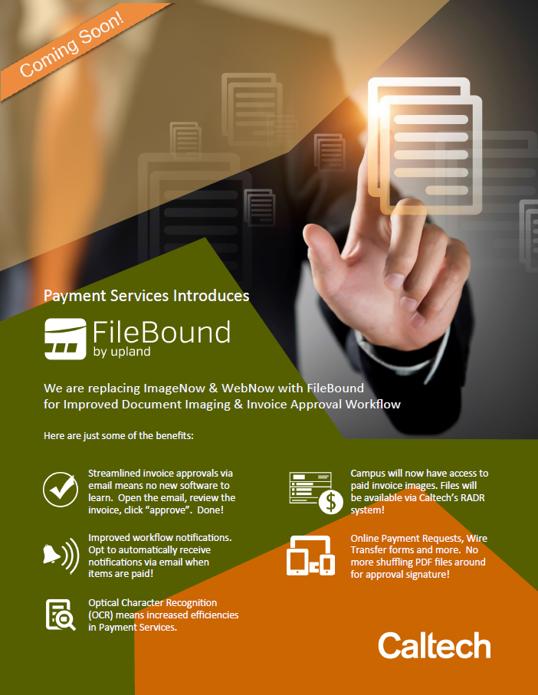

Slide 8

US Imports
Application for Duty-Free Entry of Scientific Instruments
Adilia Koch

Slide 9

Frequently Asked Questions
Can I change the value of the shipment when it arrives in the US?
Can I tell customs that my shipment has no value?
My foreign collaborator told me not to list all of the items being imported to avoid paying duties, can I do this?
Why do I have to pay duties, I am a Caltech professor!
Why didn’t anyone tell me that I had to pay duties?

Slide 10
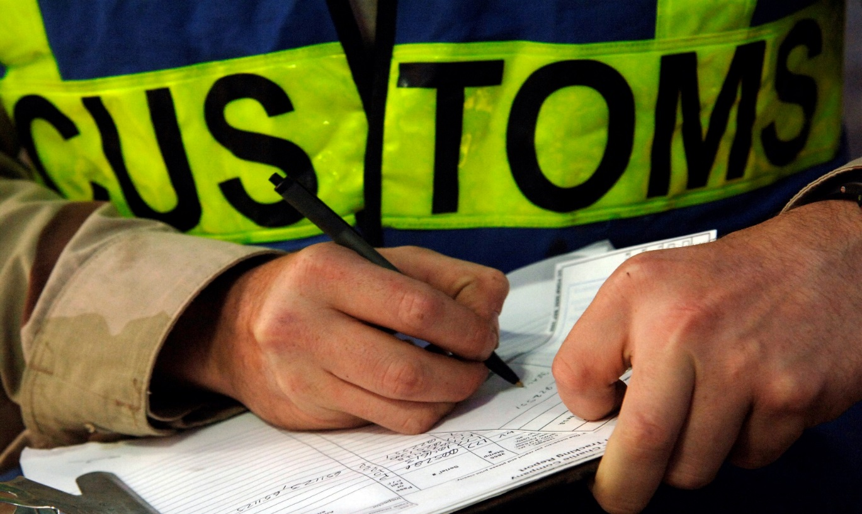
Are universities exempt from paying duties?
Generally, no. But exemptions can apply to your particular import.

Slide 11

What is a “Duty” or “Tariff”?
Duty or Tariff is a form of international tax that is levied on goods that are imported into a country.
Each country determines the amount of duty that will be levied on a particular commodity.
Duty rates are affected by international trade agreements like NAFTA, commercial markets or industries that a country may wish to protect (limit imports), or are imposed to stimulate (export) or to disrupt the economy of another country (high tariffs)
Import
Export

Slide 12


Slide 13

Who pays the duty?
What does it really cost?
This depends on your agreement with the foreign vendor
INCO terms are used between buyer and seller to describe to freight forwarders, customs, custom brokers and parties to transaction who will be responsible for what and when
Important: What’s the real price of your instrument? Purchase price of an imported item will incur additional fees (insurance, transportation, duty, port fees, etc.).
Make sure your faculty is aware so they can budget accordingly. Unplanned duties and fees creates many problems down the line …

Slide 14


What about Duty Free entries?
Temporary Import Bond (TIB)
  Valid for items that will return after a year
  Cannot be sold
  Used for repairs, alterations, samples, models, tools of the trade, etc.
Carnets
  Used for unlimited entries within a year
  Eliminate VAT and duties
“Duty-free” Harmonized Tariff Code (HTS#): some items are “duty free” based on the type of commodity, country of import, country of origin, processing or modification of the item prior to importation into the US
“Duty-free” based on International Trade Agreements, for example
  NAFTA (http://forms.cbp.gov/pdf/CBP_Form_434.pdf)
  US-Chile Free Trade Agreements, etc.

Slide 15


Duty-Free entry of Scientific Instruments – What is it?
REQUEST FOR DUTY-FREE ENTRY OF SCIENTIFIC INSTRUMENTS OR APPARATUS (338P Filing): Application for waiver of duties on scientific instruments and apparatus imported for use by eligible nonprofit institutions.
“No waiver of duty may be granted unless a completed application form has been received” (19 U.S.C. 1202; 15 CFR 301)
Application must be approved by:
US DEPARTMENT OF COMMERCE INTERNATIONAL TRADE ADMINISTRATION, and
U.S. DEPARTMENT OF HOMELAND SECURITY
U.S. CUSTOMS AND BORDER PROTECTION

Slide 16

How do I get my scientific instrument approved for “Duty-free” entry?
Instrument must meet strict requirements in order to qualify
Supporting document and declarations must support the application:
REQUEST FOR DUTY-FREE ENTRY OF SCIENTIFIC INSTRUMENTS OR APPARATUS -- 338P Filing
  Technical Specifications
  Harmonized Tariff Number
  Proof that no other instrument is available in the US
  Proof that you searched for instrument in the US
  Proof that no other manufacturer can make this instrument
  Proof that instrument is key to specific project or area of research
  Proof that that instrument will not be sold or be used for commercial purposes
  Proof that a bona fide order has been placed for the instrument

Slide 17

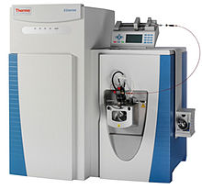

Not all instruments are eligible
HTS# 9810.00.60 - Instruments and apparatus, if no instrument or apparatus of equivalent scientific value for the purposes for which the instrument or apparatus is intended to be used is being manufactured in the United States …

Slide 18
How does the 338P process work?
Contact CEC; if instrument qualifies, 338P Application is sent to PI
Joint Preparation of 338P Duty-Free Entry Application
Submit the Application to U.S. Customs and other agencies
Pay Duty, Get a Refund, or Duty-Free Entry
Government Approval/Denial Received

Slide 19
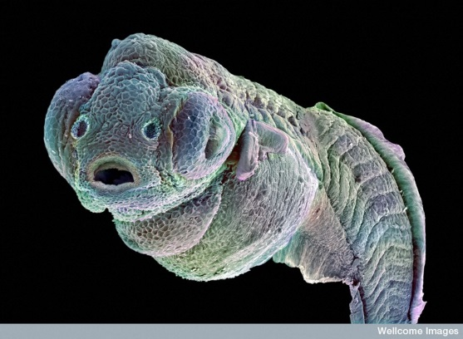
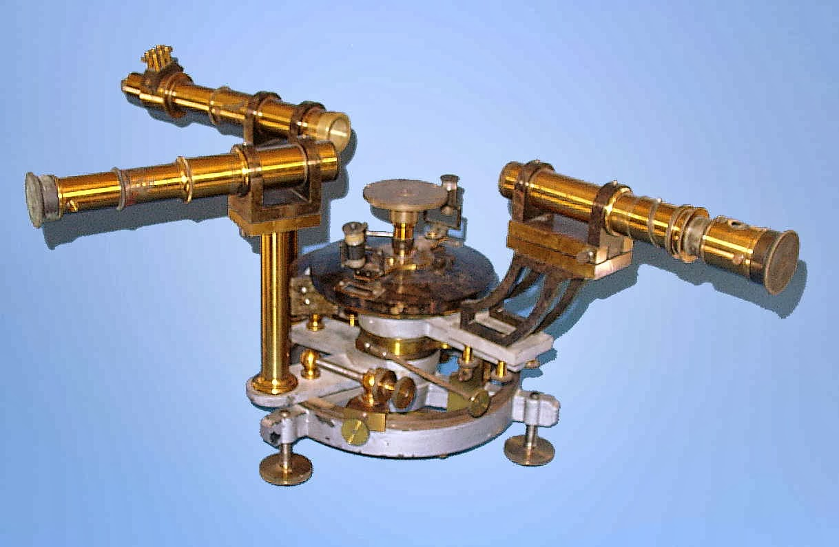

The 338P process requires PI participation
Application is only as good as the data submitted
Customs will review every detail of the application
Will ask why the instrument is important to the research
PI needs to provide detailed technical data, phenomena to be researched, why is the instrument necessary for research, etc.

Slide 20
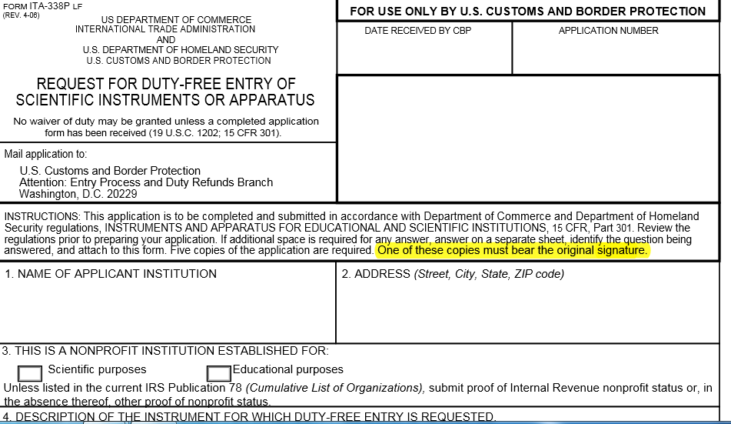

Slide 21
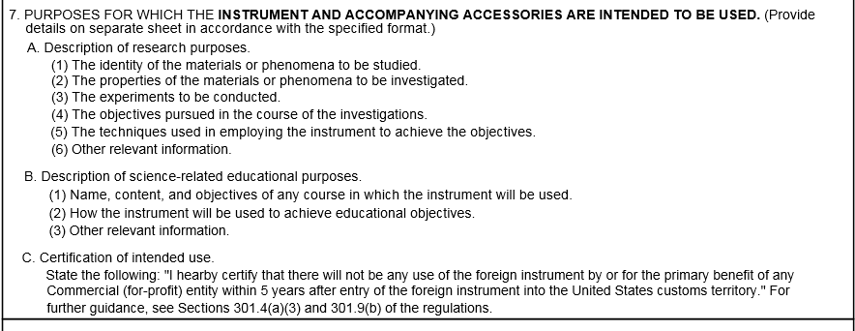

Slide 22
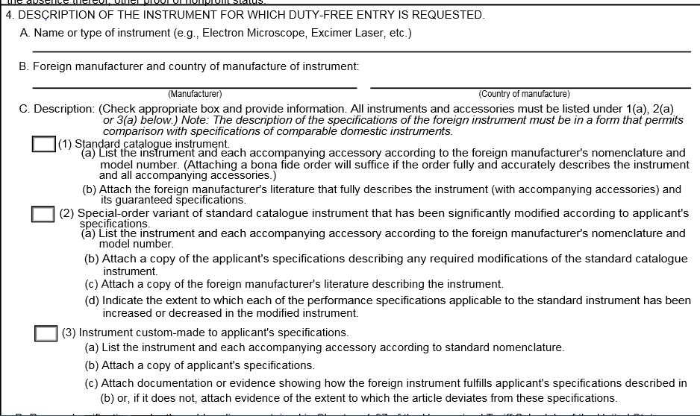

Slide 23
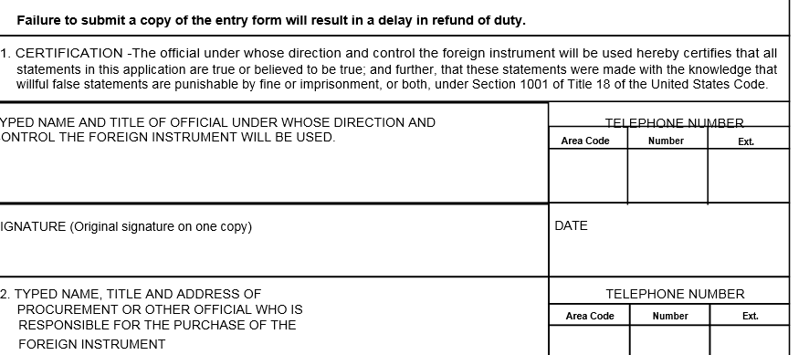

Slide 24
Regulations: Harmonized Tariff Code – Chapter 98 http://hotdocs.usitc.gov/docs/tata/hts/bychapter/0901C98.pdf
HTS: 9810.00.6000

Slide 25

What can you do to help?
Contact us early in the process
Buyer and seller agreements should
be clear about who is responsible for what:
  Duties
  Transportation
  Custom clearance, insurance and freight
Make sure the PI knows about import fees, so they can budget for it
Ask the manufacturer to provide you with the HTS# (Harmonized Tariff Code) for the items you wish to import
Direct communications or inquiries from custom brokers to us

Slide 26



Mitigate import risks and protect your PIs research dollars
Improper importation of goods can result in payment of duties and fees that could have been avoided if properly cleared through customs
Improper declaration of value, or goods can result in violation that can result in forfeiture of your goods, or steep penalties and fines
Use only Campus authorized brokers and freight forwarders
  Send Custom Broker requests for Power of Attorney to CEC
Get us involved early in the process

Slide 27
Duty-Free Application Success Stories
Duty-Free
Prof. Lewis
Microscope
$22,400
Prof. Greer
Microscope
$14,300
Prof. Nadj-Perge
Microscope
$41,437
Prof. Hauksson
Gyrocompass
$2,702
Prof. Zewail
Microscope
$13,063
Prof. Greer
Laser system (pending) $10,727
Other – Duty Free entry of based on value, country of origin, HTS#

Slide 28


QUESTIONS?
Contact us: export@Caltech.edu

Slide 29

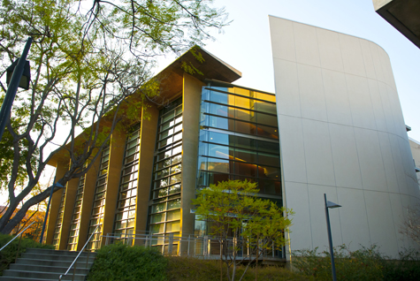
Office of Research Compliance
www.researchcompliance.caltech.edu
WELCOME TO THE OFFICE OF RESEARCH COMPLIANCE
The California Institute of Technology is committed to the highest standards of integrity in fulfilling its mission to expand human knowledge and benefit society through research. All research activities undertaken by faculty, staff, and students at Caltech will be conducted in accordance with strict ethical principles and in compliance with federal, state, and institute regulations and policies. The Office of Research Compliance, which reports to the Vice Provost for Research, is responsible for providing support and training to faculty, students and staff in order to meet these requirements and maintain a robust research compliance program at Caltech.
Committees:
Animal Research (IACUC)
Human Subjects Research (IRB)
Biosafety (IBC)
Compliance Areas:
Conflicts of Interest
Responsible Conduct of Research
Research Misconduct
Controlled Substances
Export Compliance
Data & Facilities Use:
Facilities Use/Technical Services
The Office of Research Compliance works with faculty oversight committees to promote the ethical and responsible conduct of research and to ensure compliance with regulatory requirements relating to research involving human and vertebrate animal subjects, recombinant DNA, biohazards, radioactive materials and stem cells. The committees supported by this office include the Institutional Animal Care and Use Committee (IACUC), the Institutional Review Board (IRB), and the Administrative Committee on Biosafety. The Office of Research Compliance also has responsibilities relating to responsible conduct of research, conflicts of interest, controlled substances, compliance with U.S. export control regulations, and third party use of Caltech's research facilities.

Slide 30
Areas of Interest for Grant Managers
Proposal Stage
  Conflicts of Interest
    All Interests must be disclosed (Can check in COI Lookup. As of Nov. 7, must have FY 17 Disclosure)
    If NIH, FCOI training should be up to date (every 4 years).
    If NIH, NSF, SBIR/STTR, or Faculty/Caltech Start up, it may be a good idea to start developing a management plan.
  Animal Procedures (Need Congruency)
    If DoD sponsor, notify IACUC Administrator as soon as possible, special handling required.
    All others, remind PI that an IACUC protocol will be required at award stage.
  Biosafety Procedures
    Sometimes needed, contact IBC Administrator.
  Human Subjects Procedures
    One protocol per proposal. NSF requires up-front .

Slide 31
Areas of Interest for Grant Managers
Award Stage
  Conflicts of Interest
    Any potential or actual COI must be eliminated, mitigated or managed prior to expenditure.
      Research Management Plan templates (ORC Website).
      NIH, NSF, SBIR/STTR, or Faculty/Caltech Start up.
    If NIH
      Any actual COI must be disclosed to NIH and management plan entered into their system.
      If there is a subaward, subawardee must be compliant with NIH rule, if not, our COI policy applies.
      If training is not complete, the PI must complete.
  Animal Procedures (Need Congruency)
    If DoD sponsor, notify IACUC Administrator as soon as possible, special handling required.
    IACUC approval required.
  Biosafety Procedures
    IBC approval required.
  Human Subjects Procedures
    IRB approval required.

Slide 32
Who do I call?
Conflicts of Interest
Clarisse Whisenand x6366
Grace Fisher-Adams Reviews
IACUC
Kristin Lund x8448
IRB & IBC
Isabel Junie Hildebrandt x4699

Slide 33
Use of Off-Campus Overhead Rate
Only that portion of the proposal budget that is off-campus can be assessed the off-campus rate
  The proposal SOW must document the basis for use of the off-campus rate
  The budget must breakout which costs are on- and which are off-campus
  Salaries and benefits may be assessed the off-campus rate only if the individual(s) do not use any campus facilities
  Subawards are not part of the costs that can be considered “off-campus”
The Provost must approve each proposal that will utilize the off-campus rate:
  Before OSR can submit the proposal
  Even if the project has previously used the office campus rate, whether or not approved by the Provost

Slide 34
Equipment Purchase – Last 90 Days
It is common knowledge that PIs should not purchase equipment under sponsored awards in the last 90 to 120 days of an award
  There is no Caltech or federal policy that prevents purchases of equipment in the last 90 days of an award
  HOWEVER, auditors tend to scrutinize these purchases because there is a higher likelihood that any such the equipment did not benefit the award
If the auditors request clarification on a particular equipment purchase, PAA will contact the division for justification as to how the purchase benefited the award.

Slide 35
Equipment Purchase – Last 90 Days (cont.)
OSR and PAA recommend that if the PI does decide to purchase equipment in the last 90-120 days of an award, the PI should take special care to document the Division award file as to how the purchase benefits the award
Some invalid reasons for purchase of equipment in the last 90-120 days
  I have funds remaining and the equipment would benefit my lab
  I have funds remaining and the equipment will benefit the follow-on phase of the project

