Slide 1


Slide 2

Research Administration Forum
Wednesday, September 20, 2017

Slide 3
Agenda
Research Administrator Day – Sam Westcott
New and Modified Reports Available – Commitment Balance Report – Estella Venegas
Transition to JP Morgan – Estella Venegas
Conference Expenses – Estella Venegas
Research Compliance Update – Grace Fisher-Adams
PDF FAQs and Instruction Manual – Mary Gibson
NASA-China Funding Issue – Mary Gibson
The “50/50 Rule” for Collaborations with JPL – Dick Seligman
New Rates – David Mayo
Cayuse & Other Federal Proposed Submission Options – David Mayo
Caltech Foreign Person Questionnaire – Adilia Koch

Slide 4
Research Administrator Day
Sam Westcott

Slide 5
Updates from PAA
Estella Venegas

Slide 6
New Reports in Cognos/Data Warehouse
Commitment Balance Report (replaces ITD Commitment Balance)
Award Worksheet Campus

Slide 7
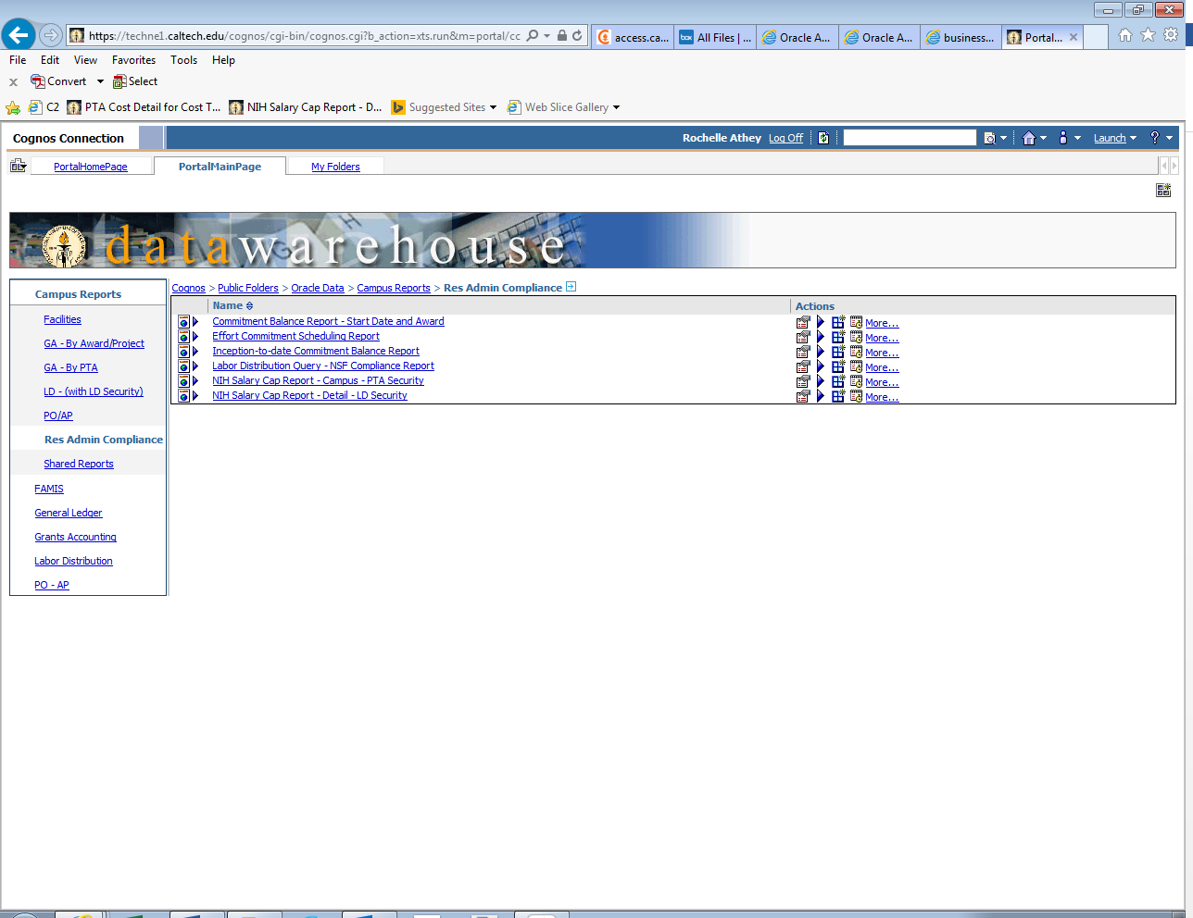
Commitment Balance Report

Slide 8
Commitment Balance Report
Replaces ITD Commitment Balance Report
Filters include:
Oracle Award Number (new)
Award Manager
Employee Name
Funding Source Award Number
Award Status
Sponsored Award Organization
Commitment Start (new)
Commitment End
Commitment Lines

Slide 9
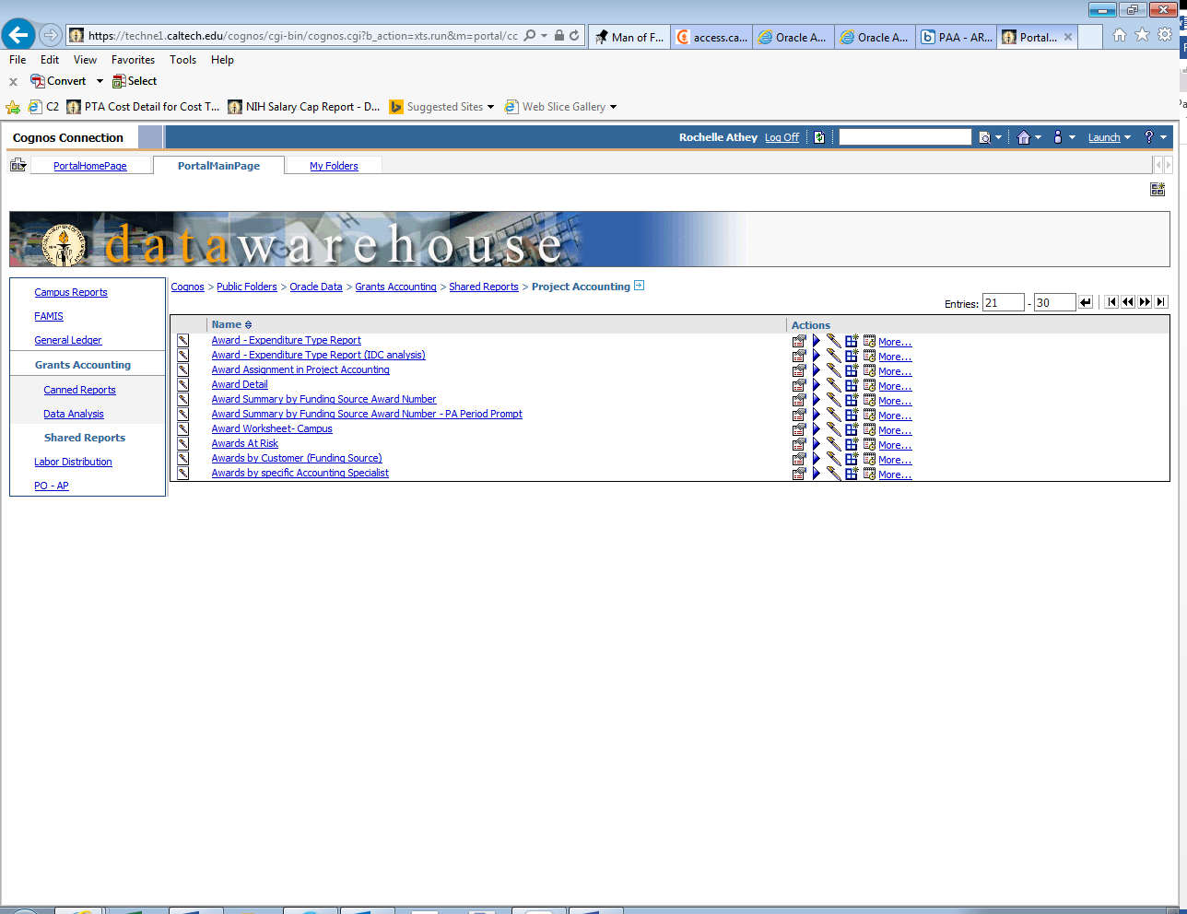
Award Worksheet Campus

Slide 10
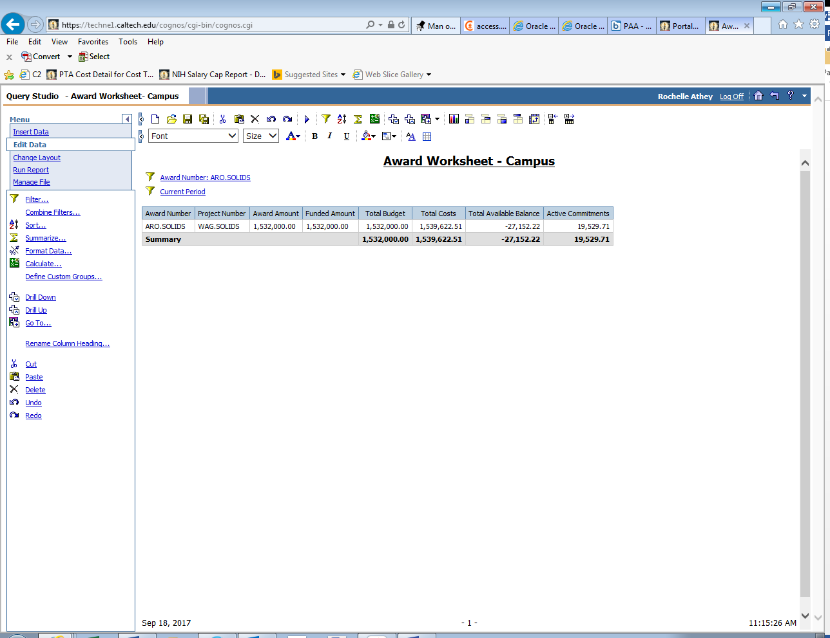
Award Worksheet Campus
For any Oracle award number, this report provides the Award Amount, the Funded Amount, Total Budget, Total Costs, Total Available Balance, and Active Commitments for the date it is run.

Slide 11
Transition to new bank – JP Morgan
Caltech is moving to using a new bank for its business purposes – JP Morgan.
Post Award Administration will begin using the new bank account early in 2018.
We are not expecting any impact to the Divisions during the PAA transition to JP Morgan. (PAA can’t comment on whether there will any impact on other Divisional business as a result of the new bank transition.)
In preparation for the banking transition, PAA will be working with all sponsors to notify them of the new bank account and PAA’s change of address in December 2017.
OSR will also make changes in SAM.gov to reflect the new banking information when we transition in early 2018.

Slide 12
Appropriate Use of Expenditure Type – Mtgs and Conf Exp-Allocable
During recent reviews of expenses on several awards across all Divisions, PAA accountants have noticed that the expenditure type Mtgs and Conf Exp-Allocable is being used for situations where a researcher or student is traveling to a conference. Do not use this expenditure type for travel to conferences. Use a travel expenditure type.
Mtgs and Conf Exp-Allocable is used for conference costs for conferences and meetings held locally. If you were hosting a conference at Caltech for instance, this expenditure type would be appropriate for the costs related to the conference.
Please request a change in expenditure type if in your review of expenses, you see use of this expenditure type for someone who is traveling to a conference.

Slide 13
Research Compliance Update
Grace Fisher-Adams
Director, Office of Research Compliance

Slide 14
FY17 President’s and Director's Fund Terms and Conditions – Mary Gibson
Domestic programmatic travel needed for research purposes is allowed.
Domestic conference travel up to 5% of the total budget (joint JPL Budget AND Caltech Budget) is allowed. Campus needs to coordinate with the JPL PI to confirm campus domestic conference travel is allowable.
No foreign travel is allowed under the PDF Program.
Campus is not allowed to exceed the amount of the funding authorized in the award.
An annual one-page statement of accomplishments and a list of publications resulting from the PDF project is required.
Campus Co-Principal Investigators are required to participate in PDF Seminar Day by presenting results of the work supported by the PDF award.
It is anticipated that researchers will publish the results of their PDF project in refereed journals.

Slide 15
Publications arising from PDF projects should contain the following acknowledgment:
“This research was carried out at the Jet Propulsion Laboratory and the California Institute of Technology under a contract with the National Aeronautics and Space Administration and funded through the President’s and Director’s Fund Program
Notice: In accordance with NASA requirements, JPL, under its Prime Contract, must report the cost associated with the fabrication of all non-flight property with a cost of $1,000 or more and a useful life of 2 years or more. While fabrication is in process, these costs need to be reported as Contractor-Work-In-Process (CWIP) on a monthly basis. If your project/task will include the fabrication of property or if you have any questions pertaining to property reporting requirements please contact the JPL PI and the Caltech Property Services group.

Slide 16
 | Export of Items | Exports and hand-carried items require review by the Caltech Export Compliance Office. Please allow sufficient time for review and to obtain any necessary licenses or permits. Forms and information are at www.export.caltech.edu/shipments.
 | JPL or Third-Party Involvement | JPL/third-party participation may require the transfer of export controlled items (i.e., technical data, hardware or software) to campus. Please contact the Caltech Export Compliance Office before you accept or transfer to Foreign Persons.
 | Statement of Work Changes | If this statement of work changes, please contact the Caltech Export Compliance Office to perform a revised export license determination.
 | NASA-China Restriction | Since this project is funded by NASA, please notify in advance the Caltech Export Compliance Office if the PI plans to have any Foreign Persons (individuals or entities) from China (PRC) participate in this project.

Slide 17
NASA-China Funding Issue – Mary Gibson
All NASA direct awards, and flow through awards with NASA Prime Funding (JPL, USRA, STScI, and incoming or outgoing subcontracts), require you follow the following guidelines with regard to restrictions on associations and funding with China using NASA funds.

Slide 18
You may not purchase build-to-print or build-to-specification items from any Chinese-owned company. You may, however, purchase commercially available off-the-shelf items from a Chinese-owned company.
You may not fund work on this project at any organization in China (e.g., government entity, educational institution, research institution, commercial entity), unless countries other than the United States and China also will be participating in this project.
You may not receive assistance from any organization in China on this project, unless countries other than the United States and China also will be participating.

Slide 19
Continued…
You may not fund a Chinese national who is currently employed by or affiliated with any organization in China, unless such individual also has a Caltech affiliation as either a student, visitor, or employee.
You may not fund participation (including related travel) in conferences, science teams, data-sharing, or papers in which only the United States and China are participating. If you participate in multinational conferences, you may not discuss collaborations or other endeavors involving only the United States and China with Chinese nationals.
In addition, please keep in mind that the International Traffic in Arms Regulations prohibit the transfer of any defense articles and defense services to China, regardless of whether the related research project involves only the United States and China (bilateral) or includes other countries, too (multilateral). You may contact the Office of Export Compliance for further information.

Slide 20
The “50/50 Rule for Campus-JPL Research Collaborations – Dick Seligman
1.
JPL funds are transferred to the campus.
2.
Campus funds are transferred to JPL
Two types of Collaborations:

Slide 21
JPL funds transferred to campus
Interdivisional Authorizations (IAs)
President’s and Director’s Fund Awards
R & TD Awards

Slide 22
Funds from Campus are transferred to JPL
Award to Caltech from an external sponsor (generally a Federal agency)
Part of the project will be carried out at JPL

Slide 23
The 50/50 Rule:
Applies when campus funds are being transferred to JPL.
The split in funding should be approximately 50/50.

Slide 24
Calculating the 50/50 Split
Excludes subawards and subcontracts
Examples:
1. $100,000 award to Caltech; $50,000 transferred to JPL
2. $100,000 Award to Caltech; $75,000 transferred to JPL
3. $100,000 award to Caltech; $25,000 subaward to USC; $50,000 transferred to JPL

Slide 25
For Exceptions:
Start with the Division Chair
If the Chair supports the exception, the chair can refer the case to the Vice Provost for Research.

Slide 26
Proposal Submission Systems
David Mayo
Director, Office of Sponsored Research

Slide 27
Grants.gov
Grants.gov
  Submission portal for vast majority of federal grants and cooperative agreement proposals
  Proposal ends up in agency system (e.g., Commons, FastLane, etc.)
  Proposals are created in individual Adobe Formsets, one for each Opportunity (very burdensome)
  Only OSR has user accounts because this is only for proposal submissions
  Caltech uses Cayuse for proposal preparation instead of Adobe Formsets - Cayuse submits to Grants.gov

Slide 28
Grants.gov
Cayuse
  Caltech subscribes
  Allows for preparation and submission for all proposals that can be submitted to Grants.gov
  Limited to what Grants.gov allows, but much more flexible in doing it
  User accounts setup by OSR - flexible
  Primarily used by Caltech for NIH submissions
  Can be used for NSF (except multi-proposal submissions)

Slide 29
Grants.gov and Cayuse
Federal Agency
Proposal
Solicitation
Grants.gov
Proposal
Solicitation
Cayuse (Caltech)

Slide 30
Grants.gov
WORKSPACE
  Developed by Grants.gov as a proposal development system to replace Adobe Formsets – 12/31/2017
  OSR does not support WORKSPACE
    No benefit over using Cayuse
    Another system to learn
    Very little user experience from other institutions
    User access constrained to 3 possible roles
  OSR will support WORKSPACE if a federal requirement makes it necessary to do so
  Accounts would be setup by OSR

Slide 31
NIH ASSIST
Only for preparation/submission of NIH grant/cooperative agreement applications
Developed by NIH as a substitute for Adobe Formsets
User access constrained to 3 roles
OSR does not recommend using ASSIST
  Cayuse does everything ASSIST can do
  Caltech not familiar with it
  Caution - incoming PIs may use out of habit

Slide 32
NSF FastLane
Preparation and submission of all NSF proposals
Developed by NSF – just because
Very flexible user access
OSR manages accounts
Can receive proposals from Grants.gov (Cayuse), except for multi-proposal submissions.

Slide 33
NASA NSPIRES
Preparation and submission of most NASA proposals for contracts/grants/coop. agreements
User accounts created by user, authorized by OSR
Can receive proposals from Grants.gov (Cayuse)

Slide 34
FedConnect
Preparation and submission of proposals for contracts/grants/coop. agreements
Used by DOE, USGS, EPA, DHS
Agency uses FedConnect as management and award system
User accounts established by user, authorized by OSR

Slide 35
Systems by Sponsor
 | Grants.gov | NIH ASSIST | NSF FastLane | NSPIRES | FedConnect
 | Grants/ Coop. Agreements | Grants/ Coop. Agreements | Grants/ Coop. Agreements | Contracts/Grants/ Coop, Agreements | Contracts/Grants/ Coop, Agreements
NSF | Almost all |  | All
NIH | All | All
NASA | Most |  |  | Most
DOE | Most |  |  |  | Some
DOD | Most
USGS | Most |  |  |  | Some
EPA | Most |  |  |  | Most
DHS | Most |  |  |  | Some

Slide 36
Caltech
Foreign Person
Questionnaire
September 20, 2017
Adilia F. Koch
Director of Export Compliance

Slide 37
Caltech Foreign Person Questionnaire (FPQ)
Purpose:
U.S. export laws control the conditions under which certain commodities and technologies can be transmitted to Foreign Persons.
What is the purpose of an FPQ form?
The Caltech Export Compliance Office (CEC) uses the FPQ to determine whether the Foreign Persons working on controlled projects will need an export license or other requirements; review to determine if the foreign person is subject to NASA-funding restriction.
Where can I get the form?
From our website: http://export.caltech.edu/forms/

Slide 38
NASA-Funding Restriction with PRC (China)
Public Law 112-10, effective April 25, 2011
NASA is restricted from using funding to participate, collaborate or coordinate bilaterally in any way with China or any Chinese-owned company, at the prime contract or any tier subcontract level.
Accordingly, contracting officers shall make no awards to China or Chinese-owned companies with funds appropriated by the Acts or any funds appropriated subsequent to the Acts. This policy applies to all contracts except those for commercial and non-developmental items.
The restrictions of the Acts and this policy neither limit nor prohibit the purchase of commercial or non-developmental items.
“China” or “Chinese-owned Company” means the People’s Republic of China, any company owned by the People’s Republic of China or any company incorporated under the laws of the People’s Republic of China.

Slide 39
NASA-Funding Restriction with PRC (China)
1852.225-71 Restriction on Funding Activity with China.
(a) Definition - “China” or “Chinese-owned company” means the People’s Republic of China, any company owned by the People’s Republic of China or any company incorporated under the laws of the People’s Republic of China.
(b) Public Laws 112-10, Section 1340(a) and 112-55, Section 539, restrict NASA from contracting to participate, collaborate, coordinate bilaterally in any way with China or a Chinese-owned company using funds appropriated on or after April 25, 2011. Contracts for commercial and non developmental items are exempted from the prohibition because they constitute purchase of goods or services that would not involve participation, collaboration, or coordination between the parties.
(c) This contract may use restricted funding that was appropriated on or after April 25, 2011. The contractor shall not contract with China or Chinese-owned companies for any effort related to this contract except for acquisition of commercial and non-developmental items. If the contractor anticipates making an award to China or Chinese-owned companies, the contractor must contact the contracting officer to determine if funding on this contract can be used for that purpose.

Slide 40
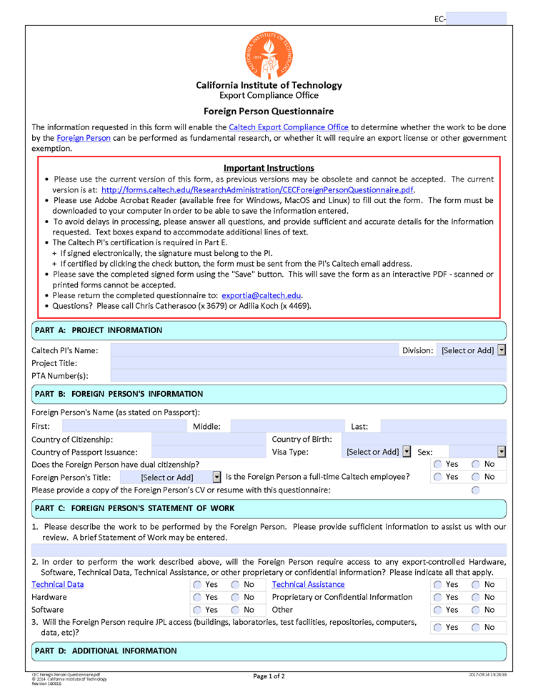
FPQ screenshot

Slide 41
FPQ screenshot (continued)

Slide 42
When is a Foreign Person Questionnaire required?
 | Analysis |  | A |  | B |  | C
1 | What is the Funding Source? |  | JPL Interdivisional Authorizations |  | NASA Projects |  | Other Funding Sources
2 | What is the Foreign Person’s Nationality? |  | China (PRC) | Other | China (PRC) | Other | Any
3 | Is the Project Export Controlled? | Yes | FPQ Required | FPQ Required | FPQ Required | FPQ Required | FPQ Required
 |  | No | FPQ Required | FPQ Not Required | FPQ Required | FPQ Not Required | FPQ Not Required
This information will be posted on our website: http://export.caltech.edu/

Slide 43
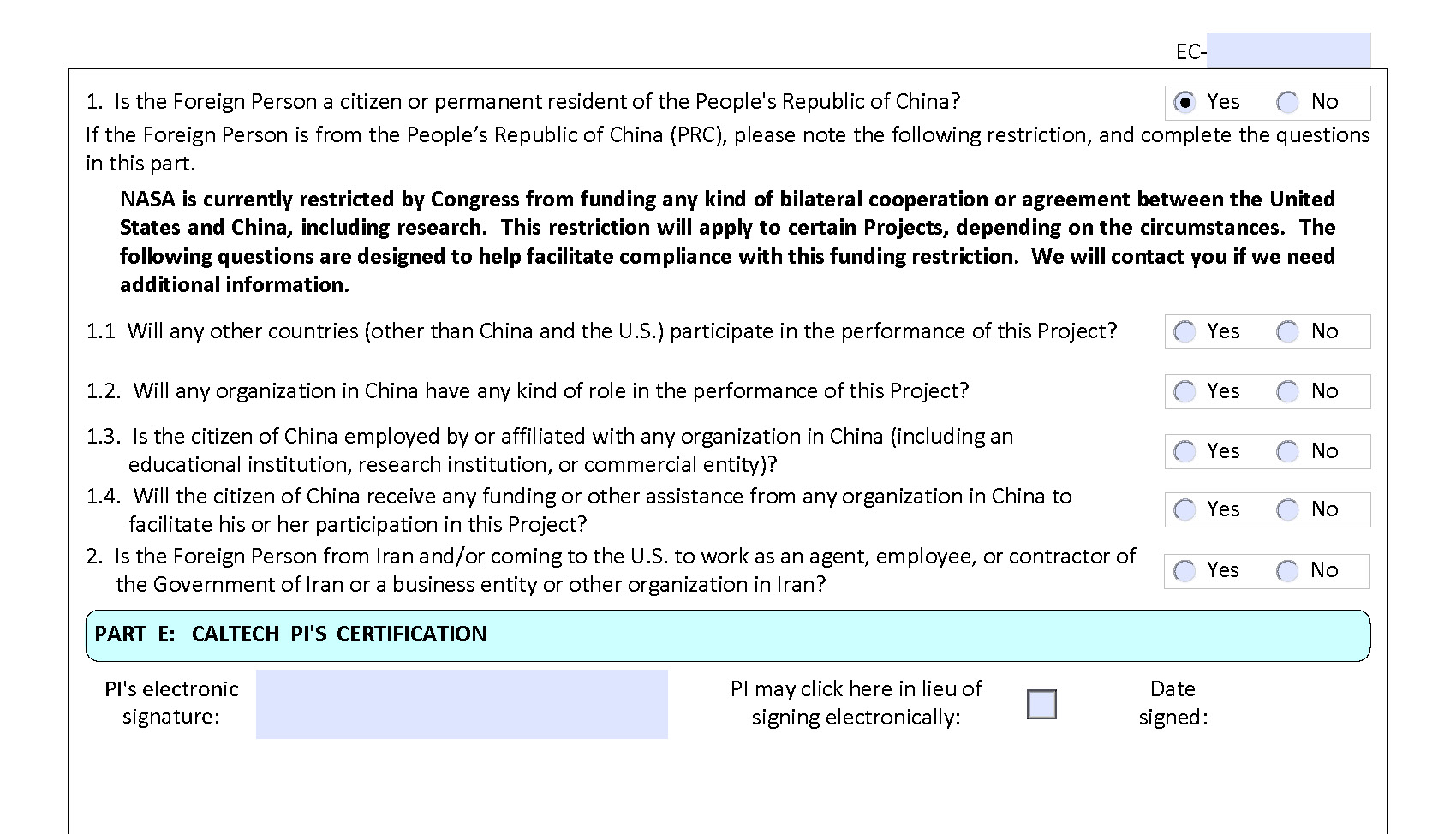
FPQ NASA-China questions

Slide 44
Resources
  Telephone: (626) 395-2641
  Email: export@caltech.edu
  Webpage: http://export.caltech.edu/
  FPQ form location: http://export.caltech.edu/forms/
  NASA-China Information Circular:
  https://www.hq.nasa.gov/office/procurement/regs/pic12-01A.html

Slide 45

Contact us: export@caltech.edu

