Slide 1
Research Administration Forum
Tuesday, February 6, 2018

Slide 2
Agenda:
FY 2017 Annual Report Highlights – Dick Seligman
PAA Changes – Rochelle Athey
Review of Newly Revised List of Expenditure Types – Rochelle Athey
NSF Inspector General Audit – Rochelle Athey
Controlled Unclassified Information, NIST, 7012 DFAR Clause – Adilia Koch
NIH Campaign to Eliminate Delinquent Technical Reports – Mary Gibson
New NSF Proposal Submission Requirements – David Mayo
Cayuse and Grants.gov Workspace – David Mayo

Slide 3
FY 2017 Annual Report Highlights –
Dick Seligman

Slide 4
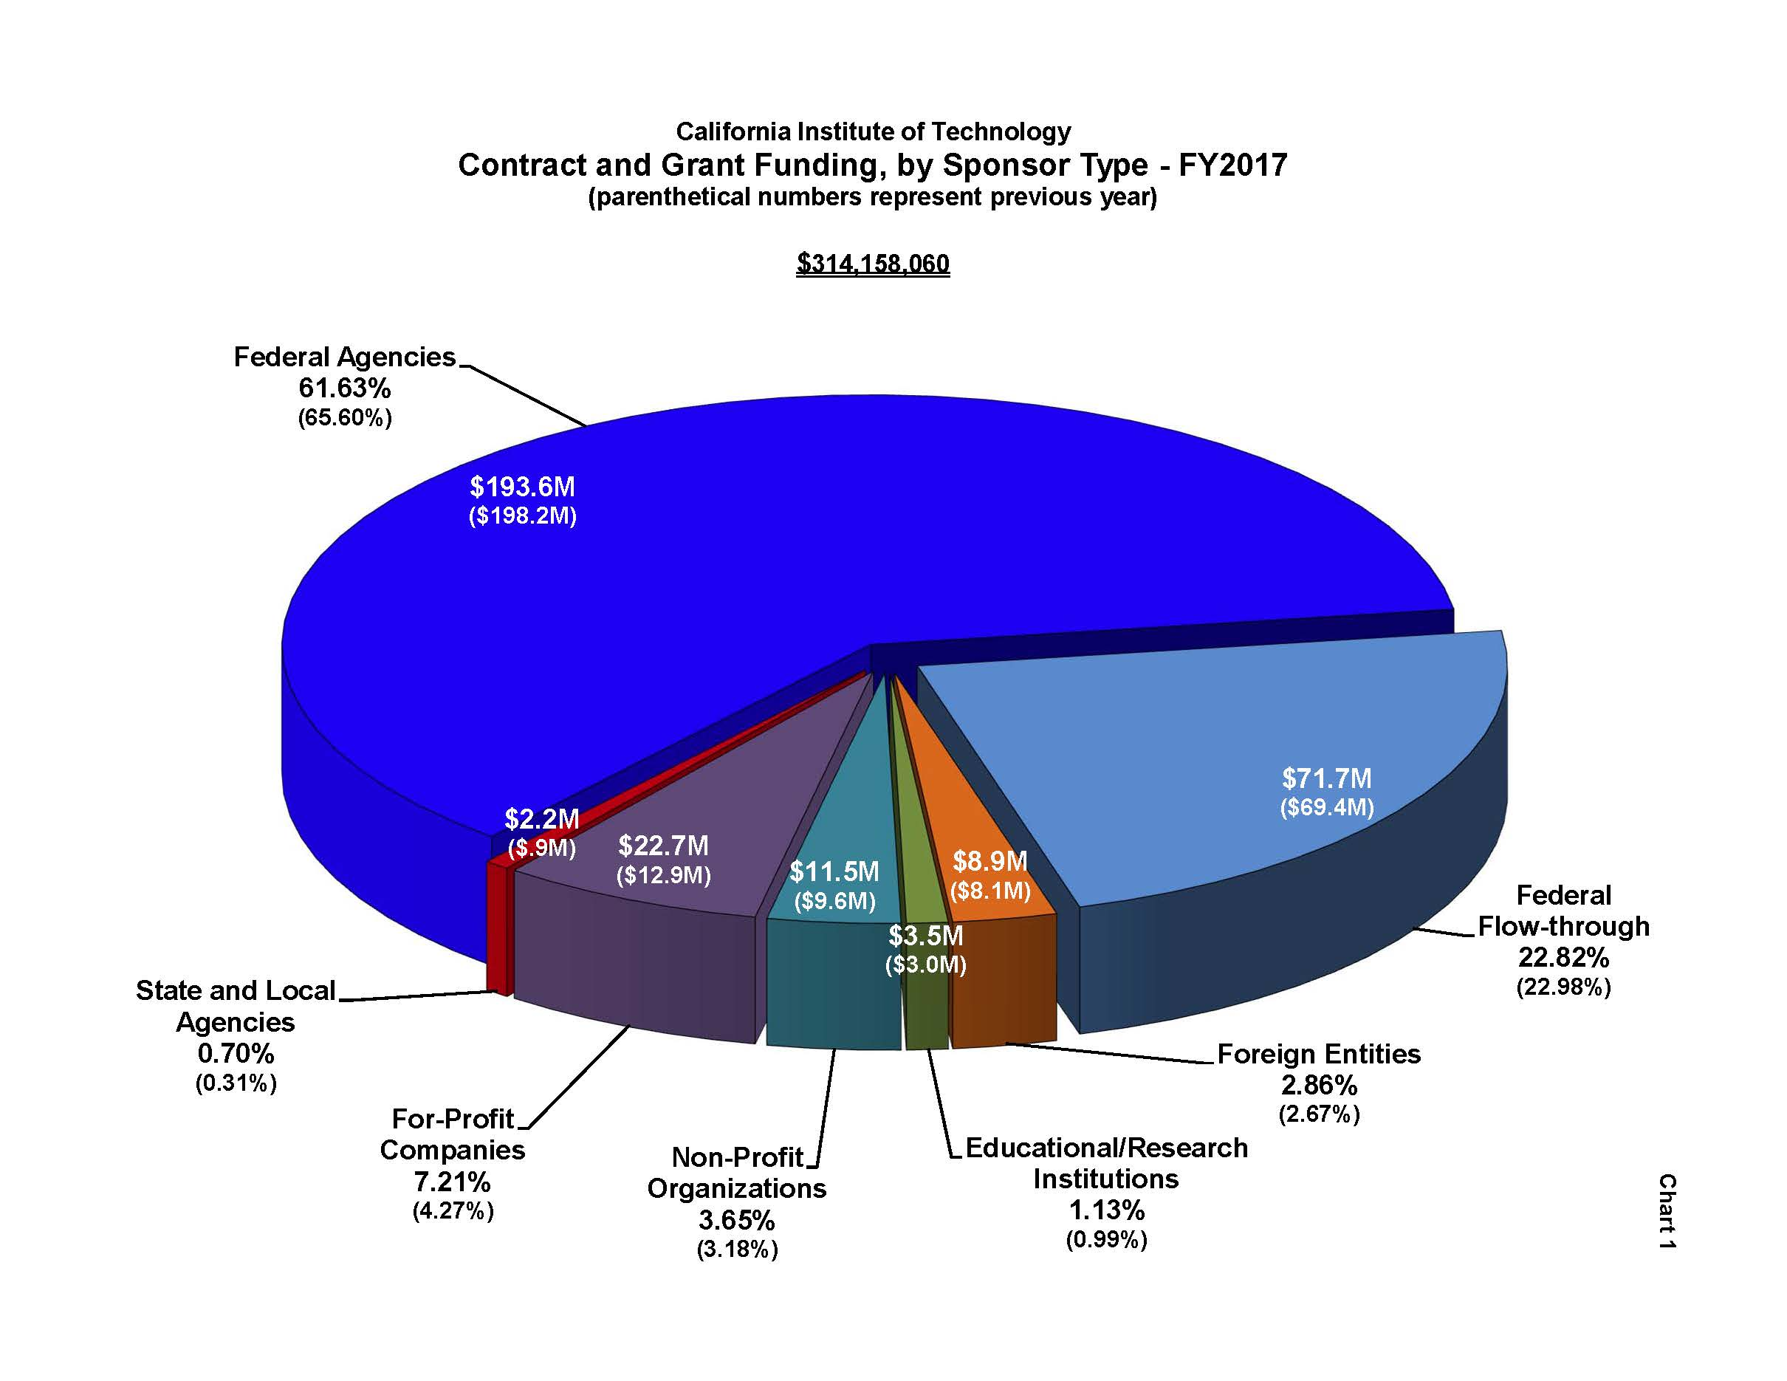

Slide 5
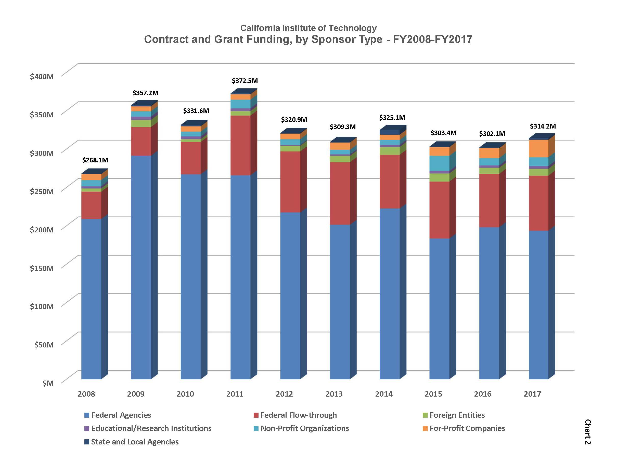

Slide 6
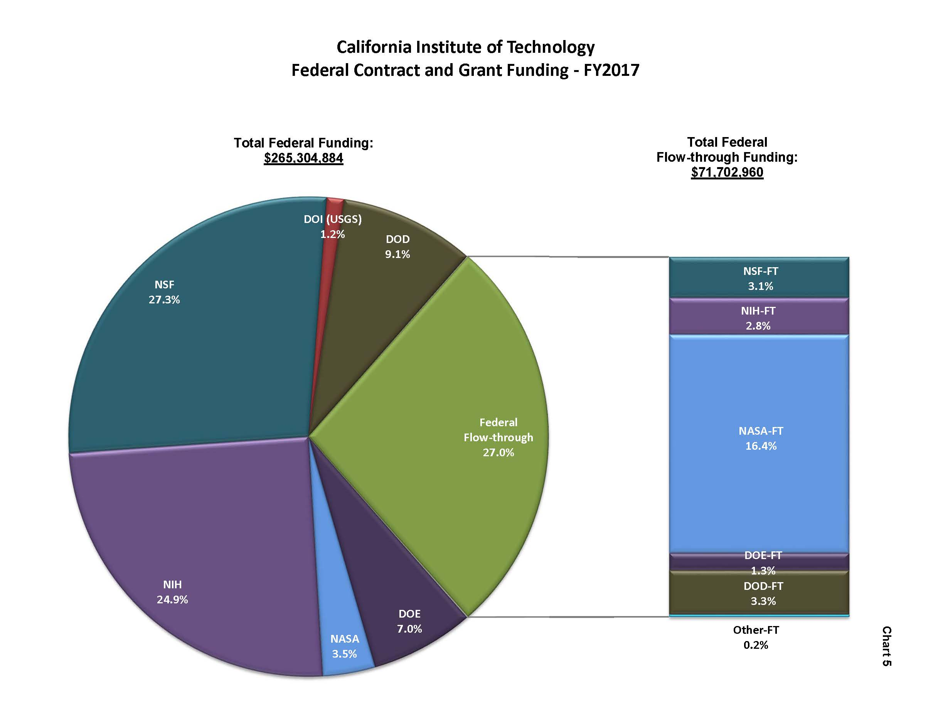

Slide 7
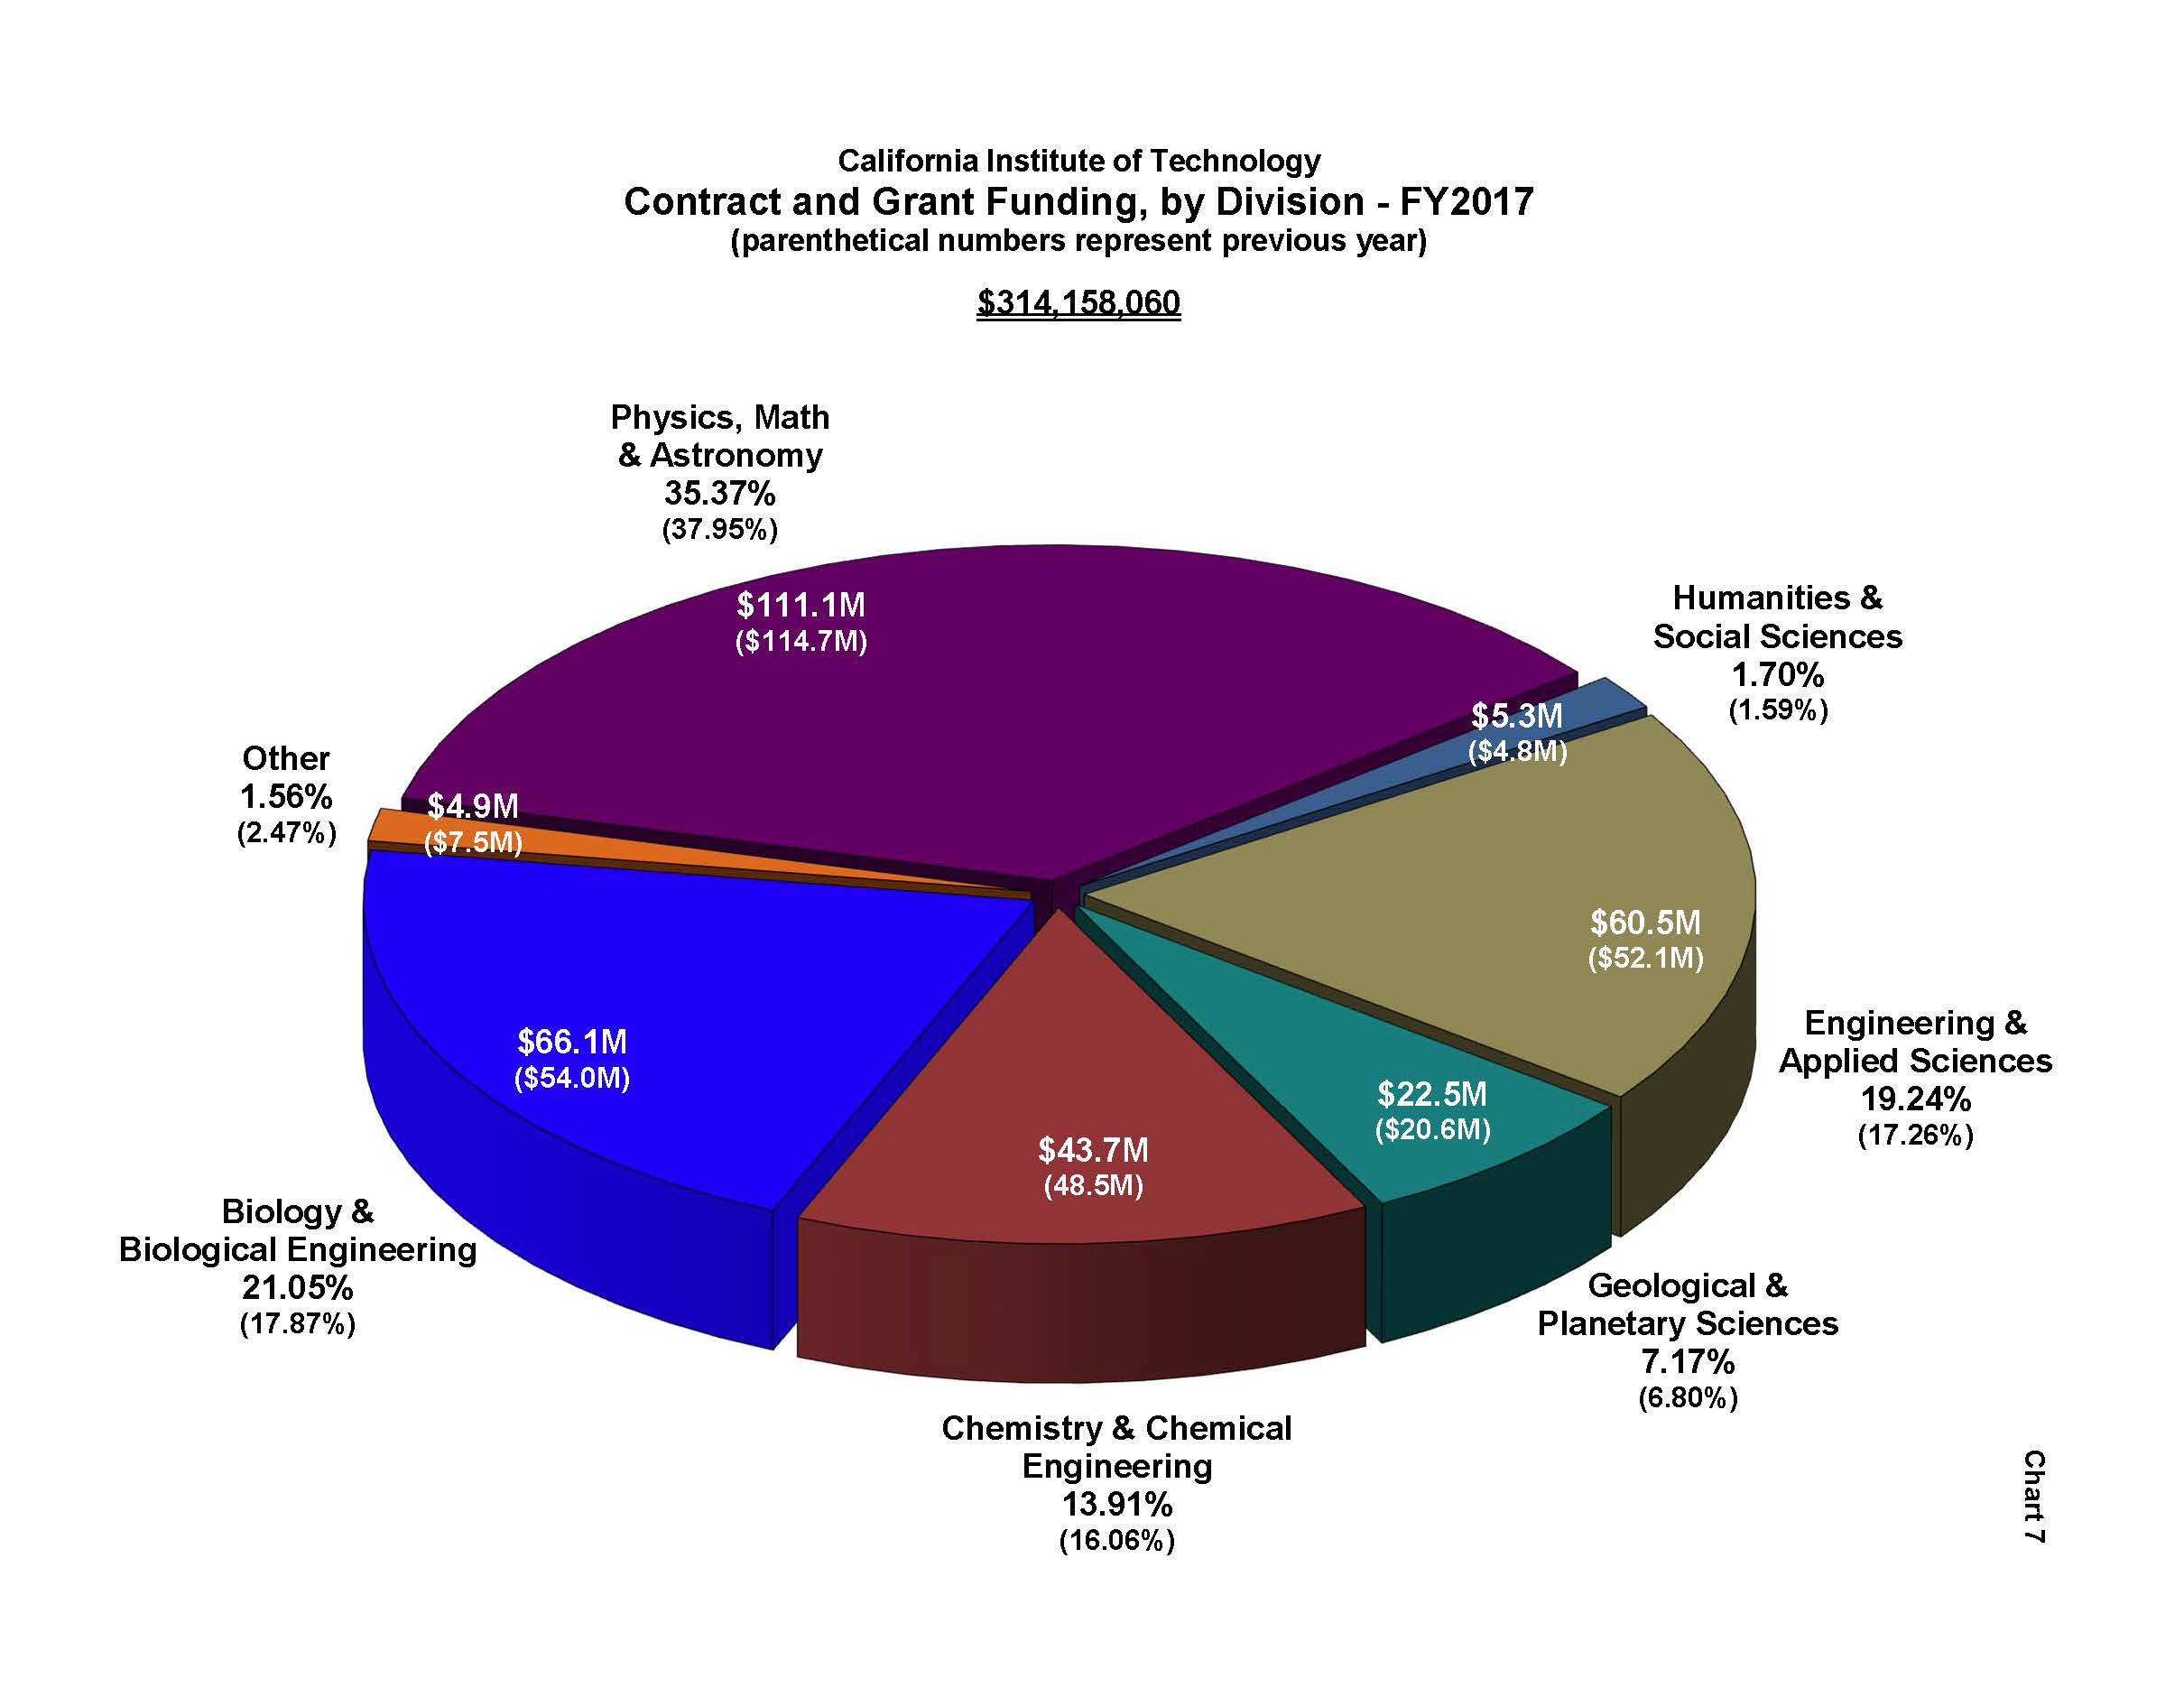

Slide 8
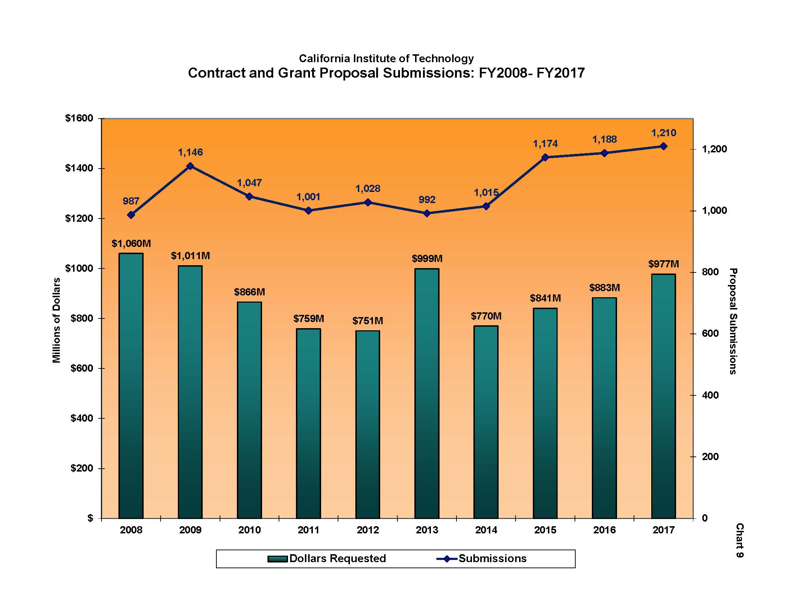

Slide 9
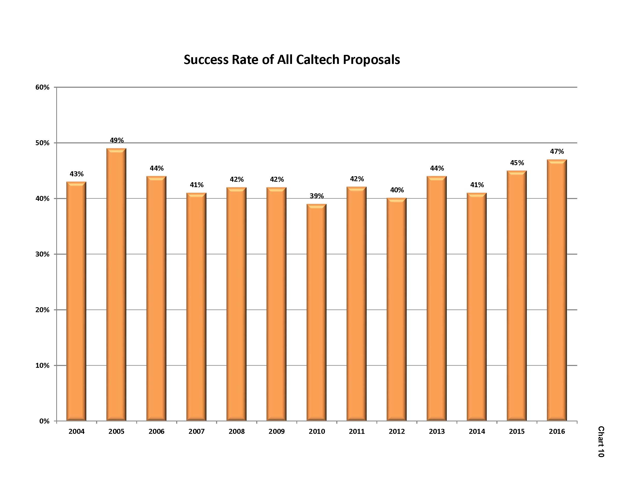

Slide 10
PAA Changes – Rochelle Athey

Slide 11
Guidance on Expenditure Types – Rochelle Athey

Slide 12
Sponsored Award Expenditure Type Matrix Dec 2017
 | A | B | C | D | E | F
1 | Expenditure Type | Rolls Up To | Expenditure Definition | Usage | Restricted Expenditure Type | Chargeable to federal sponsored award?
2 | Advertising | Materials and Supplies | Costs of advertising media; such media include magazines, newspapers, radio and television, direct mail, exhibits, electronic or computer transmittals and the like. | May be charged to federal sponsored awards only when costs are incurred for the following: 1) recruiting for a position; 2) the procurement of goods and services for the performance of an award; 3) the disposal of scrap or surplus materials acquired in the performance of a Federal award except when non-Federal entities are reimbursed for disposal costs at a predetermined amount; or 4) program outreach and other specific purposes necessary to meet the requirements of the Federal award. |  | Yes, to the extent the cost is allocable, allowable, and reasonable and the award is directly benefited, the charges comply with Uniform Guidance requirements, and there are no award restrictions.
3 | Bi-Weekly Admin Staff | Staff Salaries | Salary costs for effort expended by administrative staff (i.e. those who support the administrative activities of Caltech) paid on a bi-weekly basis | Can be used on federal awards as long as the costs are consistent with the requirements outlined in the Uniform Guidance §200.413 (c). Costs should be included in approved award budget or written approval obtained from sponsor. | Yes - additional review of cost is performed by Post Award Administration | Yes, to the extent the cost is allocable, the award is directly benefited, consistent with the requirements outlined in the Uniform Guidance §200.413 (c), and costs have been included in approved award budget or written approval obtained from sponsor.
4 | Bi-Weekly Research Staff | Staff Salaries | Salary costs for effort expended by research staff (i.e. those who support organized research projects) paid on a bi- weekly basis. | Can be used on sponsored awards. |  | Yes, to the extent the cost is allocable, allowable, and reasonable; the award is directly benefited, and there are no award restrictions.
5 | Bi-Weekly Technical Staff | Staff Salaries | Salary costs for effort expended by technical staff (i.e. those who support the technical activities of Caltech) paid on a bi-weekly basis | Can be used on sponsored awards. |  | Yes, to the extent the cost is allocable, allowable, and reasonable; the award is directly benefited, and there are no award restrictions.
6 | Computer Maintenance | Materials and Supplies | Service and materials costs incurred to maintain computers. | Use when necessary to maintain computer operations. |  | Yes, to the extent the cost is allocable, allowable, and reasonable; the award is directly benefited, and there are no award restrictions.

Slide 13
Sponsored Award Expenditure Type Matrix Dec 2017
 | A | B | C | D | E | F
1 | Expenditure Type | Rolls Up To | Expenditure Definition | Usage | Restricted Expenditure Type | Chargeable to federal sponsored award?
7 | Computer Software | Materials and Supplies | Computer costs associated with various packages, programs, routines, and symbolic languages that control the functioning of a system (excluding hardware and maintenance costs) | Use when purchasing software for a Caltech business use. |  | Yes, to the extent the cost is allocable, allowable, and reasonable; the award is directly benefited, and there are no award restrictions.
8 | Consulting Fees | Materials and Supplies | Fees charged for professional or technical services by non-employees that are retained by Caltech |  |  | Yes, to the extent the costs are reasonable, allocable, the award is directly benefited, and there are no award restrictions. Usually specifically described in approved award budget.
9 | Copying | Materials and Supplies | Costs related to photocopying and reproduction services | For Federal awards, can be used if budget has specific reference to copying and/or if the cost directly benefits the award. |  | Yes, when the award budget contains a specific reference to copying and/or when the cost directly benefits the project.
10 | Document Fees | Materials and Supplies | Cost of miscellaneous allocable immigration fees | Used to cover short term visa fees. | Yes - additional review of cost is performed by Post Award Administration | Yes - when the fees are associated with a recruitment, are allocable, there are no award restrictions, and the costs meet the requirements of the Uniform Guidance (2 CFR 200). Typically, fees associated with premium, expedited or "rush" processing are unallowable unless specifically authorized by the sponsor in writing.
11 | Document Fees - Unallocable | Materials and Supplies | Cost of visa fees that are not allocable | Used to cover premium processing visa fees; permanent immigration application costs. |  | No - unless award budget specifically includes such costs or written permission from sponsor is obtained
12 | Dues - Allocable | Materials and Supplies | Dues charged by organizations that are allocable under applicable cost principles. | Used to cover dues costs; may be associated with attendance at conferences/meetings to disseminate technical information. | Yes - additional review of cost is performed by Post Award Administration | If dues are required in order to attend a conference or meeting, the expense must be included in the Travel Report. Typically an unallowable expense on federal awards.
13 | Equipment - Caltech | Equipment-Caltech | Equipment where title is retained by Caltech and is to be carried as an asset under Caltech's capitalization policy | Use when Caltech obtains title, unit cost is $5,000 or more (including freight and tax), has a useful life of 2 years or more, and is a stand alone asset. | Yes - additional review of cost is performed by Post Award Administration | Yes, to the extent the cost is allocable, allowable, and reasonable; the award is directly benefited, and there are no award restrictions.

Slide 14
Sponsored Award Expenditure Type Matrix Dec 2017
 | A | B | C | D | E | F
1 | Expenditure Type | Rolls Up To | Expenditure Definition | Usage | Restricted Expenditure Type | Chargeable to federal sponsored award?
14 | Equipment - Government | Equipment-Non-Caltech | Equipment where title is retained by the US government and tracked by Caltech. | Use when the US government retains title to items defined as equipment under the terms of the agreement. | Yes - additional review of cost is performed by Post Award Administration | Yes, to the extent the cost is allocable, allowable, and reasonable; the award is directly benefited, and there are no award restrictions. Typically used on JPL IAs.
15 | Equipment - Other Owned | Equipment-Non-Caltech | Equipment where title is retained by others (excluding the US government) and tracked by Caltech. | Use when the non-federal sponsor retains title to items defined as equipment under the terms of the agreement. | Yes - additional review of cost is performed by Post Award Administration | Yes, to the extent the cost is allocable, allowable, and reasonable; the award is directly benefited, and there are no award restrictions.
16 | Equipment Maintenance | Materials and Supplies | Service and materials costs incurred to maintain equipment (other than computers) | Use when equipment requires maintenance. |  | Yes, to the extent the cost is allocable, allowable, and reasonable; the award is directly benefited, and there are no award restrictions.
17 | Fees | Materials and Supplies | Services performed by professionals (other than consulting) |  |  | Yes, to the extent the cost is allocable, allowable, and reasonable; the award is directly benefited, and there are no award restrictions.
18 | Grad Assistantships | All Other Salaries | Salary costs for effort expended by graduate students | Used when charging to sponsored awards, PI discretionary funds and division teaching PTAs. Generates tuition remission; payment constitutes an employer-employee relationship. |  | Yes, to the extent the cost is allocable, allowable, and reasonable; the award is directly benefited, and there are no award restrictions.
19 | Grad Fellowships | Student Aid | Stipend paid to graduate students under fellowships | Used when charging to federal training, non-federal, foundation, Caltech divisional, or departmental fellowship awards; does not constitute an employer-employee relationship. Will generate tuition remission. |  | Yes, allowable on federally-funded training awards. Usually this expenditure type is used on fellowship or scholarship type awards.
20 | Honoraria | Materials and Supplies | Fees in recognition of a special service or distinguished achievement for which custom or propriety forbids a price to be set. | To recognize a special service or achievement for a non-employee; not chargeable to federal awards |  | No

Slide 15
Sponsored Award Expenditure Type Matrix Dec 2017
 | A | B | C | D | E | F
1 | Expenditure Type | Rolls Up To | Expenditure Definition | Usage | Restricted Expenditure Type | Chargeable to federal sponsored award?
21 | Human Research Participant | Materials and Supplies | Payment to an individual participating in research studies. | Must have an approved IRB protocol to utilize. |  | Yes, to the extent the cost is allocable, allowable, and reasonable; the award is directly benefited, there are no award restrictions, and an approved IRB protocol is in place.
22 | Leased Equipment | Leased Equipment | Equipment lease payment on a capital lease | Not chargeable to sponsored awards; considered capital asset of Caltech. Use Rentals of Equipment expenditure type instead |  | No
23 | Microelectronic chips | Materials and Supplies | Microelectronic chips manufactured by an outside vendor based on Caltech design and specifications | Can be used on sponsored awards. | Yes - additional review of cost is performed by Post Award Administration | Yes, to the extent the cost is allocable, allowable, and reasonable; the award is directly benefited, and there are no award restrictions.
24 | Mtgs and Conf Exp - Allocable | Materials and Supplies | Costs incurred to pay for the cost of hosting local meetings and conferences. | This expenditure type is used for locally hosted conferences (within a 50 mile radius of Caltech). Costs of meetings and conferences for the dissemination of technical information are allowable. Allowable costs for hosting a conference include meals, transportation, rental of facilities, and other items incidental to such meetings or conferences. It should NOT be used when Caltech researchers or graduate students attend conferences more than a 50 mile radius from Caltech to disseminate research information - use one of the Travel expenditure types for those circumstances. |  | Yes, to the extent the cost is allocable and allowable, the award is directly benefited, and there are no award restrictions. Should not be used for costs associated with researcher travel to a conference outside of local area (beyond 50 mile radius); use only if hosting or attending a conference locally.
25 | Mtgs and Conf Exp - Unallocable | Materials and Supplies | Costs incurred to pay for meetings and conferences that are unallocable under the applicable cost principles. | Costs of meetings and conferences that are not allocable under applicable cost principles, i.e. community, civic, or lobbying meetings. |  | No

Slide 16
Sponsored Award Expenditure Type Matrix Dec 2017
 | A | B | C | D | E | F
1 | Expenditure Type | Rolls Up To | Expenditure Definition | Usage | Restricted Expenditure Type | Chargeable to federal sponsored award?
26 | Monthly Admin Staff | Staff Salaries | Salary costs for effort expended by administrative staff (i.e. those who support the administrative activities of Caltech) paid on a monthly basis | Can be used on federal awards as long as the costs are consistent with the requirements outlined in the Uniform Guidance §200.413 (c). Costs should be included in approved award budget or written approval obtained from sponsor. | Yes - additional review of cost is performed by Post Award Administration | Yes, to the extent the cost is allocable, the award is directly benefited, consistent with the requirements outlined in the Uniform Guidance §200.413 (c), and costs have been included in approved award budget or written approval obtained from sponsor.
27 | Monthly Research Staff | Staff Salaries | Salary costs for effort expended by research staff (i.e. those who support organized research projects) paid on a monthly basis. | Can be used on sponsored awards. |  | Yes, to the extent the cost is allocable, allowable, and reasonable; the award is directly benefited, and there are no award restrictions.
28 | Monthly Technical Staff | Staff Salaries | Salary costs for effort expended by technical staff (i.e. those who support the technical activities of Caltech) paid on a monthly basis | Can be used on sponsored awards. |  | Yes, to the extent the cost is allocable, allowable, and reasonable; the award is directly benefited, and there are no award restrictions.
29 | Mtgs - Participant Support | Materials and Supplies | Registration or conference fees associated with meetings, conferences, symposia, or training projects that are paid to, or on behalf of participants or trainees who are not employees of Caltech. | Exempt from indirect costs. |  | Yes, to the extent participant support costs are authorized in the award budget, are allocable, allowable, and reasonable; the award is directly benefited, and there are no award restrictions.
30 | NTR Grad Assistantships | All Other Salaries | Graduate assistantship without tuition remission | Used for sponsored awards; paid as salaries and wages. Does not generate tuition remission. |  | Yes, to the extent the cost is allocable, allowable, and reasonable; the award is directly benefited, and there are no award restrictions.
31 | NTR Grad Fellowships | Student Aid | Fellowship without tuition remission | Used typically for non-federal awards. Stipend - no employer- employee relationship; no staff benefits. |  | Yes, allowable on federal training awards. Usually this expenditure type is used on fellowships or scholarship type awards.
32 | Other Internal Charges | Materials and Supplies | Charges from Caltech service organizations | Utilizes "WIC" to recharge expenditures. | Yes - charges from the Athenaeum to federal awards are reviewed by Post Award Administration | Yes, to the extent the cost is allocable, allowable, and reasonable; the award is directly benefited, and there are no award restrictions.
33 | Publications | Materials and Supplies | Costs for electronic and print media, including distribution, promotion, general handling, and page charges for publishing research papers in professional journals. | May be charged to sponsored awards. |  | Yes, to the extent the cost is allocable, allowable, and reasonable; the award is directly benefited, and there are no award restrictions.

Slide 17
Sponsored Award Expenditure Type Matrix Dec 2017
 | A | B | C | D | E | F
1 | Expenditure Type | Rolls Up To | Expenditure Definition | Usage | Restricted Expenditure Type | Chargeable to federal sponsored award?
34 | Postdoctoral Fellowship | Stipends | Stipends paid to postdoctoral fellows who are recipients of NIH, NSF and NASA Fellowship awards | Used when charging specifically to federally-funded fellowships (training grants), foundation, or special postdoctoral fellowships. No staff benefits generated. No employer-employee relationship. Can only be used with training allowability schedule. |  | Yes, to the extent the cost is allocable, allowable, and reasonable; the award is directly benefited, and there are no award restrictions. Do not use this expenditure type if the fellow will be paid as an employee (obtaining staff benefits). Use the expenditure type Postdoctoral Scholar in those cases.
35 | Postdoctoral Scholar Sal | Other Faculty Salaries | Salary costs for effort expended by postdoctoral scholars | Used when charging to most sponsored awards and PI discretionary funds. Generates staff benefits. Employer-employee relationship. Can be used with most allowability schedules. |  | Yes, to the extent the cost is allocable, allowable, and reasonable; the award is directly benefited, and there are no award restrictions.
36 | Rentals of Equipment | Materials and Supplies | Equipment rental payment (on an operating lease not a capital lease). | Used on sponsored awards for charging rented equipment (as defined by regulation). |  | Yes, to the extent the cost is allocable, allowable, and reasonable; the award is directly benefited, and there are no award restrictions.
37 | Res/Postdoctoral Fellows | Materials and Supplies | Fellowship stipends paid to research/postdoctoral scholars | Used when charging specifically to non-federal fellowship awards (training grants), foundation, or special postdoctoral fellowships. No staff benefits generated. No employer-employee relationship. Not on Federal Research allowability schedule. |  | No - use Postdoctoral Fellowship instead for federal training awards
38 | Shipping Charges | Materials and Supplies | Costs incurred to deliver goods | Used to ship items. |  | Yes, to the extent the cost is allocable, allowable, and reasonable; the award is directly benefited, and there are no award restrictions.
39 | Stipend - Participant Support | Stipends | Stipends paid on federal sponsored awards for participant or trainee support | Used for stipends that would be allowable on federal sponsored awards. Exempt from indirect costs. |  | Yes if included in the award budget, the cost is allocable, the award is directly benefited, and there are no award restrictions.

Slide 18
Sponsored Award Expenditure Type Matrix Dec 2017
 | A | B | C | D | E | F
1 | Expenditure Type | Rolls Up To | Expenditure Definition | Usage | Restricted Expenditure Type | Chargeable to federal sponsored award?
40 | Student Wages NB | All Other Salaries | Salary costs for effort expended by students who do not receive wages under the work study program | Payment for effort; employer- employee relationship; does not generate staff benefits. |  | Yes, to the extent the cost is allocable, allowable, and reasonable; the award is directly benefited, and there are no award restrictions.
41 | Subcontracts - 1st 25K | Subcontracts | Used for the first $25K of expenditures made by subawardees on sponsored awards when award is on MTDC base. |  |  | Yes, as long as subcontract is listed in approved award budget; if not in approved budget, sponsor approval required prior to charging costs in most cases.
42 | Subcontracts - Over 25K | Subcontracts | Used for expenditures over $25K made by subawardees on sponsored awards when award is on MTDC base. |  |  | Yes, as long as subcontract is listed in approved award budget; if not in approved budget, sponsor approval required prior to charging costs in most cases.
43 | Supplies - Allocable | Materials and Supplies | Supplies that are allocable under applicable cost principles | Supplies that are necessary for the overall operation of Caltech. |  | Yes, to the extent the cost is allocable, allowable, and reasonable; the award is directly benefited, and there are no award restrictions.
44 | Supplies - Unallocable | Materials and Supplies | Supplies that are not allocable under applicable cost principles | Supplies that may be business expenses of Caltech but not allocable to a sponsored award. |  | No
45 | Travel - Domestic Allocable | Travel | Travel costs incurred for an individual on official Caltech business within the US that are allocable under applicable cost principles. | Costs must be allowable under Caltech's travel policy. |  | Yes, to the extent the cost is allocable, allowable, and reasonable; the award is directly benefited, and there are no award restrictions.
46 | Travel - Non US Carrier | Travel | Air fare costs for travel on a non-US airline | Used on non-federal sponsored awards for international airfare costs on a non-US carrier that would be unallocable and unallowable on federal awards. |  | No
47 | Travel - Domestic Unallocable | Travel | Travel costs incurred for an individual within the US that are not allocable under applicable cost principles. | Used for costs that would not be allowable on federal sponsored agreements - i.e. airline upgrades from economy to a higher class of service. |  | No

Slide 19
Sponsored Award Expenditure Type Matrix Dec 2017
 | A | B | C | D | E | F
1 | Expenditure Type | Rolls Up To | Expenditure Definition | Usage | Restricted Expenditure Type | Chargeable to federal sponsored award?
48 | Travel - Foreign | Travel | Travel costs incurred for an individual on official Caltech business outside the US. | Used for airfare on non-US carriers on federal awards when open skies agreement between US and country exists; foreign airline is code sharing with a US carrier (must use US Carrier code); or when a Fly America Act exception exists and has been approved | Yes - additional review of cost is performed by Post Award Administration | Yes, to the extent the cost is allocable, allowable, and reasonable; the award is directly benefited, and there are no award restrictions. Prior approval may be required otherwise.
49 | Travel - Foreign Unallocable | Travel | Travel costs incurred for an individual on official Caltech business outside the US that are not allocable under applicable cost principles. | Used for costs that would not be allowable on federal sponsored agreements - i.e. airline upgrades from economy to a higher class of service. |  | No
50 | Travel - Participant Support | Travel | Direct costs for subsistence or travel allowances associated with meetings, conferences, symposia, or training projects that are paid to, or on behalf of, participants or trainees who are not employees of Caltech. | Used for costs that would be allowable on federal sponsored awards related to meetings for participants. Exempt from indirect costs. |  | Yes if included in the award budget, the cost is allocable, allowable, and reasonable; the award is directly benefited, and there are no award restrictions.

Slide 20
NSF Inspector General Audit – Rochelle Athey
University of Southern California

Slide 21
Background
NSF IG Audit of the University of Southern California
    https://www.nsf.gov/oig/_pdf/17-1-009_USC.pdf
Audit conducted by Kearney & Company PC on behalf of NSF
Audit covered the period 10-1-11 to 9-30-14

Slide 22
Audit Information
Disallowed costs fell in the following categories
  Expenses incurred near award expiration
  Misapplication of F&A on subawards
  Unsupported or incorrect charges to participant support
  Unreasonable, unallowable or unsupported travel costs
  Unreasonable or unallocable general expense charges
  Untimely posting of travel charges
  Unreasonable payroll charges

Slide 23
Expenses Incurred Near Award Expiration
Auditors challenged equipment purchases and purchases of supplies made at or near the end of award periods
  The questioned costs for MRI equipment awards were troubling
  Examples
Keep your NSF program officer informed of any delays related to equipment purchases or problems with installation. It may be necessary to request an extension on the award.

Slide 24
Participant Support Costs
Auditors questioned participant support costs on several awards
  USC charged employee related costs – these were disallowed and USC agreed because employees should not have any costs incurred under Participant Support costs
  Remember to budget any participant support costs in your federal award budget proposals appropriately – they are costs related to trainees

Slide 25
Unreasonable Travel Costs
The auditors took a very stringent approach to travel costs under this audit
  Auditors referenced whether travel costs were budgeted
  Auditors indicated they believed many trips were unreasonable
  Examples
Be sure to justify and document all travel on federal awards

Slide 26
EXPORT COMPLIANCE: Safeguarding Controlled Unclassified Information (CUI) According to NIST Special Publication 800-171 Requirements
Adilia F. Koch
Caltech Export Compliance Office

Slide 27
What is the Government’s Reason for the Need to Protect Sensitive Unclassified Information?
The federal government is relying on external service providers more than ever to help carry out a wide range of federal missions and business functions.
For example, many federal contractors and subcontractors, routinely process, store and transmit sensitive federal information in their information systems to support the delivery of essential products and services to federal agencies such as:
- providing credit card and financial services,
- web services,
- conducting background investigations for security clearances,
-processing healthcare data,
-cloud services,
-developing communications, and
-satellite, and weapons systems.
Source: NIST 800-171

Slide 28
What is CUI?
What is CUI? Controlled Unclassified Information (CUI). CUI are categories of data that the government wishes to protect from unauthorized access or dissemination. Sometimes the CUI is provided to Caltech but CUI can also be generated by campus in some awards. CUI marking language requirements on campus generated information can result in a de facto publication restriction!
HOW DOES YOUR PI KNOW IF HE/SHE HAS CUI? The government or sender is required to provide “CUI” marking language or instructions.

Slide 29
Why does CUI have to be Safeguarded?
REASON FOR CONTROLS: Controlled Unclassified Information includes information deemed to be a “sensitive technology” due to national security concerns, terrorism concerns, privacy issues, export controls, and other reasons for control. For example, CUI can include:
  Information that can be used by terrorist organizations to affect the U.S. infrastructure: Energy, food supply, agriculture, water, etc.
  Personnel Information, Financial Information, other such as security clearance information
  Information safeguarded for national security reasons
  CUI must be safeguarded according to NIST Special Publication 800-171.

Slide 30
NIST Special Publication 800-171: Describes how to Safeguard CUI
What is NIST Special Publication 800-171?
- NIST Special Publication 800-171, is how the government describes how to safeguard data that the federal government designates as Controlled Unclassified Information (CUI). Caltech PI must implement approved CUI safeguards described in NIST 800-171.
How do you get CUI?
- When it is shared by the federal government, sponsor or other project participants with Caltech, or it can be Caltech generated CUI.

Slide 31
Controlled Unclassified Information (CUI): Marking Language Implications for the PI
CUI MARKING LANGUAGE:
  Your PI may receive information that is marked with CUI Dissemination Control Marking Language.
  Your PI may be requested by the government or the sponsor to use CUI restrictive marking language on his/her research results.
IMPLICATIONS OF CUI MARKING LANGUAGE ON CALTECH RESEARCH RESULTS: Caltech generated CUI can result in dissemination, access and publication restrictions!
CUI REQUIRES SPECIFIC GOVERNMENT IMPOSED SAFEGUARDING REQUIREMENTS: CUI must be safeguarded according to NIST Special Publication 800-171.

Slide 32
Example of CUI Marking Language
DoD Instruction 5230.24, Distribution Statements & Their Corresponding Reasons for Use
“DISTRIBUTION B: Distribution Authorized to U.S. Government Agencies (reason)(date of determination). Other request for this document shall be referred to (controlling DoD office).”
“DISTRIBUTION C: Distribution authorized to U.S. Government Agencies and their contractors (reason)(date of determination). Other request for this document shall be referred to (controlling DoD office).”
Resources: DTIC’s Web Page: http://www.dtic.mil/dtic/submit/distribution_limitations_and statements.html

Slide 33
CUI Snapshot: How did we get here?
Via Contractual Requirements Imposed on Caltech to Safeguard Controlled Unclassified Information (“CUI”)
CUI Designation is identified via CUI Restrictive Marking Language
How? Usually via “the DFARS 7012 clause”
Caltech generated CUI can result in dissemination, access and publication restrictions!
In NIST Special Publication 800-171, the government describes how to safeguard “CUI”.
How is CUI Safeguarded?
Government or sponsor directs Caltech to mark their research results as “CUI”
Government or sponsor transfers CUI to PI
How is CUI Transferred or Generated?

Slide 34
CUI Review and NIST 800-171 Compliant Security Implementation Process
OSR NOTIFIES PI
OSR will notify the PI and explain the implications of accepting an award with CUI, such as potential publication restrictions, and the CUI safeguarding requirements associated with complying with NIST 800-171.
NIST 800-171 COMPLIANT SECURITY PLAN
If YES: IMSS IT Security Director and the Export Compliance Office will work with the PI to develop a CUI NIST 800-171 compliant IT security infrastructure “plan”.
The PI and the Award
QUESTION: Does the PI wish to proceed?
REPORTING REQUIREMENT: Caltech may be required to describe in writing how the PI has implemented and is complying with the requirements of NIST 800-171.
The Award’s “Comment Section” will remind the PI that the Award is subject to “CUI Safeguarding of Information” requirements in accordance with the NIST 800-171.
QUESTION: Does the PI wish to proceed with the campus approved NIST 800-171 compliant security plan?

Slide 35
What are some of the PI’s responsibilities?
What are some of the Caltech PI’s responsibilities when receiving or generating CUI?
The PI must implement and ensure that the approved NIST 800-171 compliant security plan is followed by all members of his/her project research team for the life of the project, or for as long as CUI information is retained on campus. Export control requirements will most likely also apply. Whenever possible, the PI should return the CUI to the source. Cyber incidents or access violations must be reported immediately.
What if no CUI is expected at the start of the project award and later the PI expects to receive or to generate CUI and there is no IT Security NIST 800-171 approved CUI safeguarding plan in place?
Prior to receiving or generating CUI, PI must immediately notify OSR. OSR will notify Export Compliance and IMSS IT Security Director about the need to establish a NIST 800-171 with PI.
What is IMSS Security’s role?
-IMSS IT Security Director and the PI will work together to determine whether: based on the project and the scope of the CUI, whether Caltech PI can meet the IT CUI safeguarding obligations of NIST 800-171. IMSS approved IT security plan must be in place prior to acceptance of the award or CUI.
What about Export Controls?
- The Export Office is responsible for the review of the CUI, export classification, license determination and export compliance implementation process; the majority of CUI falls under the “sensitive”, or “export controlled” information category.

Slide 36
QUESTIONS?
EXPORT@CALTECH.EDU

Slide 37
Terms you should know . . .
“CUI” – Controlled Unclassified Information
NIST Special Publication 800-171 (National Institute of Standards and Technology) – Is a publication that defines security requirements for protecting Controlled Unclassified Information (“CUI”) in nonfederal information systems including institutions of higher learning. It provides a standardized and uniform set of requirements for all CUI security needs for nonfederal systems
What is “7012 clause”? It is a DFAR contract clause is one way that Caltech is contractually bound in some federal awards to follow strict safeguarding requirements pursuant to the guidance and requirements described in NIST Special Publication 800-171.

Slide 38
CUI Categories at a Glance
What are some examples of CUI categories?
Agriculture (agricultural operation, farming projects, etc.)
Controlled Technical Information
Critical Infrastructure (chemical terrorism vulnerability information, critical energy infrastructure, etc.)
Emergency Management
Export Control:
  Sub-category – “Research”: Related to the systematic investigation into and study of materials and sources in order to establish facts and reach new conclusions.
Financial (bank secrecy, electronic fund transfers, etc.)
Geodetic Product Information (imagery, imagery intelligence, etc.)
Immigration
Information Systems Vulnerability Information
Intelligence

Slide 39
CUI Categories (cont’d)
International Agreements (protected agreements defined by the government)
Law Enforcement
Info related to Judicial Proceedings
NATO designated agreements
Nuclear (nuclear reactors, materials or security)
Patent (invention secrecy orders, etc.)
Privacy (military, death records, etc.)
Proprietary Business Information (trade secrets, performance specs, etc.)
Safety Act Information (anti-terrorism activities)
Statistical (census, certain surveys)
Tax (taxpayer info)
Transportation (sensitive information, railroad info)

Slide 40
Protecting Controlled Unclassified Information in Nonfederal Information Systems and Organizations (NIST 800-171)
Chapter 3
The requirements
3.1 Access Controls
3.2 Awareness and Training
3.3 Audit and Accountability
3.4 Configuration Management
3.5 Identification and Authentication
3.6 Incident Response
3.7 Maintenance
3.8 Media Protection
3.9 Personnel Security
3.10 Physical Protection
3.11 Risk Assessment
3.12 Security Assessment
3.13 System and Communications Protection
3.14 Systems and Information Integrity

Slide 41
Example of CUI Controls from NIST 800-171: “Chapter 3 -- 3.10 PHYSICAL PROTECTION”
“3.10 PHYSICAL PROTECTION
Basic Security Requirements
3.10.1 Limit physical access to organizational information systems, equipment, and the respective operating environments to authorized individuals.
3.10.2 Protect and monitor the physical facility and support infrastructure for those information systems.
3.10.3 Escort visitors and monitor visitor activity.
3.10.4 Maintain audit logs of physical access.
3.10.5 Control and manage physical access devices.
3.10.6 Enforce safeguarding measures for CUI at alternate work sites (e.g., telework sites).”
3.11 RISK ASSESSMENT …”

Slide 42
How do you know if your PI needs to comply with NIST 800-171 Requirements?
OSR will notify the PI and explain the implications of accepting an award with CUI, such as the potential publication restrictions, and the CUI safeguarding requirements associated with complying with NIST 800-171. Does the PI wish to proceed?
If YES, the IMSS IT Security Office and the Export Compliance Office will work with the PI to establish a CUI IT security infrastructure that complies with the requirements of the NIST 800-171. CUI safeguarding requires IT, physical protection, access and dissemination controls.
  Note: The Caltech IMSS IT Security Director must approve the security implementation plan prior to accepting the award. Does the PI wish to proceed with the IMSS CUI security infrastructure; export control requirements?
The Award’s “Comment Section” will have a note that reminds the PI that his/her award is subject to CUI Safeguarding of Information requirements in accordance with the NIST 800-171.

Slide 43
What is a CUI Designation?: It’s the Government’s Method of Identifying “Controlled Unclassified Information (CUI)” that Requires Safeguarding Controls.
The government has developed a disciplined and structured process for identifying the different types of information that are routinely used by federal agencies that require safeguarding.
On 11/4/2010 the President signed Executive Order 13556, Controlled Unclassified Information (“CUI). The EO established a government-wide CUI Program to standardize the way the executive branch handles unclassified information that requires protection and designed the National Archives and Records Administration (NARA) as the Executive Agent to implement the program.
Only information that requires safeguarding or dissemination controls pursuant to federal law, regulation, or government-wide policy may be designated as CUI.

Slide 44
NIH Campaign to Eliminate Delinquent Technical Reports – Mary Gibson

Slide 45
NIH Closeouts:
We have been hearing for some time in the research administration community that closeouts were going to become a greater focus at NIH. That time has arrived.
On November 30, 2017 NIH released Notice NOT-OD-18-107 giving the community warning they would be aggressive about delinquent reports.
In December 2017 OSR was contacted by phone and email multiple times in one week regarding delinquent final technical reports for three researchers.
NIH demanded submission of the final technical report by the end of the same day, or next day to avoid losing funding; not just funding to the specific PI, but all NIH funding to Caltech.
The additional slides are provided in the hope you will use it in your division meetings to make people aware NIH is actively and aggressively going after delinquent reports.
NIH grants office process calls for NIH to send e-mail reminders directly to the PI at the end of the period of performance, and at 120 days. However OSR has found NIH does not always send the e-mail reminder at the end of the period of performance, and may not send a delinquent notice until 160 days out.
After 120 days NIH will perform a unilateral closeout, without Caltech reports. They may take action that will impact future funding to the PI and to campus.
OSR is asking the grant managers to assist in reminding PIs, at the end of the period of performance, the final technical report is due within 120 days.
OSR will send PI’s and grant managers reminders within the 120 day period. Delinquent notices will be escalated to the Chair earlier in the process.

Slide 46
NIH Enforcement of Closeout Policies
Notice Number: NOT-OD-18-107
Key Dates
Release Date: November 30, 2017
Related Announcements
NOT-OD-17-085
NOT-OD-17-022
NOT-OD-15-136
NOT-OD-15-135
NOT-OD-15-111
NOT-OD-14-084
Issued by
National Institutes of Health (NIH)
Purpose
The purpose of this Notice is to alert the NIH extramural community that NIH is strengthening enforcement of longstanding closeout requirements, outlined in the NIH Grants Policy Statement Section 8.6, Closeout. NIH has consistently reminded recipients of their responsibility to submit timely, accurate final grant expenditure reports, and has communicated the critical need for recipients to reconcile cash transaction reports submitted to the HHS Payment Management System (PMS) with expenditure reports submitted to NIH. In order to fulfill agency requirements under the Grants Oversight and New Efficiency (GONE) Act and HHS grants policy, NIH will no longer delay the closeout of awards unless the recipient submits a prior approval request to the IC providing an acceptable written justification. Without prior approval from the awarding IC, NIH will initiate unilateral closeout for all awards that fail to meet closeout requirements within 120 days as required by the NIH Grants Policy Statement (NIH GPS) Section 8.6. See below for details.

Slide 47
Background
Recipient Responsibilities
The requirement for timely closeout is generally a recipient responsibility. However, NIH may initiate unilateral closeout if a recipient does not provide timely, accurate closeout reports or does not respond timely to NIH requests to reconcile discrepancies in grant records.
NIH recipients must submit a Final Federal Financial Report (FFR), Final Research Performance Progress Report (F-RPPR), and Final Invention Statement and Certification (FIS) within 120 calendar days of the end of the period of performance (project period), as required in section 8.6 of the NIH GPS. The reports become overdue the day after the 120 calendar day period ends. Cash transaction data continues to be submitted directly to and processed by PMS. It is the recipient's responsibility to reconcile reports submitted to PMS and to the NIH awarding Institute or Center.
NIH Actions
NIH is committed to addressing and reducing grant closeout delays and to enhance compliance with HHS regulations and policies, and the GONE Act. Therefore, NIH will strictly enforce its closeout policies. When recipients fail to submit timely reports, NIH will initiate unilateral closeout. It is important to note that for financial closeout, if a recipient fails to submit a final expenditure FFR, HHS policy directs NIH to close the grant using the last accepted Federal Cash Transaction Report’s cash drawdown amount. This could be considered a debt or result in disallowed costs. In addition, failure to correct recurring reporting problems may cause NIH to take one or more actions that may include, but are not limited to, corrective actions, withholding of further awards, suspension or termination.
Inquiries
Please direct all inquiries to:
Division of Grants Policy
Office of Policy for Extramural Research Administration
Office of Extramural Research
Telephone: 301-435-0949
GrantsPolicy@od.nih.gov

Slide 48
NIH Blog - Posted on December 21, 2017 by Mike Lauer
The Importance of Timely Grant Closeout
At any given time, NIH staff are monitoring nearly 50,000 active grant awards. This monitoring happens throughout the grant life cycle, including once the award is over. Just as we strive to award meritorious grants as quickly as we can, it is equally important for us to ensure grant awards are taken off the books in a timely manner. A grant that slips past its closeout due date is costly and time consuming.
NIH has for years highlighted the impact of discrepancies between final financial reports for grant closeout and the importance of timely closeout. Ideally, we engage in a bilateral closeout with our awardees at the end of an award as described in Section 8.6 of the NIH Grants Policy Statement. This means that the awardee submits acceptable final research progress reports, expenditure reports, cash transaction reports, and invention reports within the required timeframe.
Most NIH grants are closed in a timely manner as required. But, unfortunately, too many grants have payment accounts that remain open beyond the time required for closeout. For each of these grants, we, and by proxy the taxpayer, pays a fee to keep the accounts in the Payment Management System open. This is money better directed elsewhere. We have taken steps to remedy the situation.
NIH recently issued NIH Guide notice (NOT-OD-18-107) alerting the community that we are now strengthening enforcement of the longstanding closeout requirements. The notice informs the community that, in accordance with the Grants Oversight and New Efficiency (GONE) Act and HHS policy, NIH will initiate unilateral closeout—i.e. closeout without receipt of acceptable final reports—for all awards that fail to meet closeout requirements within 120 calendar days.
We can see that this initiative is paying off—as NIH unilaterally closed a backlog of over 5,000 grant payment accounts over the last year.
Occasionally, awardees may have questions on the closeout process or need more time to get their affairs in order. We understand that. In cases seeking an extension past the 120 days, awardees may submit a request for more time from the funding NIH Institute or Center.
Failing to meet the standard closeout requirements may adversely affect future funding decisions. Failure to correct recurring reporting problems may cause NIH to take one or more actions that may include, but are not limited to, corrective actions, withholding of further awards, suspension or termination.
We seek your continued support in managing this important grant function, as scientific and financial monitoring are key components of our role as responsible stewards of taxpayer funds.

Slide 49
Wednesday, December 13, 2017
Dear Signing Official,
The above referenced grant ended on 6/30/17. As reflected in the terms and conditions in the final Notice of Award, NIH grant closeout policy requires the submission of three final reports no later than 120 calendar days after termination of the grant. The above grant is now over 160 days delinquent.
As stated in the NIH Grants Policy Statement 8.6, "Failure to submit timely and accurate closeout documents may affect future funding to the organization. NIH may apply enforcement actions to institutions that fail to correct recurring reporting problems."
The immediate submission of this report is imperative. As stated in Guide Notice NOT-OD-18-107 NIH Enforcement of Closeout Policies NIH will initiate unilateral closeout for all awards that fail to meet closeout requirements within 120 days as required by the NIH Grants Policy Statement (NIH GPS) Section 8.6 https://grants.nih.gov/grants/guide/notice-files/NOT-OD-18-107.html
The following report is now overdue:
Final Research Performance Progress Report (FRPPR): An FRPPR is required. As announced in NOT-OD-17-022 and NOT-OD-17-037 the Final-RPPR replaced the Final Progress Report (FPR) for closeout effective January 1, 2017. In addition, effective February 9, 2017, the NIH discontinued the policy for renewal applications whereby, “whether funded or not,” the progress report contained in the renewal application may serve in lieu of a separate final progress report. Therefore, if the recipient organization has submitted a renewal application on or before the date by which a Final-RPPR would be required for the current competitive segment, then submission of an "Interim-RPPR" via eRA Commons is now required.
In addition, recipients will be required to adhere to the new requirement to report on Project outcomes in both the Final and Interim-RPPR. This section will be made publicly available, thus allowing recipients to provide the general public with a concise summary of the cumulative outcomes or findings of the project at the end of a competitive segment. Either the Final or Interim-RPPR must be submitted via the eRA Commons no later than 120 calendar days from the period of performance end date. If a recipient fails to comply with this reporting requirement, NIH may take one or more enforcement actions, such as a decision to withhold a non-competing continuation award, consistent with NIHGPS Chapter 8.5.2.
Additional information on Project Outcomes and how to submit the Final or Interim-RPPR can be found in the RPPR Instruction Guide or on the eRA Online Help website.
Failure to correct recurring reporting problems may cause NIH to take one or more actions that may include, but are not limited to, corrective actions, withholding of further awards, suspension or termination.
Thank you for your prompt attention to this matter. Should you have any questions, please contact me.
Kindest Regards,
Grants Management Specialist

Slide 50
Monday, December 18, 2017
Good Afternoon Ms. Gibson,
It was a pleasure speaking with you. Per our conversation we haven’t received a response to the email sent last week and the above award is within days of unilateral closeout which occurs automatically at 181 days delinquent. It is imperative to submit the outstanding FRPPR to prevent this from happening. Please encourage the PI to submit the FRPPR by tomorrow.
The role of Grants Management is to assist institutions with avoiding unilateral closeout. I sincerely appreciate your understanding.
Have a good day,
Grants Management Specialist
National Institute of Biomedical Imaging and Bioengineering
NIH
This e-mail message, including attachments, may contain confidential, proprietary, or export controlled information. Unauthorized disclosure, distribution or other use is prohibited unless expressly authorized. If you believe you received this message in error, and are not an intended recipient, please notify the sender immediately and permanently delete this e-mail and attachments from your systems.

Slide 51
New NSF Proposal Submission Requirements – David Mayo
Can be found in 2018 NSF Proposal and Award Policy and Procedure Guide (PAPPG)
    https://www.nsf.gov/pubs/policydocs/pappg18_1/nsf18_1.pdf
Includes summary of significant changes
Effective with proposals submitted on or after January 29, 2018
New requirements will be validated within FastLane
  FastLane not permit submission if errors exist!!

Slide 52
New NSF Proposal Submission Requirements (cont.)
Collaborators and Other Affiliations section
  If required by program announcement, must use NSF-provided template
Intellectual Merit
  Long-standing component within the Project Description
  Now must be identified with a specific header of “Intellectual Merit”
Budget Justification page limit
  Increased from 3 pages to 5 pages per participating institution

Slide 53
New NSF Proposal Submission Requirements (cont.)
Definition of institutional “year”
  Associated with 2-month limit on budgeting of senior personnel salaries and benefits
  Institutional definition must be included within Budget Justification, preferably as part of the discussion of Senior Personnel
  Use the following wording:
    For purposes of NSF’s limitation on salary compensation, Caltech defines “year” the same as its academic year, October 1 through September 30.

Slide 54
New NSF Proposal Submission Requirements (cont.)
Additional detail about Indirect Costs
  The Budget Justification must now include the indirect cost base (e.g., MTDC amount) on which indirect costs are being assessed, in addition to the indirect cost amount and rate.
  If you are using on- and off-campus rates, then you will need to show the base for each calculation.

Slide 55
Reminder - Federal Proposal Systems
Grants.gov
  Proposal receipt system (mailbox) for federal grant/cooperative agreement applications
  Proposals cannot be created within Grants.gov
  Each federal agency collects its own proposals from the Grants.gov mailbox and downloads them to its own agency system
  Grants.gov performs validations on proposal data elements that are defined by the UG
  Each agency performs a subsequent validation on agency-specific data requirements once the proposal arrives in the agency system.
  No user accounts except for OSR

Slide 56
Reminder - Federal Proposal Systems (cont.)
Workspace
  Newly created federal system for proposal development for submission to Grants.gov.
    Its what should have been built into Grants.gov from the start
  Still in development – does not yet support all federal grant applications
  Not supported by OSR.
  DO NOT USE because OSR will not be able to submit via this system.

Slide 57
Reminder - Federal Proposal Systems (cont.)
Cayuse
  Caltech subscription that already does everything that Workspace is intended to do
    Developed because there was no equivalent to Workspace when federal proposal submission transitioned from hardcopy to Grants.gov
  User accounts managed by OSR
  Fully supported by Caltech

Slide 58
Reminder - Federal Proposal Systems (cont.)
NSF FastLane
  Preparation and submission of all NSF proposals
  Most NSF proposals can be prepared and submitted in Cayuse, except collaborative – parallel submissions
  OSR manages accounts
NSF is bringing new system online within Research.gov in April - will co-exist with FastLane for at least a year
  While proposals may be prepared/submitted in new system, not all opportunities will be available

