Slide 1
Research Administration Forum
June 28, 2018

Slide 2
Agenda
Results of the 2017 Single Audit – Estella Venegas
Compliance Update – Grace Fisher-Adams, Kristen Abraham, Megan Ellison, and Junie Hildebrandt
Industry Research Partnerships – Mary Beth Campbell
Procure to Pay (P2P) – Monica Marquez & Kelly Lam
Emeritus Faculty – Mary Gibson
New NIH Proposal Forms– Mary Gibson
Reminder Concerning Effort Commitments – David Mayo
A Series of Unfortunate Events – David Mayo

Slide 3
Results of the 2017 Single Audit
(Formerly the A-133 Audit)
Estella Venegas
Assistant Director, Post Award Administration

Slide 4
Federal Awards:
Material weakness(es) identified?
No
Significant deficiency(ies) identified that are not considered to be Material weakness(es)?
None Reported
Type of auditor’s report issued on compliance for major problems:
Unmodified
Any audit findings that are required to be reported in accordance with 2CFR 200.516(A)?
No
Auditee qualified as a low-risk auditee?
Yes

Slide 5
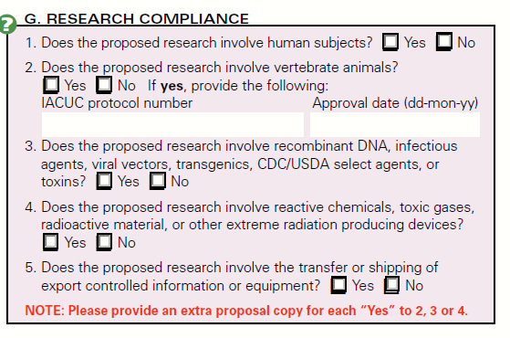
Office of Research Compliance
IRB
IACUC
IBC

Slide 6
Office of Research Compliance
Isabel (Junie) Hildebrandt
irb@Caltech.edu | ext. 4699 | irb.caltech.edu
Megan Hayashi
iacuc@Caltech.edu | ext. 8448| iacuc.caltech.edu
Kristen Abraham
ibc@Caltech.edu | ext. 6435 | ibc.caltech.edu
IRB
IACUC
IBC

Slide 7
Institutional Biosafety Committee
The IBC oversees any research involving the following:
  select agents and toxins;
  the use of human or non-human primate blood or other potentially infectious materials such as unfixed human tissues, primary and established human cell lines and other bodily fluids;
  experiments that use CRISPR/Cas9 technology;
  recombinant organisms administered to animals;
  human, animal, or plant pathogens;
  genetically modified animals and whole plants;
  Dual Use of Concern (DURC)

Slide 8

Institutional Biosafety Committee
If the research involves any of the above, a protocol needs to be in place or created.
If you are unsure if the research falls under the purview of the IBC, please ask!
The approval process may take a few months, so the sooner the IBC is contacted, the better.

Slide 9
Institutional Animal Care and Use Committee
The primary role of the IACUC is to ensure the ethical and humane care and use of animals in research, testing, and teaching.
The IACUC is responsible for oversight of the animal care and use program:
  Review, at least semi-annually, the institution’s program for the humane care and use of animals;
  Inspect, at least semi-annually, the institution’s animal facilities;
  Prepare reports to the Institutional Official (IO) of the IACUC evaluations;
  Review animal welfare concerns;
  Make recommendations to the IO on any aspect of the animal program, facilities, or personnel training;
  Review and approve, those components of PHS conducted or supported activities related to the care and use of animals;
  Review and approve, proposed significant changes to the use of animals in ongoing activities; and
  Authorized to suspend an activity involving animals.

Slide 10
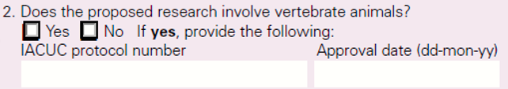
Institutional Animal Care and Use Committee
All research or teaching activities involving use of live vertebrate animals or tissues collected from such animals must hold an approved IACUC protocol.
The Approval Date should reflect the protocol’s 3 Year approval date, not the annual protocol review date. Only protocols with USDA covered species require annual approval.
If the YES box is checked, but no protocol number is listed, please send the full proposal to the IACUC office as soon as possible.
Even if animal work does not start until year 2 or 3 of a project, a fair amount of time may be required for an IACUC protocol to be approved.
Sending full proposals to the IACUC office once funding is awarded will help prevent congruency issues.

Slide 11
Single IRB Policy
Junie Hildebrandt
Research Compliance Administrator - IRB
Office of Research Compliance
isabelh@Caltech.edu OR irb@Caltech.edu x4699
Notes:
Means to increase efficiency of multi center studies?

Slide 12
What is the IRB, an IRB Protocol and sIRB?
The IRB approves, monitors, and provides advice on research involving human subjects to ensure the research is guided by ethical principles that protect the rights and safety of human subjects.
Caltech studies which involve human subjects are required to have an approved Caltech IRB protocol. This is also a requirement of all Federal sponsors, most private sponsors, and scientific journals for publication.
Before January 25, 2018 each participating institution in a multi-site NIH funded study could elect to have its own IRB review the study.
Notes:
Multiple IRB review Costly, and redundant (and sometime costs time)

Slide 13
As of January 25, 2018
Single IRB Policy for Multi-site Research
For NIH proposals or grants with due dates on or after January 25, 2018, and NIH contract solicitations published on or after January 25, 2018, NIH expects that all sites participating in multi-site studies, which involve non-exempt human subjects research funded by the NIH, will use a single Institutional Review Board (sIRB) to conduct the ethical review required for the protection of human subjects.
This policy is intended to enhance and streamline the process of IRB review and reduce inefficiencies so that research can proceed as expeditiously as possible without compromising ethical principles and protections for human research participants.

Slide 14
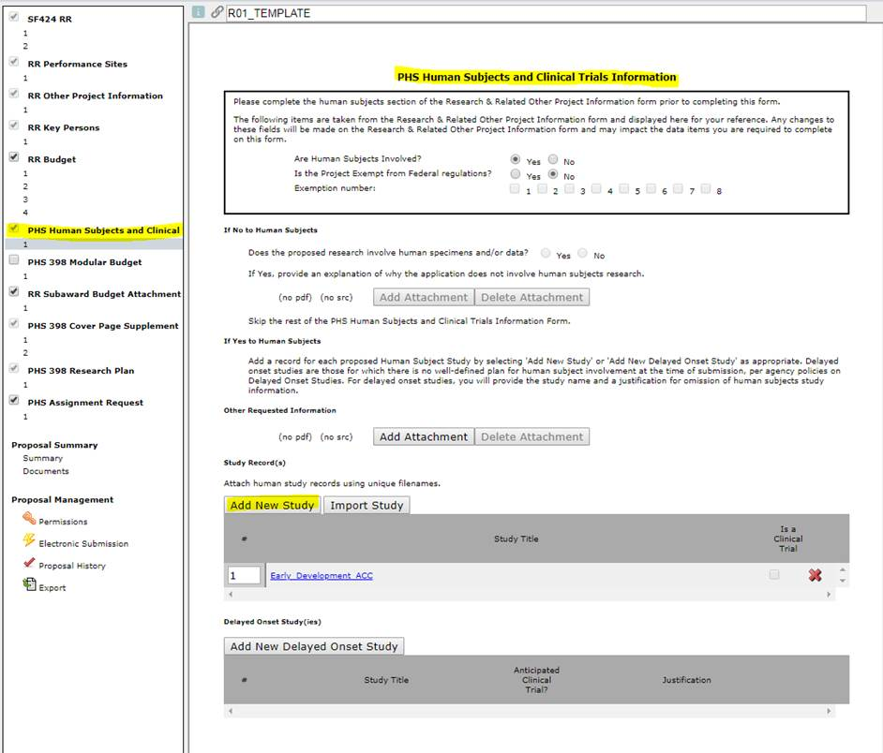
sIRB question in Cayuse for NIH Proposals
(example R01)

Slide 15
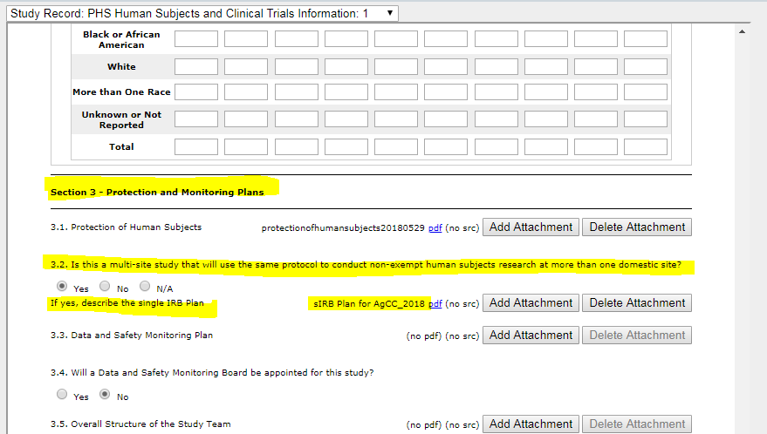

Slide 16
How Do We Comply?
Cooperative Research Agreements
  Reliance Agreements aka Institutional/IRB Authorization Agreements (IAA)
    Paper based agreements, negotiated and signed
  SMART IRB
    Online Platform - Master Reliance Agreement/Reciprocal IRB reliance model
How to determine the best plan for a PI to put in their protocol?
  Contact Junie!
  sIRB Plan Template!
Notes:
SMART IRB 416 institutions

Slide 17
sIRB Plan Template!
DIRECTIONS: This is a template sIRB plan for NIH Grant Applications. Before completing the “sIRB Plan” for submission with your NIH Grant, please consult with the IRB administrator in the Office of Research Compliance to determine if Caltech should be the Single IRB of record and which reliance option (IAA or SMART IRB) can be used for your study.
The IRB administrator will need to know the
  Who is the prime and who are the subawardee institution(s)
  The roles the different parties will play in the human subjects research
  The nature and risk of the human subjects research
  When the human subjects research will begin

Slide 18
Example of Text
Overview (Include this text in all grant proposals):
  We will comply with the NIH policy on the Use of sIRB for Multi-Site Research (NOT-OD-16-094) by designating a single IRB of record for all participating sites in this study. The participating sites involved will enter into CHOOSE: an individual authorization agreement (IAA) with (OTHER INSITUTION NAME(s)) OR will use the SMART IRB platform as (OTHER INSITUTION NAME(s)) and all other participating sites are members.

Slide 19
OPTIONS in the sIRB Plan
IRB of Record, Agreement Type, Roles
  Caltech is IRB of Record
  Other Institution is IRB of Record
  Meets the requirements for Delayed Onset
  Exemption for sIRB based on compelling justification
Record Keeping and Communication Plans
  Caltech sIRB of record and IAA used
  SMART IRB Used (regardless of sIRB of record)
  Other institution is sIRB of record
Notes:
Delayed Onset Human Subject Study: Human subjects research is anticipated within the period of award but definite plans for this involvement cannot be described in the application. All delayed onset studies must provide a justification explaining why human subjects study information is not available at the time of application.)
Note: If your human subjects study meets the agency definition of "Delayed Onset," include information regarding how the study will comply with the NIH single Institutional Review Board (sIRB) policy prior to initiating any multi-site study in the delayed onset study justification.
For Studies with Legal-, Regulatory-, or Policy-based Claims for Exception as described by the sIRB Policy: Indicate that review by an sIRB will not be possible for all or some sites (specify which sites) because local IRB review is required by an existing federal/state/tribal law or policy. Include a specific citation to the relevant law, policy, or regulation.
For sites requesting an exception based on compelling justification: Indicate which site(s) is requesting an exception to the use of the sIRB and provide compelling justification based on ethical or human subjects protection issues or other well-justified reasons. NIH will determine whether to grant an exception following an assessment of the need. Note: If you intend to request an exception to the sIRB policy based on compelling justification, do not account for this exception in your proposed budget. The proposed budget must reflect any necessary sIRB costs without an exception (i.e., applicants should not assume that an exception will be granted when considering what sIRB costs to include in the budget).

Slide 20
Questions?
Contact Junie at irb@caltech.edu
Thanks to
  Tiff Kim, HSS
  Lynn Paul and Ralph Adolphs

Slide 21

Office of Technology Transfer & Corporate Partnerships
(OTTCP)
Mary Beth Campbell
Research Administration Forum
June 28, 2018

Slide 22
Overview
Who Are We?
  History, Mission, Organization, Responsibilities
You May Remember Us From…
  Invention Disclosures & Bayh-Dole Compliance
  Funding Opportunities (Corporate & Internal)
  Corporate Gifts
Q&A

Slide 23
Who Are We?

Slide 24

A long time ago in a galaxy far far away…
Government Owns Inventions Made with Federal Funding
Universities Can Elect Ownership and Commercialize Inventions
In 1979, Government owned 28,000 patents, of which less than 10% were licensed
2000
2010

Slide 25
OTTCP’s Mission Statement
The primary mission of OTTCP is the transfer of Caltech's scientific and technical discoveries and inventions to the outside world, to maximize their benefit to society. We do this by developing partnerships with the commercial sector through the creation of new ventures, collaborations with corporations, and the transfer of intellectual property, while nurturing an entrepreneurial environment.

Slide 26
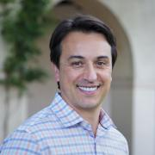
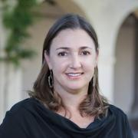
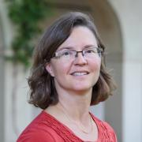
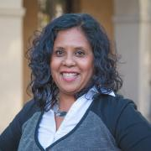
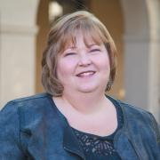
OTTCP Organization
Fred Farina
Chief Innovation and Corporate Partnerships Officer
Case Cortese
Director for Innovation, New Ventures & Entrepreneurship
Mary Beth Campbell
Director for Corporate Partnerships
Hannah Dvorak Carbone
Director for Innovation, Patents & Licensing
Melinda Bakarbessy
Manager, Patents & Licensing Administration
Becky Hernandez
Manager, Patents & Compliance Administration

Slide 27
Three Focus Areas
Patent Prosecution & Licensing
Including Invention Disclosures & Bayh-Dole Compliance!
Corporate Partnerships
Entrepreneurship Support
Including Industry Calls for Proposals & Corporate Gifts!
Including Supporting Innovation-Related Calls for Proposals!

Slide 28
The “Laundry List”
Non-core* items handled at least in part by OTTCP
Topic | Other offices involved
Non-disclosure agreements (NDAs) | OGC, Export Compliance
Industry-sponsored research agreements, including SBIRs/STTRs, master agreements | OSR
Facilities use agreements, technical services agreements | OSR
Foundation awards and master (e.g., HHMI, HMRI) agreements | Development, OSR, OGC
Subawards | Procurement
Patent policy, employee patent agreements, visiting scientist agreements | HR, OGC
Research management plans | Research Compliance
Patent litigation/enforcement | OGC
MoUs, consortium agreements, etc. | Divisions, Provost, President
Innovation funding programs (e.g, RI², Grubstake) | Provost
Non-software copyright matters (e.g., images, educational materials) | OGC
Contract close-outs and patent certifications | OSR, research labs
* “Core” items include options, licenses, strategic partnership agreements, corporate gifts, MTAs, IIAs, invention disclosures, patent filing/prosecution/maintenance, Bayh-Dole compliance, startup equity agreements, entrepreneurship programs

Slide 29
Invention Disclosures & Bayh-Dole Compliance

Slide 30
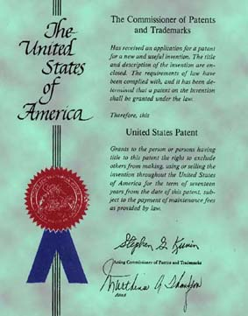

Disclosure & Patenting Process
Provisional patent filing
US
Conversion?
Scientists and engineers invent in research labs
Invention disclosures to OTTCP*
PCT
National phase entry?
Licensing to established and/or start-up companies
*At JPL, NTRs first reviewed by dedicated committee before provisional filing decisions made

Slide 31
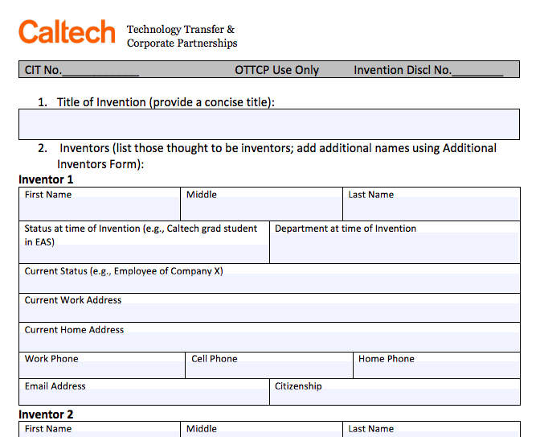
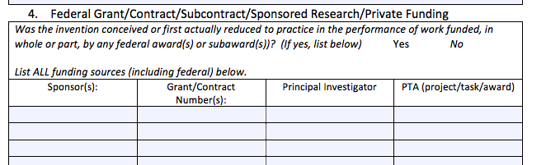
Invention Disclosure Form
Available at www.innovation.caltech.edu
>For Caltech Researchers
>Report an Invention/Discovery

Slide 32





Bayh-Dole Compliance
  Applies to all federally-funded research
  Reporting/compliance requirements
    Invention disclosures
    Election of title
    Government license
    iEdison reporting
    Federal Support Statements
    Offering rights back to agencies
    Utilization reporting

Slide 33

Interim/Final Reporting
CONTRACT
($) REPORTING
NIH Commons
NSF Fast Track
PAMS
EPIC
INTELLECTUAL PROPERTY (IP) REPORTING
iEdison
eNTR
Email
Snail Mail
PATENT CERTIFICATION
Regardless of who is completing and/or signing a Report an Invention/Patent Certification is needed from OTTCP
Invention/Patent Certification needs to be approved by the PI
Discrepancies need to be reconciled by OTTCP and approved by the PI

Slide 34
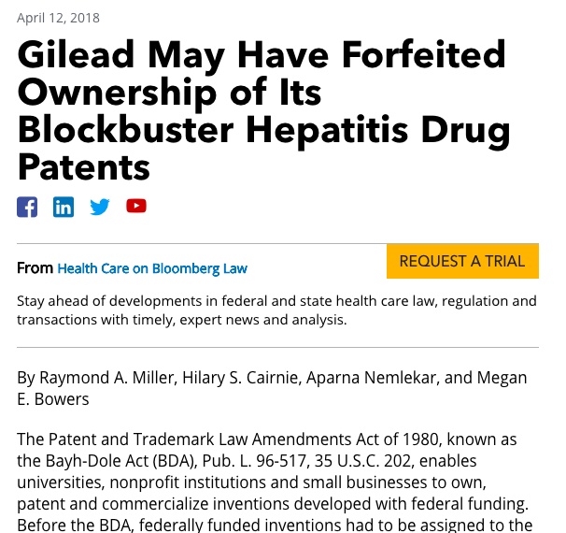
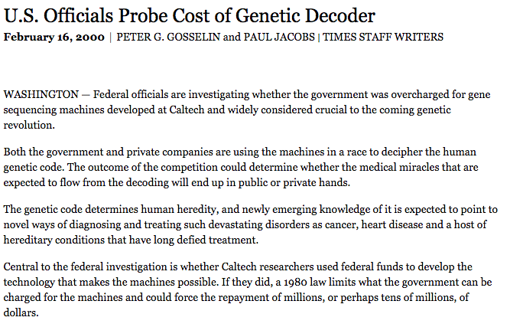
Does This Really Matter?
YES!!
Failure to properly report federal funding may jeopardize Caltech’s ownership of IP.

Slide 35
Innovation-Related & Corporate Funding Opportunities

Slide 36
Calls for Proposals
OTTCP sends out announcements for industry funding opportunities
  Some are for existing strategic partners (e.g. Amgen)
  Most are independent opportunities
  Often not clear if funding is gift or SR
OTTCP also supports the Provost’s office in administering the RI² call for proposals

Slide 37
Rothenberg Innovation Initiative (RI²)
Launched in 2009 with gift from Caltech trustee, Jim Rothenberg
Purpose: to support high-risk, high-reward big ideas that
  Wouldn’t be supported with federal funds because they’re too risky and/or translational
  Could produce transformative and disruptive technologies with practical applications in the marketplace
RFP usually announced in January with applications due end of February, awards made by May/June

Slide 38
Corporate Gifts

Slide 39
Some Context
Over past 15+ years, corporations have moved away from pure philanthropy towards seeking strategic engagements with a smaller number of universities:
Funding to universities closely aligned with mission and priorities of company
Corporations now expect a clear ROI
IP often plays a central role
Generally more complex, multi-component engagements, which can be difficult to implement as they require involvement of many different areas of university
For any questions about corporate gifts, contact us!

Slide 40
Conclusion
We try to be a “one-stop shop” for any Campus/Industry/IP issues
  Think of us any time you have an IP issue or may be engaging a company for funding or collaboration
Each faculty member on campus has a dedicated CP lead + a dedicated TT lead
Contact us with any questions!

Slide 41
Questions?

Slide 42

www.innovation.caltech.edu

Slide 43
Research Subcontracts in TechMart
Old system vs. New system
Grant Manager’s Process
Negotiator’s Process
Transition Period
Change orders/Modifications
Closeout
JPL Work Orders
System Demo
What the new system can do for you
Additional Resources

Slide 44





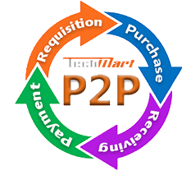
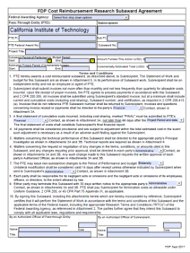

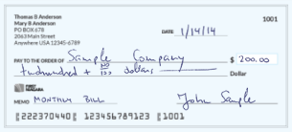
Old system vs. New system
??
??
RADR
FileBound

Slide 45

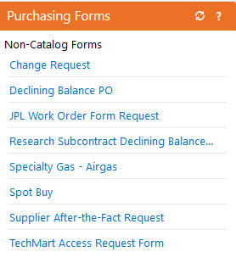






Grant Manager’s Process for Research Subcontracts
Initiate Research Subcontract Declining Balance Form
***
*** please contact Purchasing ***
for instructions
Grant Manager
2. Attach SOW, budget, prime
agreement, etc. to this form
Institution letters
Sponsor approvals
Award Summary
SOW
NSF
OSR
3. to forward request
to Purchasing Negotiator

Slide 46

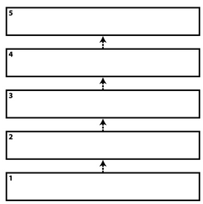

Negotiator’s Process for Research Subcontracts
Receive requisition
2. Create CCT in TechMart
Research Sub. Decl. Form
Requisition
CCT
Purchase Order
Invoices/payment
Grant Manager
Purchasing
3. Obtain internal approvals
4. Send Agreement to
Subrecipient
OGC
Assoc. VP Finance
Director
ORC
$$$
Sub
Assoc. Director
Contracting Manager
OSR
Negotiator

Slide 47
Transition Period
109-numbers
S-numbers
The Research Subcontract group will be converting all Oracle PO ‘109-’ numbers to TechMart ‘S-numbers’.
  Change will occur in the first of 2 scenarios:
    In 2018
      a Change Order is issued in TechMart
    In 2019
      If no Change Order request is issued by December 31, 2018, the Research Subcontract group will automatically convert the ‘109’ number to a TechMart ‘S-number.’

Slide 48
Change Orders/Modifications
Same process…(TechMart > Change Request > additional funds, NCE’s, term changes, etc. > Negotiator > internal approvals > mod to Sub)
  EXCEPT (transition subawards)
Old ‘109-’ numbers that will need new ‘S-numbers’ will
need to be initiated with the
‘Research Subcontract Declining Balance Form’
***
*** please contact Purchasing *** for instructions

Slide 49




Closeout Process
Invoices come in:
Grant Manager
review of invoices
AP
Approved for payment?
Final?
Not final?
Which PTA line to apply payment?
Not final
OK to pay PTA 1
Sub
Final
dual signatures (PI/GM)
OK to pay
PTA 1
Reports
AP/Disbursements
Purchasing
CLOSEOUT
AP
Sub

Slide 50
JPL Work Orders
Announcement
New JPL Work Orders will be initiated by the ‘JPL Work Order Form Request’ Form
***
*** please contact Purchasing *** for instructions
Please note: transition JPL Work Orders (109 to S-numbers) will occur on a case-by-case basis
? ? ?
109-numbers
S-numbers

Slide 51

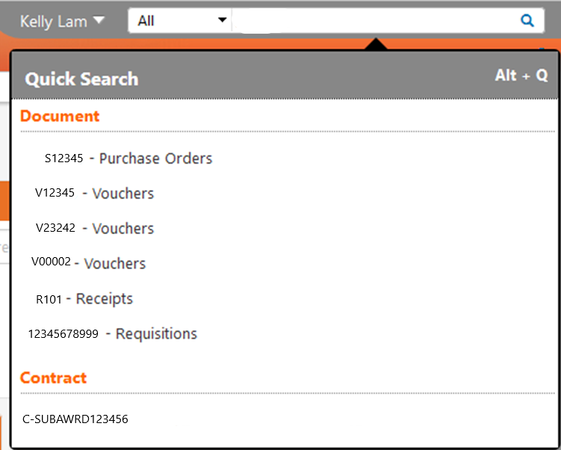

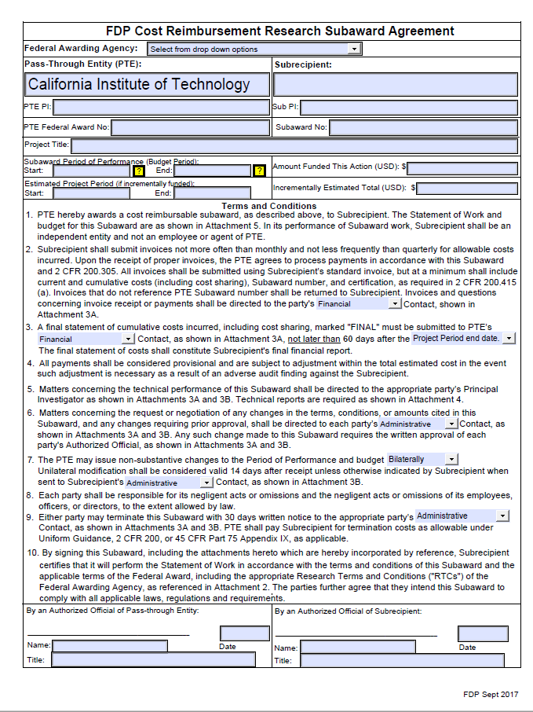
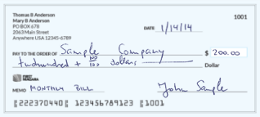

System Demo
1. Run a search in TechMart
2. Select from the various options associated with your search
Notice how all associated options are tied together in the search results?

Slide 52
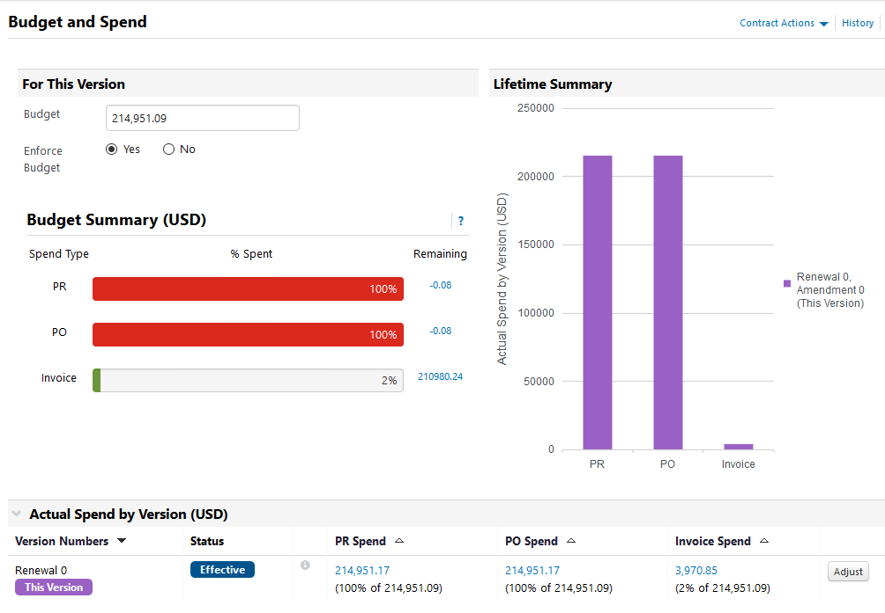

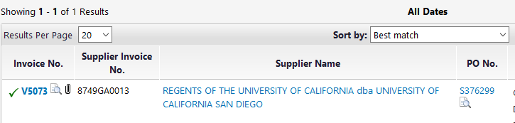
System Demo (cont’d)
3. Track your budget
4. Look for your paid invoice
5. Select the invoice you want to review

Slide 53
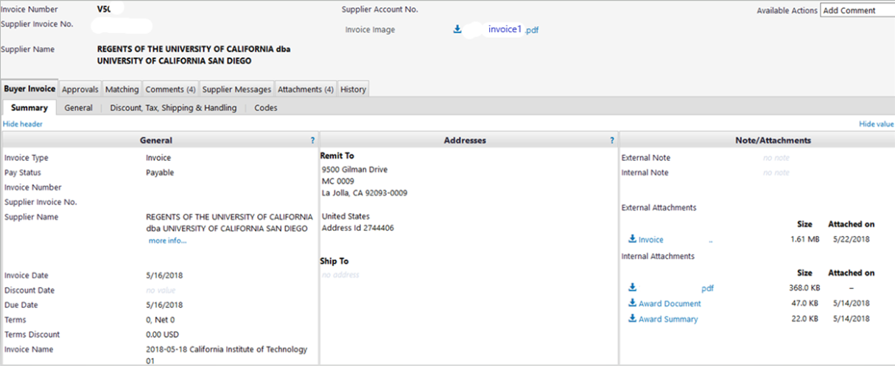
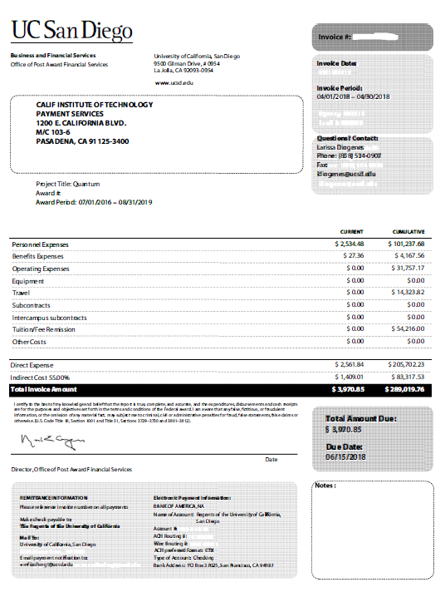
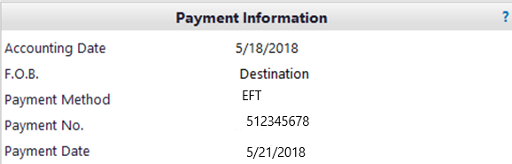

System Demo (cont’d)
6. Review invoice
7. Download invoice image
8. Check payment info

Slide 54
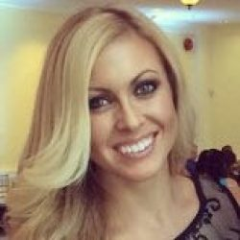
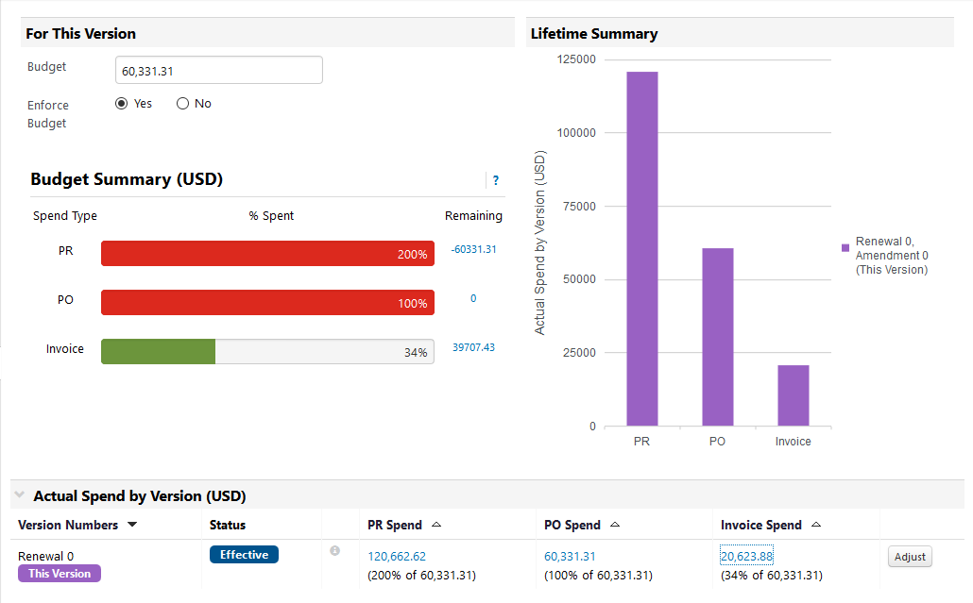

What the new system can do for you…
Genelle Vinci
Access subaward agreements
Monitor budget spending
Alert you to spending thresholds
Access and track requisitions, purchase orders, invoices and payments

Slide 55
Additional Resources
CCT training presentation: procurement.sites.caltech.edu/documents/1086/P2P_CCT_Training_Presentation_v1.pdf
http://procurement.sites.caltech.edu/p2p
P2P website
QUESTIONS?

Slide 56
Emeritus Faculty as PI – Process and Approvals
Mary Gibson, Associate Director
Office of Sponsored Research
Grant manager should submit a DAF with division chair approval/sponsor memo to the vice provost to request permission for the emeritus faculty to serve as a PI on the grant. The process is the same as for other non-professorial PIs.
Emeritus faculty do not have to receive salary to serve as PIs on grants.
Emeritus faculty may request to receive salary from grants. The request must be approved by both the division chair and the provost. The process to request salary on an external grant for emeritus faculty is for the division to submit a salary change recommendation form through the Faculty Records Office.
Emeritus faculty cannot be paid more than 49% of their last base salary rate.

Slide 57
Emeritus Faculty (cont.)
Emeritus faculty may not receive any salary for six months immediately following their retirement date.
Show the percentage of effort in the proposal for the emeritus faculty
If the emeritus faculty is proposing effort with no salary, include a statement in the Budget Justification the individual is emeritus faculty with no base salary.
Set up a ZOACS / cost share PTA as Mandatory Cost Sharing to track the effort rather than the salary.
Certify the effort in the same way you would for any other faculty member committing effort with no salary.

Slide 58
Reminder to check you are using the correct NIH forms
Reminder: FORMS-E Grant Application Forms & Instructions Must be Used for Due Dates On or After January 25, 2018
For those applying directly through Cayuse, the old form / new form issue should be resolved; however the wrong forms continue to be an issue for Caltech sub proposals to another university or research institution. Make sure you are not reusing old forms you may have previously downloaded to your desktop or shared drive. Pull the correct forms off Cayuse for use on sub proposal preparation.
Check and make sure you are using the correct Bio sketch form (check the expiration date in the margin of the form).

Slide 59
NIH Forms (cont.)
NIH Biosketch Forms are changing. Biosketches are required in both competing applications and progress reports. The current form expires 10/31/2018, and they may be used up to 10/31/2018. After 11/1/2018 you are required to submit the Biosketch form that shows an expiration date of 03/31/2020.
Find instructions, blank format pages, and sample biosketches at https://grants.nih.gov/grants/forms/biosketch.htm
Biosketches are required in both competing applications and progress reports. Try SciENcv, a tool supporting multiple research agencies, to help you develop your biosketch and automatically format it according to NIH requirements. https://www.ncbi.nlm.nih.gov/sciencv/

Slide 60
A Refresher on Effort Commitment in Proposals
David Mayo
Director, Office of Sponsored Research

Slide 61
Federal Policy
Office of Management and Budget:
  Federally-funded research programs should have some level of committed faculty effort. However, some types of research programs, such as programs for equipment and instrumentation, doctoral dissertations, and student augmentation, do not require committed faculty effort, paid or unpaid by the Federal Government.
  The budget justification should detail the rates of pay by individual for senior personnel, postdoctoral associates, and other professionals.

Slide 62
Caltech Audit
In 2006 an NSF IG audit found that Caltech was not compliant with the federal requirement
Corrective Action Plan – as its penance, Caltech promised that all proposals for federal funding would include:
  Committed effort for PIs/co-PIs (except for certain categories of project), and
  The rate of pay for all personnel charging time
NSF accepted Caltech’s corrective action plan…

Slide 63
Caltech Policy regarding proposals
In 2008 Caltech issued its policy: Commitment of Effort on Federally Sponsored Projects, effective with proposals submitted on or after April 1, 2008
Revised June 13, 2016 (current version)
  All PIs/co-PIs are required to commit effort in federal proposals
  Committed effort must be greater than zero
  Committed effort must be at a level necessary to carry out the project
  Committed effort must be budgeted, or PI must reimburse GB for unrecovered overhead

Slide 64
Per Caltech policy…
No effort commitment required for:
  Awards for instrumentation acquisition or development;
  Awards restricted by the sponsor for dissertation support, undergraduate or graduate student training, or other awards intended to provide student financial assistance;
  Limited purpose awards, such as travel grants or conference grants;
  Postdoctoral fellowship awards where a professorial faculty member serves in an advisory capacity.

Slide 65
Please NOTE
No penalty for cost sharing of PI/co-PI effort cost sharing when required by sponsor, for example:
  To meet a mandatory cost sharing requirement
  As a result of a sponsor-imposed limitation on charging of PI/co-PI salaries
Only the Provost may approve exceptions to Caltech’s policy
No one at Caltech has the authority to exempt a PI/co-PI from the federal requirement to commit effort in a federal proposal

Slide 66
Rate of Pay in Federal Proposals
Must be included for all individuals who will charge salary in the proposal budget
May be excluded from the budget IF the sponsor has a mechanism for addressing salary confidentially, but it must be included in the proposal at some point. The only two agencies who provide for confidential salary info are:
  NSF – may include salary rates in Single Copy Document section of proposal
  NIH – may be included with Just-in-Time submission

Slide 67
Thank you for coming!
Today’s slides will be available on our website:
http://researchadministration.caltech.edu/training

