Slide 1
Research Administration
Forum
March 19, 2019

Slide 2
Agenda
Postdocs as PIs – Dick Seligman
Postdoc Employment Status - Dick Seligman
Disclosure of Foreign Affiliations - Dick Seligman
Payroll Distribution Confirmation – Estella Venegas
Research Administration Website Update – David Mayo
Human Embryo and Stem Cell Committee – Grace Fisher-Adams
Procurement Services Advisory Board – Tina Lowenthal
Property Services Training for FY2019 – Ted Lieu

Slide 3
Postdocs as Principal Investigators
Policy Clarification: Postdocs can serve as PIs, as long as
A professorial faculty member agrees to be a mentor
The Division Chair approves
The Vice Provost for Research approves
There are no graduate students employed on the project.
There are no other postdocs employed on the project
There is a plan for what happens if the postdoc’s appointment ends before the project ends

Slide 4
Postdocs’ Employment Status and Compensation
Effective October 1, 2019, Postdoctoral Scholars and Senior Postdoctoral Scholars will have a minimum salary of $54,080
Effective October 1, 2020, most Postdocs will be classified as exempt employees and eligible for staff benefits
Minimum salaries have been established for
2021, $58,240
2022, $62,400

Slide 5
Disclosure of Foreign Affiliations
Recent concern on the part of Congress and several Federal agencies has been focused on foreign influence on research and intellectual property.
Issues of concern:
Failure of investigators to disclose financial interests in foreign companies that are involved in areas related to their research
Failure of investigators to disclose research support received from foreign entities for work that is similar to the work for which they are seeking Federal grant support.
  Possible overlap in scopes of work
  Time commitments

Slide 6
Payroll Distribution Confirmations – Estella Venegas
DUE: Monday, March 25th!!!

Slide 7
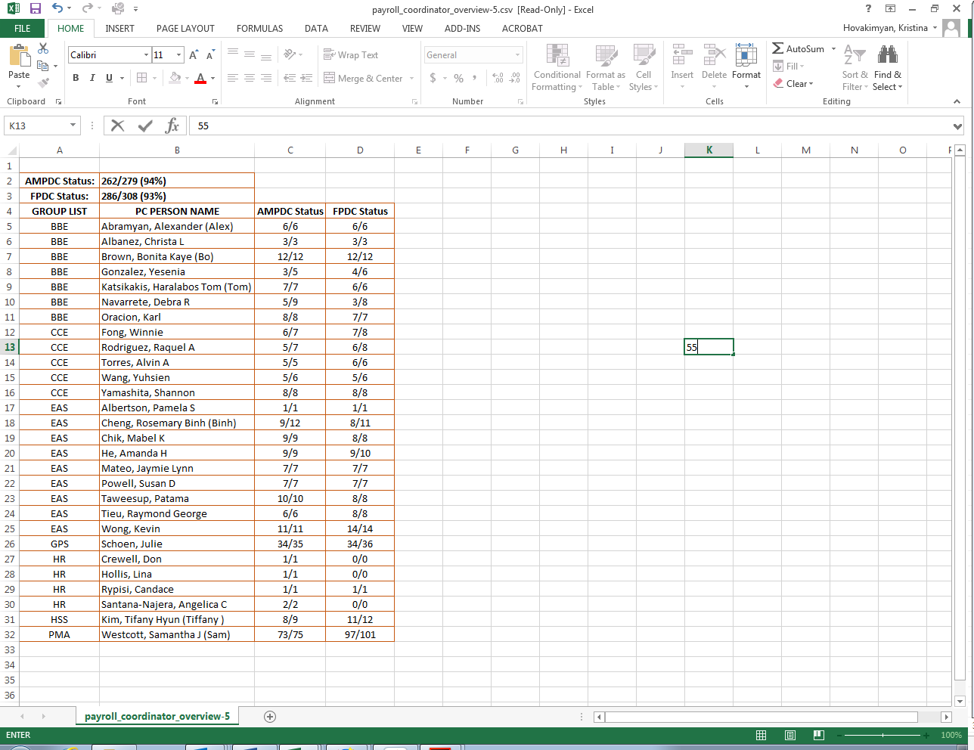
Award Manager and Faculty PDC Status

Slide 8
PDC Help/Questions:
PDC FAQs: http://finance.caltech.edu/pa/faq
Lisa Frenchie: lisa.frenchie@caltech.edu Ext.3595
Kristina Hovakimyan: kristina.hovakimyan@caltech.edu Ext.2880
Paulina Perez: paulina.perez@caltech.edu Ext.2382

Slide 9
Changes to OSR Website – David Mayo
About
  Research Administration Overview
  Sponsored Research Activity
Policies & Procedures
  Notices & Clarifications
  Roles & Responsibilities
  Faculty Handbook
  NCURA Regulation & Compliance Compendium

Slide 10
Revisiting Box G on the DAF
Grace Fisher-Adams
Director, Office of Research Compliance

Slide 11
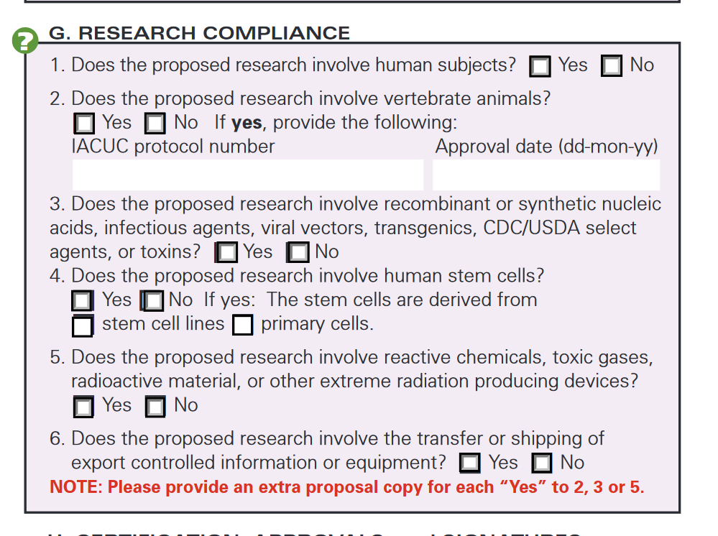
Revisiting Box G on the DAF
Human Subjects: IRB [Protocol #] and maybe HESC
Vertebrate Animals: IACUC [Protocol #]
Recombinant or Synthetic Nucleic Acids, etc.: IBC
Human Stem Cells: HESC
Chemicals, Radioactive, etc: Radiation Safety Committee, and/or EHS
Export: OEC

Slide 12
Human Embryos & Stem Cells (HESC)
Relevant Regulations/Guidance
CIRM Medical and Scientific Accountability
CIRM Grantee Regulations Stem Cell Research
CA Use of Human Cells
CA Human Cloning
CA Abortion Laws
Dickey-Wicker Amendment 1996
NIH Guidelines for Research Using Human Stem Cells
National Academies' Guidelines for Human Embryonic Stem Cell Research
International Society for Stem Cell Research Guidelines for Stem Cell Research and Clinical Translation

Slide 13
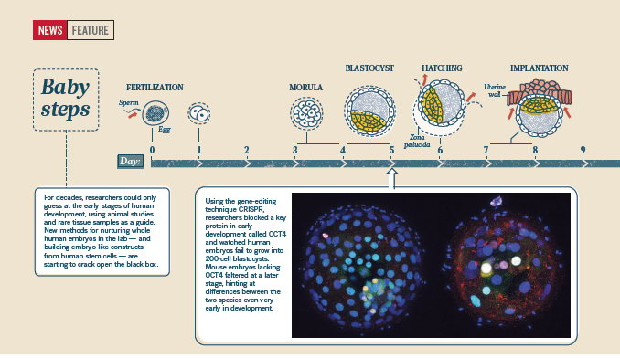
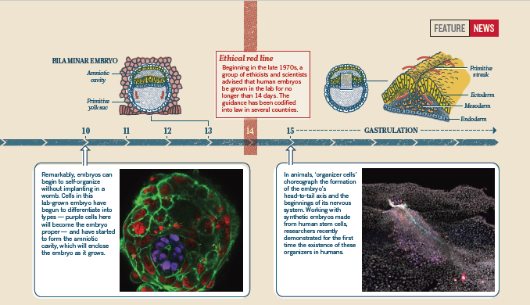
Human Development/Ethics
CIRM Funding: 12 Days/Primitive Streak
ISSCR: 14 Days/Primitive Streak
New Field: Embryogenesis Models (No Regulations or Guidance as of Yet)

Slide 14
Administrative Committee on the Use of Human Embryos and Stem Cells
Fills the role of Stem Cell Research Oversight (SCRO) required by certain laws and guidance
Performs Ethics Review Strongly Recommended by Ethical Guidance

Slide 15
Back to the DAF
X
X
X

Slide 16
So #1 and #4 are Checked. Or maybe not…
Now What?
Identifying HESC Research
  Human Stem Cell Lines (NIH Approved or Not) vs. Primary Cells
  Embryos: Defined differently (Can be early cellular stages, up to 9 weeks post fertilization)
  hESC: Human Embryonic Stem Cells: Cells arising from embryo (morula or blastula)
  iPSC: Induced pluripotent Stem Cells: Cells derived from somatic (or other cells) through the introduction of external genes
  Embryogenesis Models using Human Tissues/Cells
Sponsors
  CIRM (California Institute of Regenerative Medicine)
Appropriate Caltech Review and Approval: IRB and HESC Committees

Slide 17
Procurement Advisory Group – Tina Lowenthal
Goal – Connect key Campus customers with Procurement Services management to resolve challenges and identify opportunities
PAG Members
Quarterly meetings
Kimberly Baker-Gatchalian | Jonathan Gross | Doris Shimabukuro
Elisa Brink | Tiffany Kim | Sheri Stoll
Tuyen Dang | Welby Lai | Sue Zindle
Manny De La Torre | Ling Lin
Loly Ekmekjian | Debby Miles
Sarah Gordon | Katie Pichotta

Slide 18
Property Services Training
for FY2019 – Ted Lieu

Slide 19
Property Services Training Topics
Equipment Inventory Process (2 Sessions)
Equipment Tracking System (2 Sessions)
Equipment Disposal Certification Process (1 Sessions)
Accounting for Capital Equipment (2 Sessions)

Slide 20
Equipment Inventory Process
Beginning new inventory process now
Pilot Program: Two Divisions will be doing their own inventory and scanning of their equipment and providing the scanners to PS to upload into Fixed Asset System
Changes in the treatment of “Not Found” equipment
  Will not be retiring Not Found equipment, but instead will change status to “Inactive”
  Inactive status
    Depreciation or gains & losses will still be reflected in Financial Statements, but not claimed in the F&A process
    Will continue to be included in future inventories until it is fully depreciated
    Once fully depreciated, the department can request the asset to be retired through the new Equipment Disposal Certification (EDC) process
    Status can be changed to “active” once equipment is found, and has been or will be in use

Slide 21
Equipment Tracking System (ETS) Tool
Provide demonstration and training on how to use the ETS tool
  Created by IMSS to allow Campus users to view information about their equipment
  The source of information in ETS is from the ORACLE Fixed Assets
  Useful in supporting the equipment inventory process
  ETS can include
    Photos and other images
    Include comments about the equipment
    Requests to change record information or equipment status
  Hoping in the future, ETS can be improved to include some automation for supporting the EDC process

Slide 22
Equipment Disposal Certification (EDC)Process
FY14-15 F&A ICP Audit Finding
  DCAA discovered cases where there were inconsistencies between retirement/disposal information supplied on retirement request forms and what actually ended up happening with the equipment.
  CIT had to change the retirement/disposal process to ensure consistency between how equipment was processed is consistent with the manner in how the equipment was actually disposed/retired.
  Equipment Disposal Certification (EDC) Process
    Certification language
    Having the appropriate person certifying
    Providing appropriate supporting documentation as evidence of how the equipment was disposed or retired

Slide 23
Accounting for Capital Equipment
Most Common Equipment Expenditure Types
Types of Transactions & Support Documentation
Equipment Definitions
Equipment Ownership
Selecting the Correct Equipment Expenditure Types
Fabrications vs. Deliverables
Equipment Upgrades vs. Repairs and Maintenance
Equipment Leases vs. Rental of Equipment
Microelectronic Chips
Supplies and Other Internal Charges

Slide 24
Contact Property Services
(Ernest Katacha (x4181 ) or Ted Lieu (x2579)
Acquiring new equipment
Correcting or changing record information in ORACLE Fixed Asset
Moving equipment to another location (between buildings, or site)
Internal or external transfer of equipment ownership
Equipment upgrades vs. repairs
Establishing a equipment fabrication project
Selling, trading, donating, e-wasting, cannibalizing, or retiring equipment
Activating or Inactivating equipment in Fixed Assets
Any other issue or questions regarding the accounting or administrative management of capital equipment

