Slide 1
Research Administration
Forum
October 2, 2019

Slide 2
Agenda
Foreign Influence on Sponsored Research Projects – Dick Seligman
Foreign Persons on Research Projects – Adilia Koch
New Tool from Foundation Relations – Lauren Limbert
Simons Foundation – Rochelle Athey
SciENcv and ORCID – Mary Gibson
Minimum Wage & Employment Status of Postdocs – Mary Gibson
Update on Interdivisional Authorizations (IAs) – Mary Gibson
Allowability of Travel & Relocation Costs – Mary Gibson
NIH/RPPR Requirements – Mary Gibson
Procurement Services Updates – Tina Lowenthal & Kelly Lam-Tickle

Slide 3
Foreign Influence – Dick Seligman
What are the issues?
National Security, including diversion of intellectual property
Integrity of the Peer Review System
Transparency Regarding Investigators’ Activities and Commitments (failure to fully disclose relevant information)
Recognition of the Benefits to the United States of collaboration with foreign researchers and graduate students

Slide 4
Foreign Influence (cont.)
Disclosure of Foreign Affiliations
Appointments at Foreign Institutions
Funds received from foreign entities, including universities, research organizations, and companies
Other Outside Professional Activities
Visiting Researchers in the laboratory
In-Kind Support: Goods and services received from foreign entities
Foreign components on research projects

Slide 5
Foreign Influence (cont.)
What are federal agencies doing?
Reassessing their policies, procedures, and requirements for information to be included in grant applications
Redesigning forms for Current and Pending Support and Other Support
Clarifying requirements as to what must be included in grant applications
What is Caltech doing?
Institute Working Group

Slide 6
Foreign Influence (cont.)
What should you do?
Be aware of changing requirements on the part of funding agencies
Assist investigators in understanding the requirements, both the current requirements and new requirements as they are implemented
Know where to direct questions or seek additional information
  Division Chairs and Division Administrators
  Office of Research Compliance
  Office of Sponsored Research
  Vice Provost for Research
  Office of the General Counsel

Slide 7
Caltech
Foreign Person
Questionnaire
Adilia F. Koch
Director of Export Compliance

Slide 8
Caltech Foreign Person Questionnaire (FPQ)
Purpose:
U.S. export laws control the conditions under which certain commodities and technologies can be transmitted to Foreign Persons.
What is the purpose of an FPQ form?
The Caltech Export Compliance Office (CEC) uses the FPQ to determine whether the Foreign Persons working on controlled projects will need an export license or other requirements; review to determine if the foreign person is subject to NASA-funding restriction.
Where can I get the form?
From our website: http://export.caltech.edu/forms/

Slide 9
NASA-Funding Restriction with PRC (China)
Public Law 112-10, effective April 25, 2011
NASA is restricted from using funding to participate, collaborate or coordinate bilaterally in any way with China or any Chinese-owned company, at the prime contract or any tier subcontract level.
Accordingly, contracting officers shall make no awards to China or Chinese-owned companies with funds appropriated by the Acts or any funds appropriated subsequent to the Acts. This policy applies to all contracts except those for commercial and non-developmental items.
The restrictions of the Acts and this policy neither limit nor prohibit the purchase of commercial or non-developmental items.
“China” or “Chinese-owned Company” means the People’s Republic of China, any company owned by the People’s Republic of China or any company incorporated under the laws of the People’s Republic of China.

Slide 10
When is a Foreign Person Questionnaire required?
 | Analysis |  | Funding Sources
1 | What is the Funding Source? |  | JPL Interdivisional Authorizations |  | NASA Projects |  | Other Funding Sources
2 | Is there Foreign Person participation? |  | China (PRC) | Other | China (PRC) | Other | Any
3 | Is the Project Export Controlled? | Yes | FPQ Required | FPQ Required | FPQ Required | FPQ Required | FPQ Required
 |  | No | FPQ Required | FPQ Not Required | FPQ Required | FPQ Not Required | FPQ Not Required
This information will be posted on our website: http://export.caltech.edu/

Slide 11
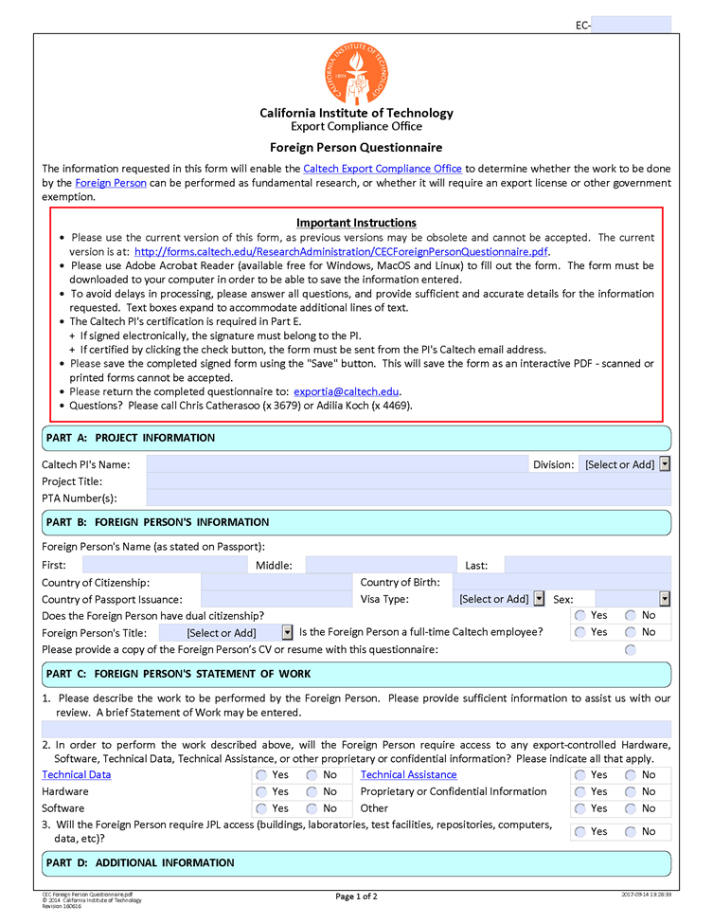
FPQ screenshot

Slide 12
FPQ screenshot (continued)

Slide 13
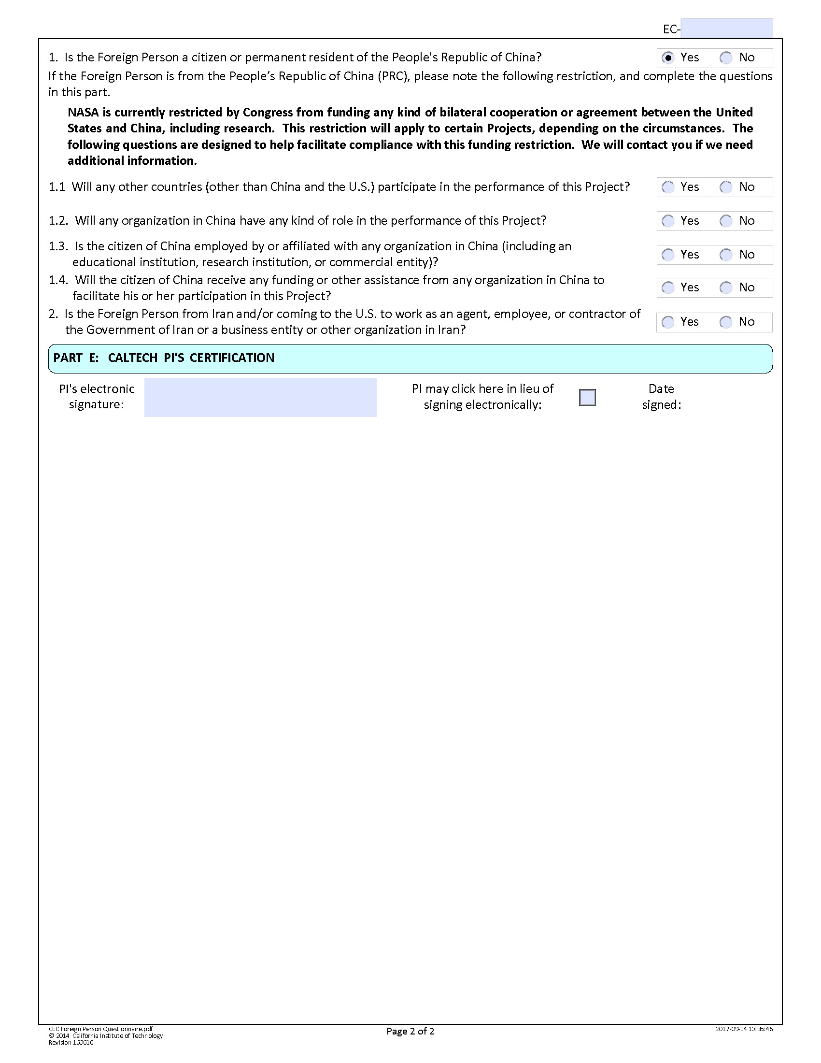
FPQ NASA-China questions

Slide 14
Resources
  Telephone: (626) 395-2641
  Email: export@caltech.edu
  Webpage: http://export.caltech.edu/
  FPQ form location: http://export.caltech.edu/forms/
  NASA-China Information Circular:
  https://www.hq.nasa.gov/office/procurement/regs/pic12-01A.html

Slide 15
NASA-Funding Restriction with PRC (China)
1852.225-71 Restriction on Funding Activity with China.
(a) Definition - “China” or “Chinese-owned company” means the People’s Republic of China, any company owned by the People’s Republic of China or any company incorporated under the laws of the People’s Republic of China.
(b) Public Laws 112-10, Section 1340(a) and 112-55, Section 539, restrict NASA from contracting to participate, collaborate, coordinate bilaterally in any way with China or a Chinese-owned company using funds appropriated on or after April 25, 2011. Contracts for commercial and non developmental items are exempted from the prohibition because they constitute purchase of goods or services that would not involve participation, collaboration, or coordination between the parties.
(c) This contract may use restricted funding that was appropriated on or after April 25, 2011. The contractor shall not contract with China or Chinese-owned companies for any effort related to this contract except for acquisition of commercial and non-developmental items. If the contractor anticipates making an award to China or Chinese-owned companies, the contractor must contact the contracting officer to determine if funding on this contract can be used for that purpose.

Slide 16

Contact us: export@caltech.edu

Slide 17
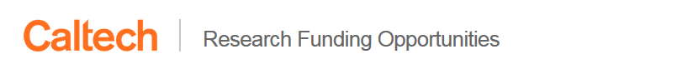
Collaboration between Foundation Relations, OTTCP, Office of the Provost, and IMSS
Web-based database of RFP opportunities
  Replace email-based RFP memo circulation
Enable researchers & staff to search, sort, and filter current and historical opportunities based on a variety of dimensions and keywords
  Open access to all opportunities for all of campus, clarity on cognizant office
Custom subscription service
  Ability for delegates to create subscriptions on behalf of their delegator

Slide 18
What isn’t changing:
  Campus cognizant offices
  Required Internal Documentation
    MORA
    DAF
    PI Eligibility Sponsor Memo, if applicable
  Foundation Relations services:
    administrative support
    liaising between campus and funder
    editing proposal narratives
    reporting & stewardship support

Slide 19
Types of Opportunities in the database:
  All OPEN calls currently released by Foundation Relations
  OTTCP opportunities
  Internal Caltech Opportunities
    e.g., Caltech/City of Hope Pilot Grants, Rothenberg Innovation Initiative
  Federal Limited Opportunities
What’s not in the database:
  Open Federal Opportunities

Slide 20
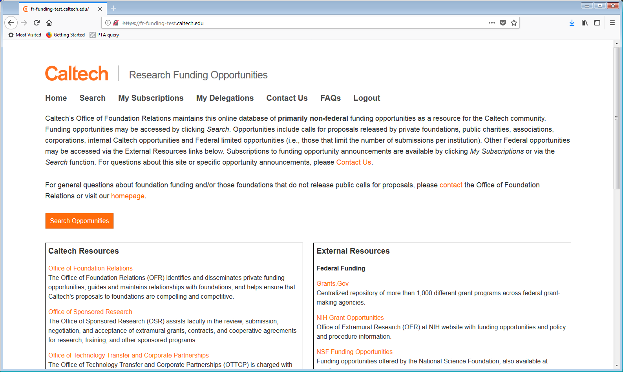

Slide 21
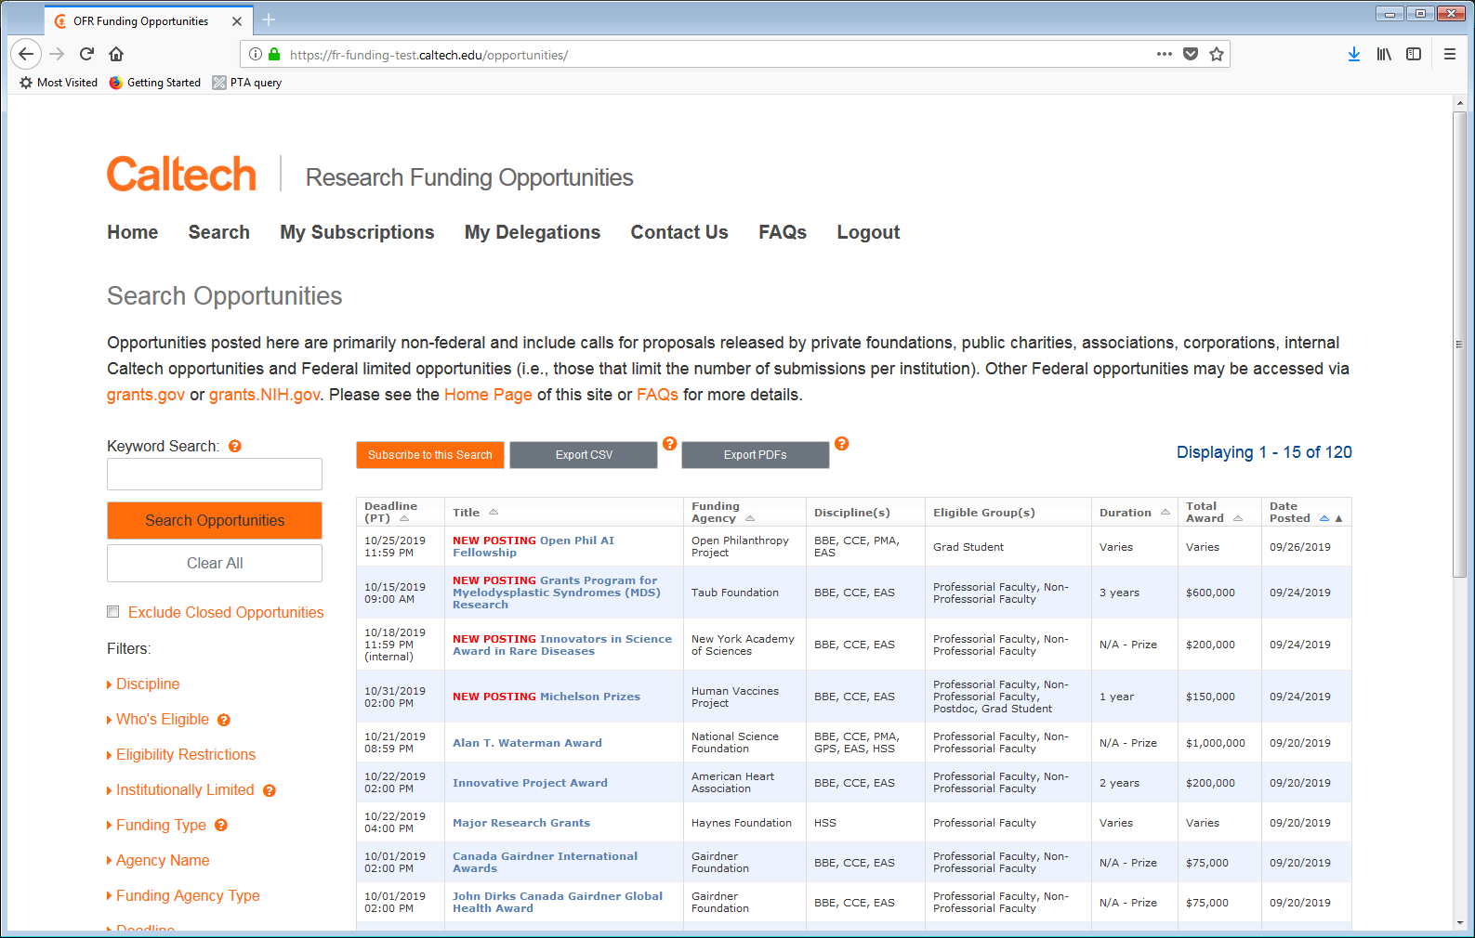

Slide 22
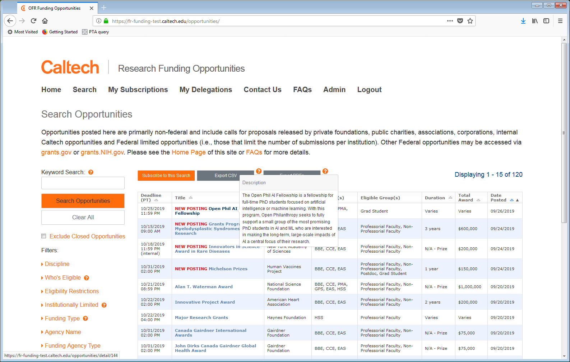


Slide 23
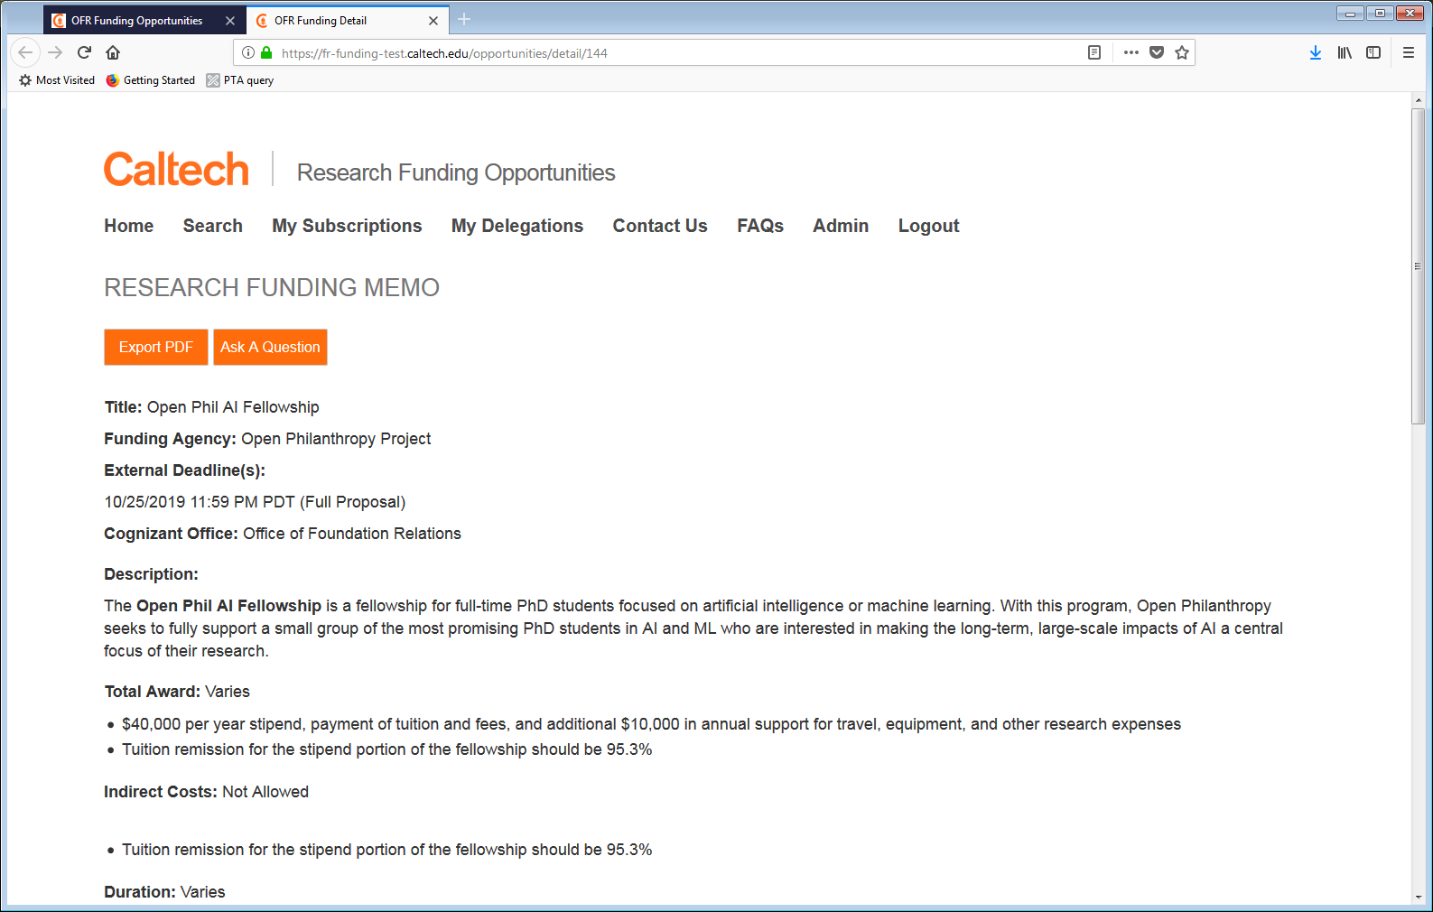
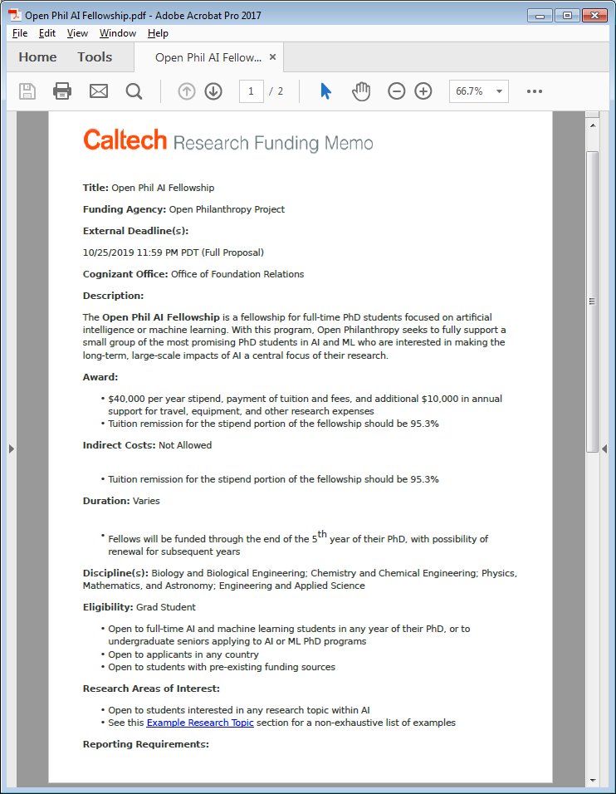

Slide 24
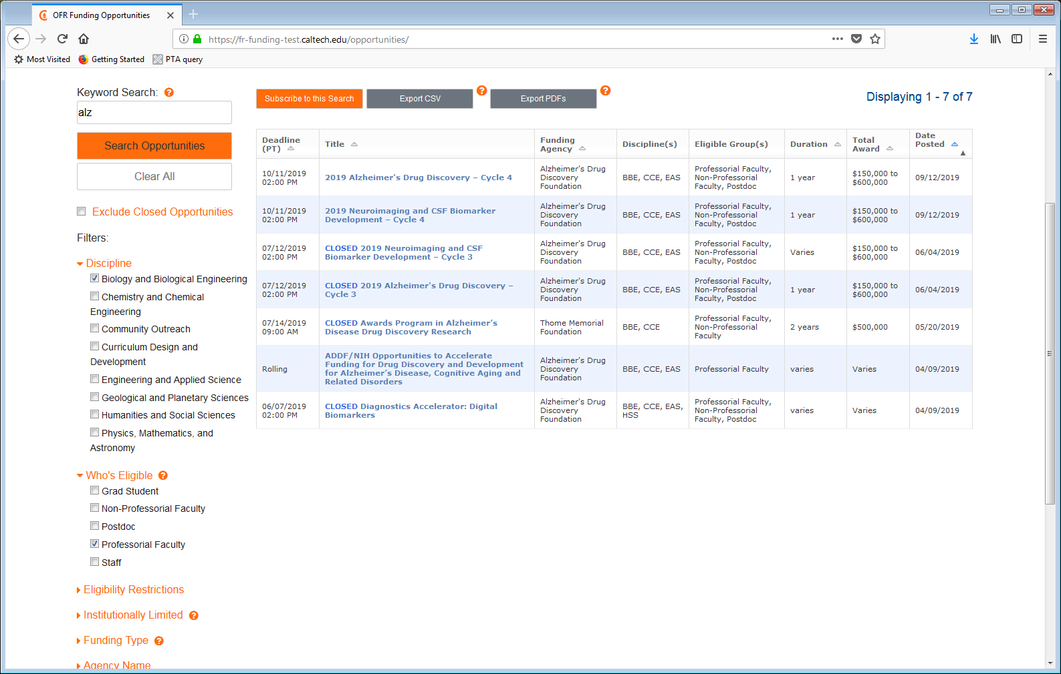
Filters

Slide 25
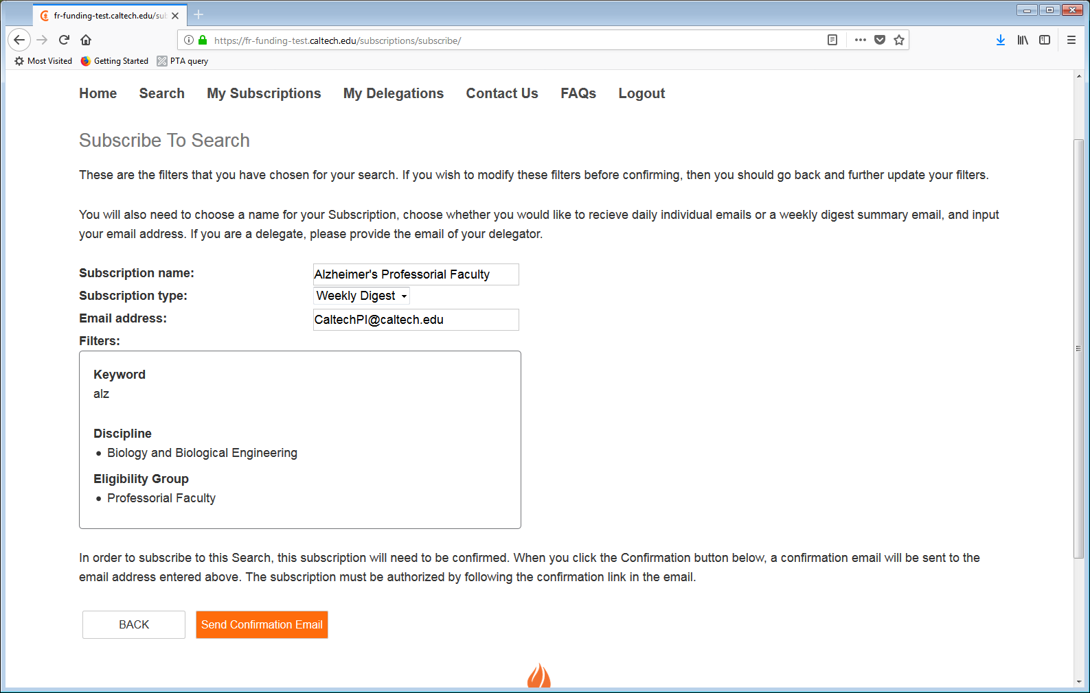
By entering an email address other than your own, the recipient will receive a confirmation email asking them to
1) confirm you as a delegate and 2) confirm the subscription

Slide 26
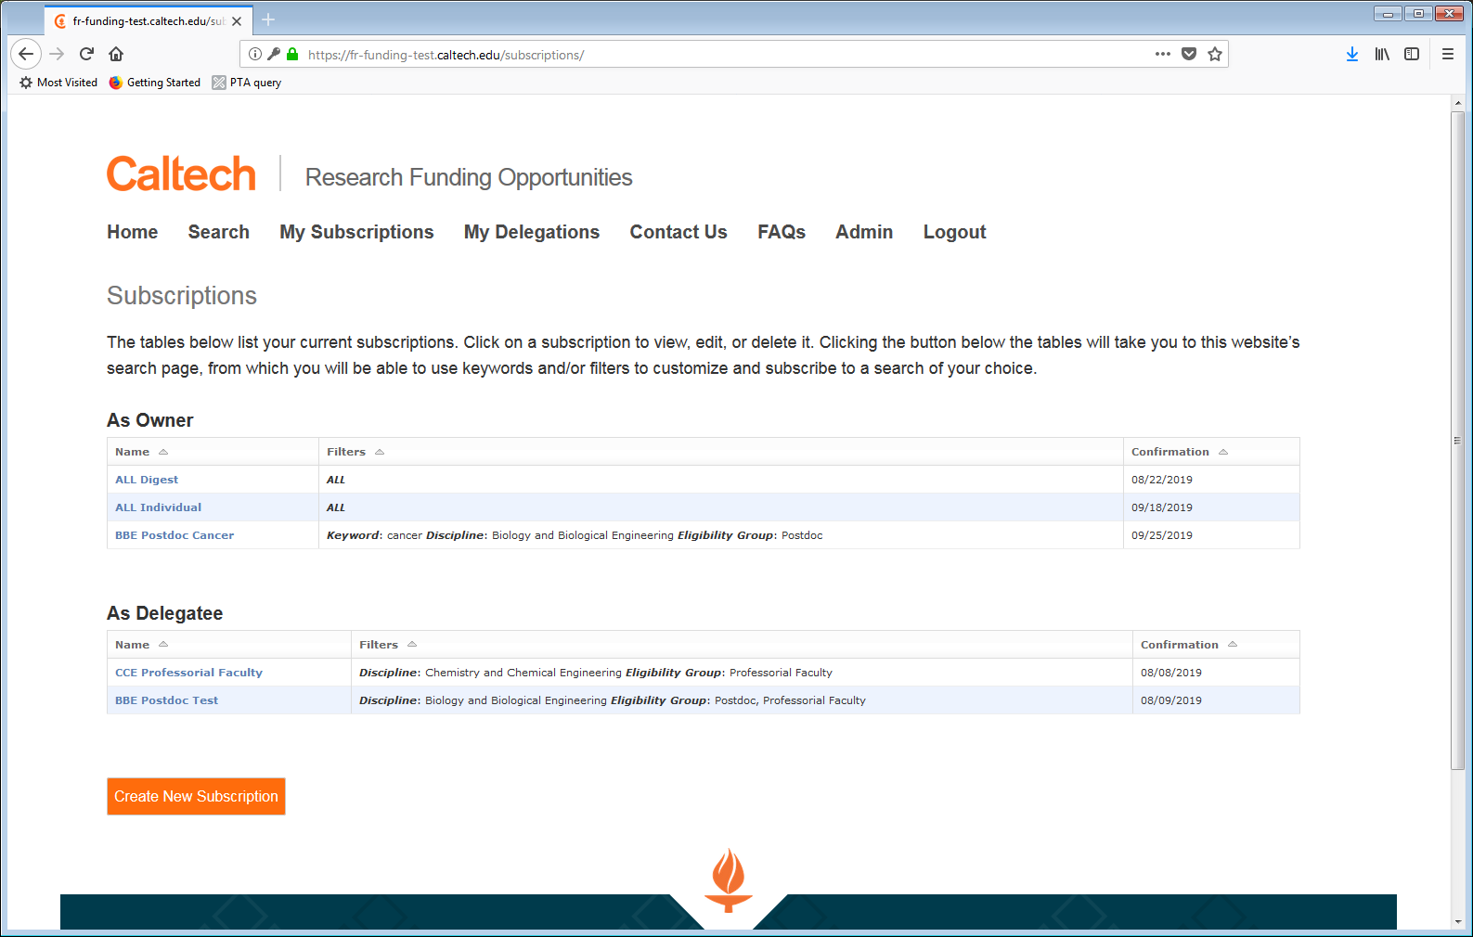

Slide 27
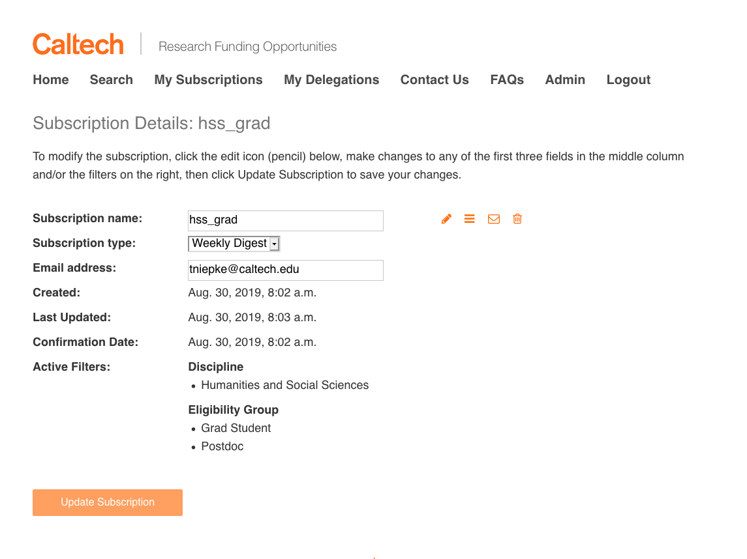

Slide 28
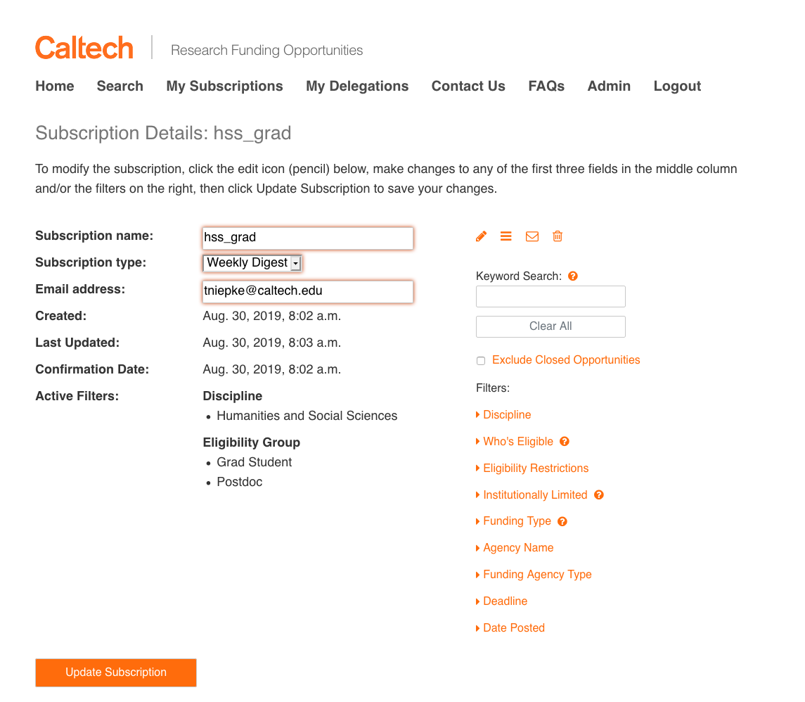

Slide 29
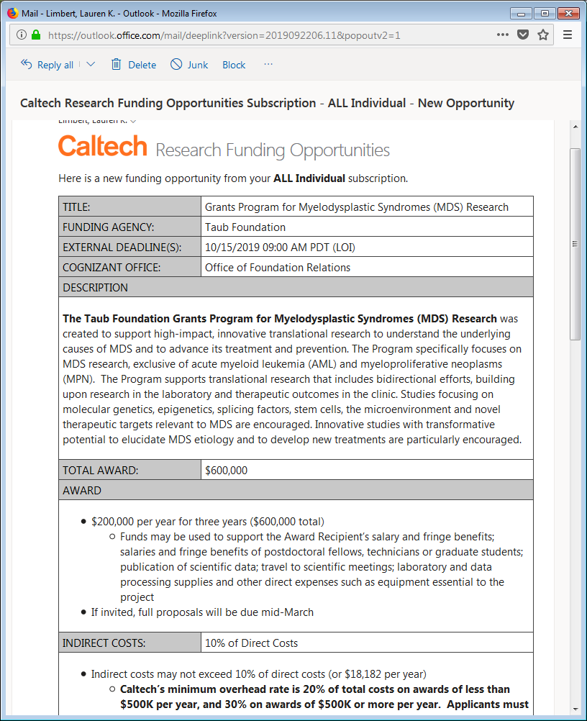
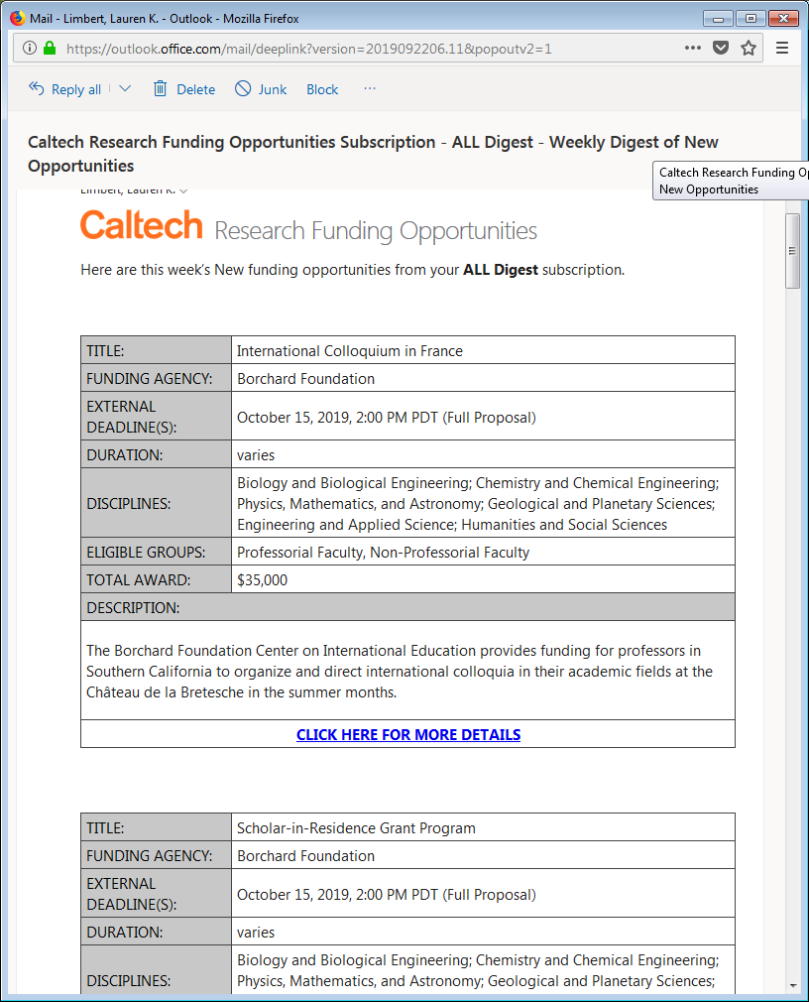

Slide 30
Go-Live: FY20 Q1
Questions?
  Contact Lauren Limbert
  llimbert@Caltech.edu
  x3258

Slide 31
Simons Foundation – Rochelle Athey

Slide 32
Mary Gibson – Associate Director, Office of Sponsored Research

Slide 33
Foreign Travel Relocation Costs Allowability
A reminder that incoming foreign travel for the purpose of “relocation” to Caltech is allowable on federal awards as “relocation costs” under the Other Direct Costs category if the individual is employed here for 12 months or more.
Return travel is not allowable on a federal award and should be paid out of discretionary, general budget or endowment funds; but not with federal funding.
2 CFR 200.463 and .464:
https://www.govinfo.gov/content/pkg/CFR-2014-title2-vol1/pdf/CFR-2014-title2-vol1-sec200-464.pdf
Travel Costs 2 CRF 200.474
https://www.govinfo.gov/app/details/CFR-2014-title2-vol1/CFR-2014-title2-vol1-sec200-474
This applies to all federal award funding including JPL IAs.

Slide 34
Budget Reminder – Postdoctoral Salaries
A reminder if you review budgets postdocs submit for fellowships or you include postdoc salaries on sponsored research proposal submissions.

Slide 35
ORCID iD
ORCID stands for Open Researcher and Contributor ID.
This is a unique personal digital identifier that distinguishes every researcher.
Eventually the ID will link to an eRA Commons account and other sponsor systems.
Starting in October 2019, ORCID iDs will be required for new appointees to institutional training grants and other awards who make appointments through xTrain.
When a 2271 appointment form is submitted for Training and Institutional K awards, eRA systems will check to ensure that the ORCID iD is present in the Personal Profile associated with the Commons IDs listed in the form. Starting this month, an error will be issued if the ORCID iD is not present, and the error must be cleared to successfully submit the new appointment.
How do you get an ORCID iD? Log into eRA Commons, go to Personal Profile. Just under your name and your listed eRA Commons roles, you will find a link to create your ORCID iD. https://era.nih.gov/erahelp/commons/#cshid=42
Following that link to ORCID.org, https://orcid.org/ you will be able to register and link your Commons account to your ID. See steps and screenshots in the ORCID topic in the eRA Commons online help.
For more information, see Guide Notice NOT-OD-19-109.

Slide 36
Science Experts Network Curriculum Vitae
SciENcv
SciENcv, is an NIH tool supporting multiple research agencies, to help researchers develop their biosketch and automatically format it according to NIH requirements. https://www.ncbi.nlm.nih.gov/sciencv/
National Science Foundation (NSF) has designated SciENcv as an NSF-approved format for submission of biosketches and is encouraging its use to prepare a biosketch for inclusion in proposals to NSF.
The current Proposal & Award Policies & Procedures Guide (PAPPG) (NSF 19-1), requires a biosketch for each individual identified as senior personnel on a proposal, and a separate biosketch PDF file, or other NSF-approved format, must be uploaded in FastLane for each designated individual. The biosketch and file format requirements also apply to NSF proposals submitted through Research.gov and Grants.gov.
Beginning with 2020 PAPPG, NSF will only accept PDFs for biosketches that are generated through use of an NSF-approved format. A description of NSF-approved format(s) will be posted on the NSF website when the PAPPG is issued.
Multiple training resources are available on the SciENcv website and https://www.youtube.com/watch?v=PRWy-3GXhtU&feature=youtu.be

Slide 37
Changes to IAMS Information and IAs
A quick reminder to campus that your access to IAMS is linked to your campus e-mail address. You need to notify Mary Gibson if your e-mail address changes and you are registered as an IAMS user. Note that once you change your e-mail address you will lose access to IAMS and Mary and JPL will work to reassign your open tasks to your new e-mail address. Once you are re-reregistered in IAMS with your new e-mail address, you will lose all access to your past work in IAMS.
In the fall JPL and OSR will roll out a Terms and Conditions attachment to your IA Orders and the language in the Summary for Terms and Conditions will be revised but the terms themselves will be substantially what you received now form OSR.
IAMS information will be updated in FY20 on the OSR IAMS page http://researchadministration.caltech.edu/osr/IAMS
  Updated forms
  Updated Quick Start guide
  Updated IAMS Procedures Manual.
  Updated contacts

Slide 38
NIH/RPPR Requirements as of October 1, 2019
Use of the xTRACT system in the eRA Commons is required as of October 1 to prepare the required data tables for Research Performance Progress Reports (RPPRs) for pre- and post-doctoral research training grants.
Recipients must create the required training data tables for submission with NIH and AHRQ T15, T32, T90/R90, and TL1 progress reports via the xTRACT system.
To submit the Research Performance Progress Report (RPPR), the training tables must be completed and finalized in xTRACT. Once the tables are finalized in xTRACT, they will automatically be included in the RPPR.
Users will not be able to submit RPPRs that are not in compliance.
Guidance on preparing the required tables for the RPPR are available in the xTRACT online help https://era.nih.gov/erahelp/xtract/default.htm and on the Data Tables https://grants.nih.gov/grants/forms/data-tables.htm website.
For more information, see Guide Notice NOT-OD-19-108 for the use of xTRACT.

Slide 39
Procurement Services
Tina Lowenthal
Director of Procurement Services

Slide 40
Procurement Services Updates
Personnel Changes
Payment Services
Muriel Marroquin – Associate Director of Payment Services
Theresa Perez – Sr. Financial Analyst and Specialty and Supplier Management Lead
Purchasing Services
Elizabeth DeClue (Contracting Officer) –retired; working with HR
New Hotline Hours
Mon-Fri. 8am-5pm; Out for lunch 12pm-1pm
New Procurement Website (coming soon)
Procurement Advisory Group (PAG) – http://procurement70.sites.Caltech.edu

Slide 41
Procurement Services Updates
TechMart Changes
Airgas Changes go-live 10/1/2019
Removal of Dell punchout go-live 10/1/2019
Declining Balance PO’s
- New/Updated Form Types
    Declining PO – Blanket
    Declining PO – Independent Contractor Services Agreement
    Declining PO – Services Agreement
    Declining PO – JPL Work Orders

Slide 42
JPL Work Orders
October 2019
Notes:
Genelle

Slide 43

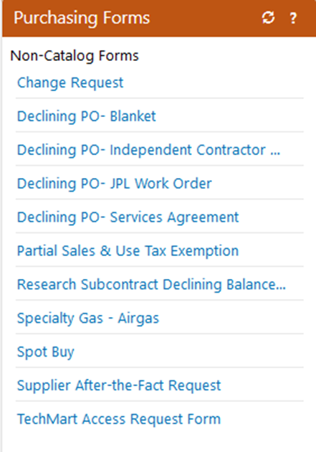
JPL Work Orders – updated version
Revised to accurately capture information fields JPL needs
Revised to process JPL Work Orders more efficiently
Revised to educate campus on the rules
Where is it?
Notice the new name
Now…the walk through…
Notes:
Rachel

Slide 44
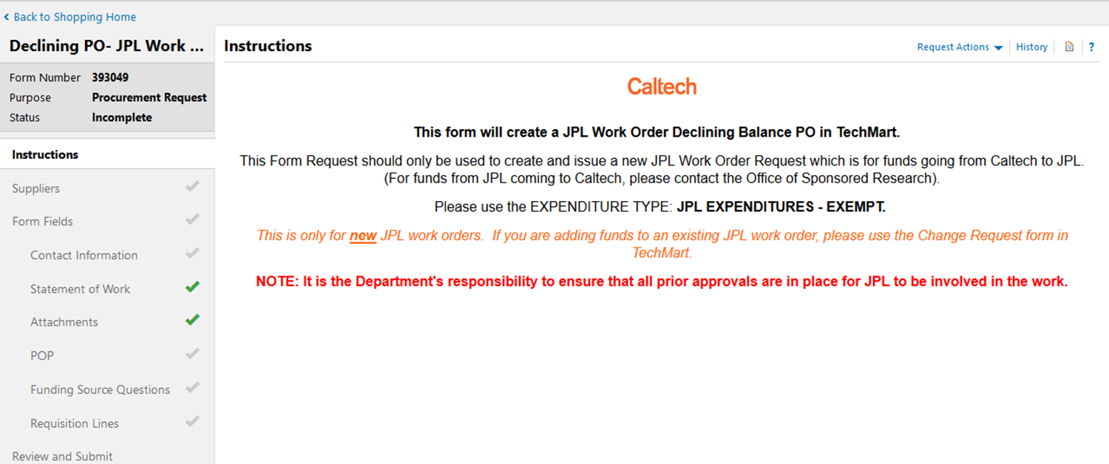
JPL Work Orders – instructions
Clarifies form purpose
- when Purchasing handles it vs. Office of Sponsored Research
Clarifies expenditure type
Clarifies when to use this form vs change request form
Clarifies campus responsibilities

Slide 45
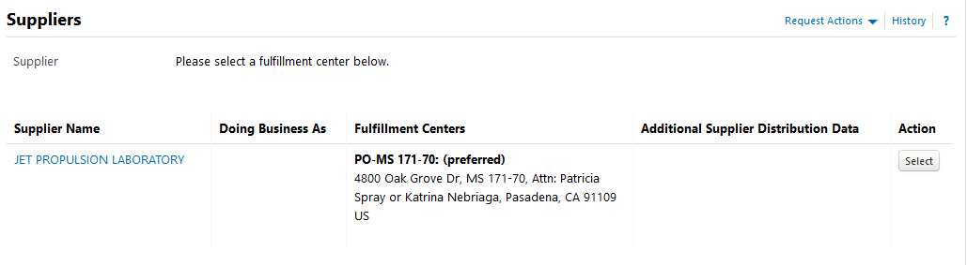
JPL Work Orders – Supplier
Supplier DEFAULTS to correct JPL supplier
YAY!

Slide 46
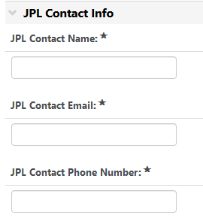
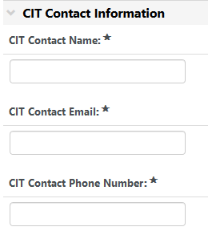
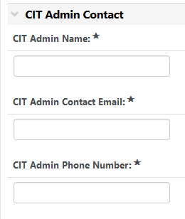
JPL Work Orders – Contact Info
Required contact fields added for faster processing
You CANNOT leave these blank.

Slide 47
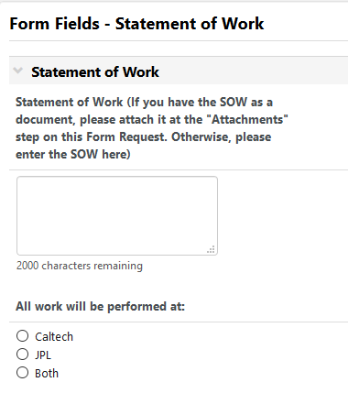
JPL Work Orders – Statement of Work
UNCHANGED

Slide 48
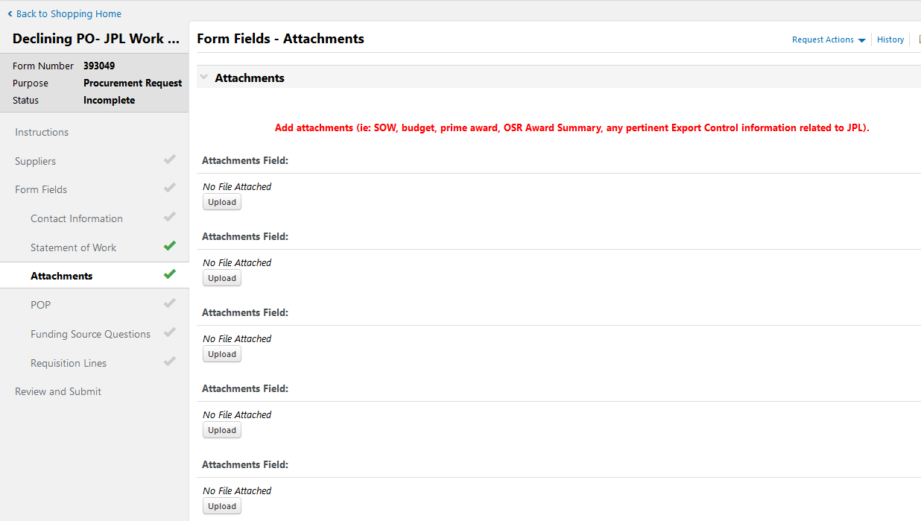
JPL Work Orders – Attachments
5 attachment fields added with attachment examples

Slide 49
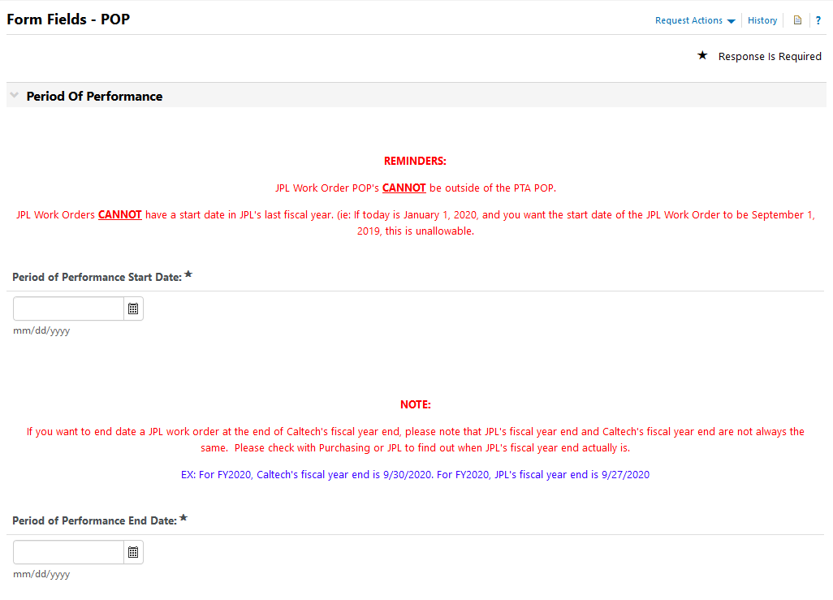
JPL Work Orders – POP
IMPORTANT: POP date rules made more clear
Rule 1
Rule 2
IMPORTANT: LEARN these rules!
Helpful practice

Slide 50
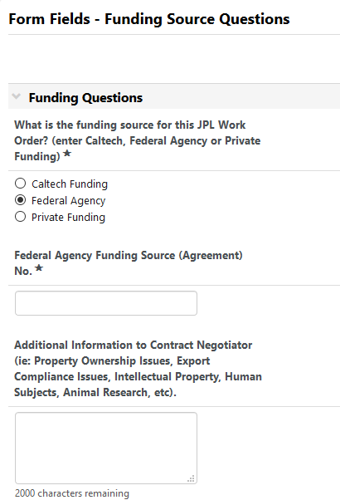
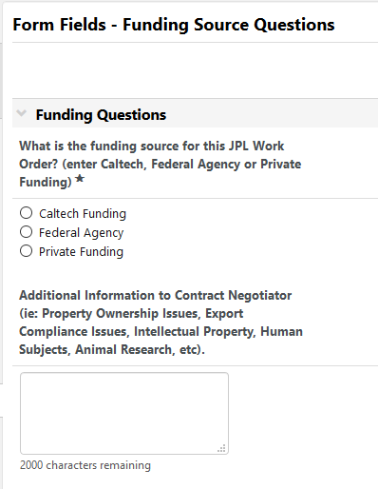
JPL Work Orders – funding source
With dropdown field for funding source number
Along with additional information field
Fields added to clarify funding source

Slide 51
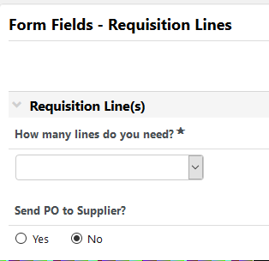
JPL Work Orders – Requisition Lines
UNCHANGED

Slide 52
JPL differences from Caltech
Burdening
Caltech
JPL
Costs
1
2
Costs
1
2
Burden
64.5%
64.5%
Burden
Ahhhh! NOT the same day
Same day
Same day
Until JPL’s fiscal year end
Fiscal year end
9/30
Last Sunday of September

Slide 53
JPL differences from Caltech
How does this impact closeout?
What happens to these costs?
Caltech
JPL
Costs
1
2
Costs
1
2
Burden
64.5%
64.5%
Burden
They hit a suspense account that PAA manages
Closeout your PTA
Closeout your PTA
**Can be costly to the Institute**

Slide 54
JPL differences from Caltech
What can you do to help?
- DO NOT assume JPL’s fiscal year end is Caltech’s fiscal year end.
Caltech
JPL
Costs
1
2
Costs
1
2
Burden
64.5%
64.5%
Burden
Closeout your PTA
Closeout your PTA
9/30
Last Sunday of September

Slide 55


JPL Work Orders – Cost data differences
Example scenario:
$
$
?
$
$
$
JPL
Ahhhh! We’re overspent!
GM
Why the discrepancy?
$0
JPL
Reports costs
PAA
AP
$
$
$
$
$
* This process can take a couple of weeks *
What can you do?
- ASK PAA or JPL to RECONCILE the account to get an accurate spending picture.

Slide 56
JPL Work Orders – conclusion
Help us help you!
Learn and follow the rules
Campus
Purchasing
Post Award Accounting
Accounts Payable
JPL

Slide 57
Questions?
Notes:
Briana, Rachel and Genelle

