Slide 1
Research Administration
Forum
April 8, 2020

Slide 2
Agenda
Introduction – Dick Seligman
The new COVID-19 Website for Research Administration – David Mayo
Charging Costs to Sponsored Awards During the COVID-19 Situation – David Mayo & Rochelle Athey
Foreign Influence on the Research Enterprise: New Checklist for Disclosures on Grant Applications for NSF & NIH – Grace Fisher-Adams
Research at Caltech during the COVID-19 Crisis – Grace Fisher-Adams
NIH Items – Mary Gibson
Salary Cap and Stipend Levels for 2020
New Grant Application Forms
NIH eRA system will be down between April 17 and April 22
NSF Forms for Biosketch and Other Support – David Mayo
DOE Order 486.1 – Adilia Koch
Conclusion – Dick Seligman

Slide 3
Introduction
A Research Administration Forum on Zoom
Please mute your microphones. You’ll still be able to hear the speakers.
Please use the “CHAT” feature at the bottom of your Zoom screen to ask questions.
At the conclusion of each presentation, we will set aside time for questions. As the host of the meeting, I will select the questions from the CHAT submissions and address them to the speakers.
We may not have time to answer all of the questions. If necessary, we can schedule a follow-up session to deal with questions that weren’t addressed during this session.
If you run into technical difficulties during the Forum, please contact Dick Seligman at Richard.Seligman@Caltech.edu for assistance

Slide 4
ORA COVID-19 Webpage
David Mayo

Slide 5
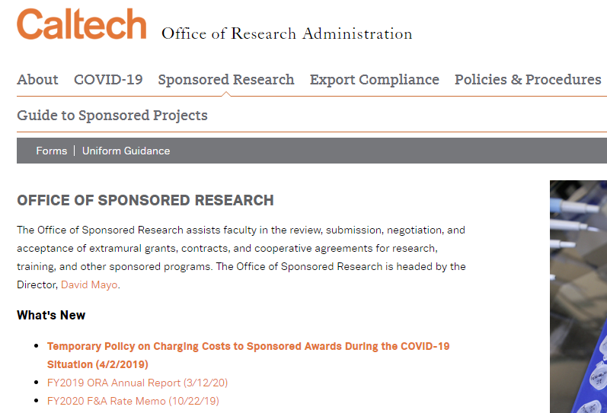

Slide 6
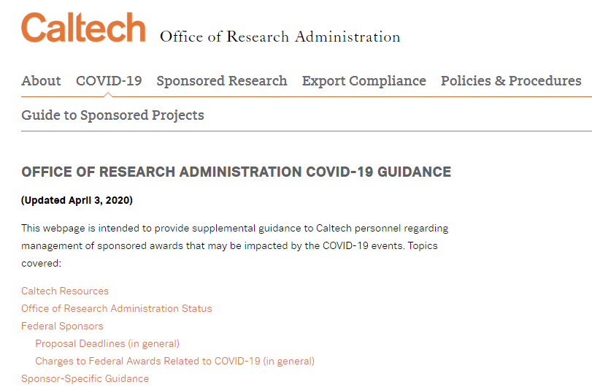

Slide 7
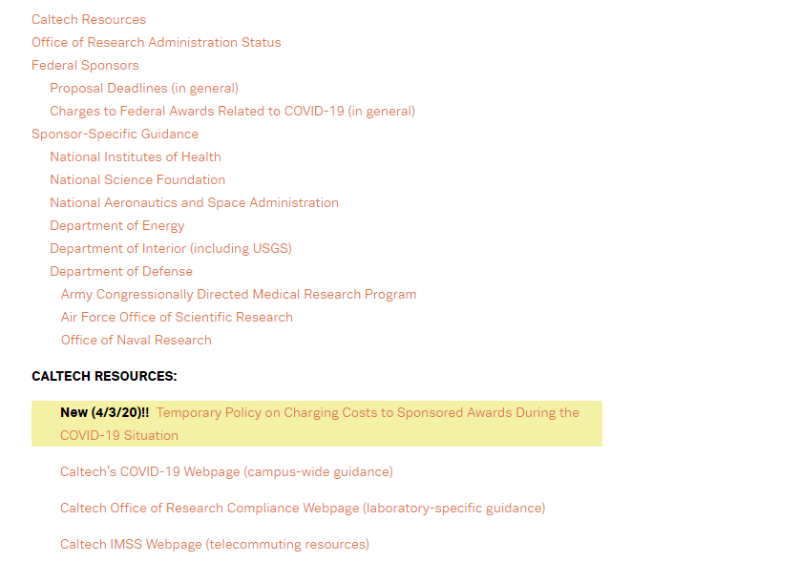

Slide 8
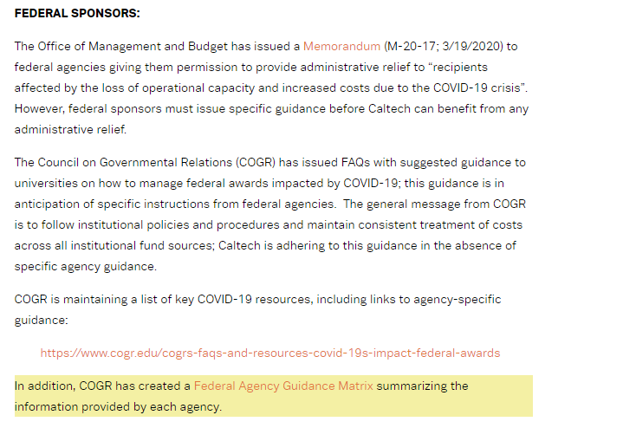

Slide 9
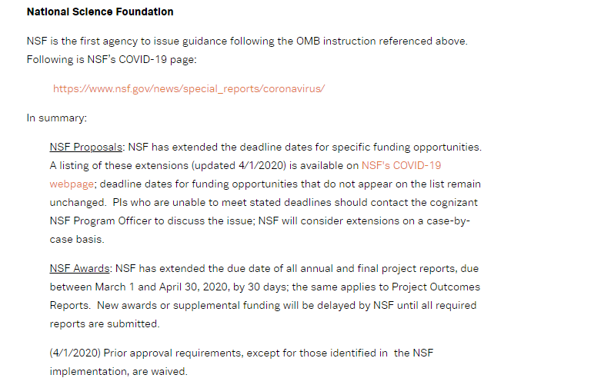

Slide 10
Examples of Administrative Relief for COVID-19 Related Issues
Flexible application deadlines
Extended progress report due dates
Additional NCEs
Waiver of many prior approval requirements
  reduction of PI time by more than 25%
  carry forward limitations relaxed
Ability to charge some normally unallowable costs

Slide 11
Charging Costs to Sponsored Award During the COVID-19 Situation
Rochelle Athey
David Mayo

Slide 12
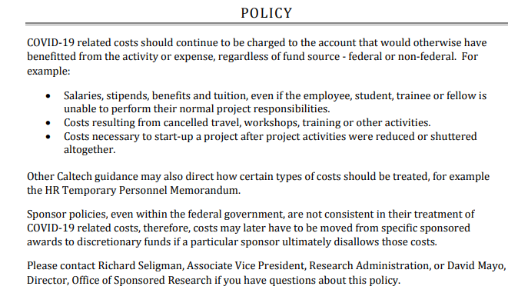

Slide 13
Things to keep in mind…
Not all federal agencies have implemented administrative relief consistently
Applies to awards active at the time administrative relief was implemented by federal agency
Applies if project activities are slowed or stopped
Time limited (currently 90 days, to be reevaluated)
Statutory funding limits still apply (e.g., 5-year rule)
Award terms require PIs to keep program officers informed of delays or other problems

Slide 14
Things to keep in mind…
Requires tracking/documentation of all otherwise unallowable costs charged to federal awards
  Suggest setting up separate project
Administrative relief does not apply to federal contracts/subcontracts
  If a PI has a potential issue of meeting performance requirements on a contract/subcontract, the PI must discuss that with the program manager; OSR can assist with also contacting the Contract Officer.

Slide 15
Things to keep in mind…
Some non-federal sponsors have issued guidance, as well. Some of the guidance is similar to the federal government, and others require asking permission.

Slide 16
Checklists for Reporting Other Support (NIH) and Current and Pending Support (NSF) – Grace Fisher-Adams
NIH Other Support
Internal (Caltech) Funds
Include only if the funds are used for a project that has a scope of work, budget, effort commitment by the PI, and a period of performance.
Start-up Funds
Include only if the source is an institution other than Caltech.
Appointments
All appointments whether compensated or not. If compensated, include in Other Support. If not compensated, include in Biosketch.
(must be reported through Caltech COI Disclosure System – Question #5)
Research Contracts
Include all research contracts, whether awarded through Caltech or another entity.

Slide 17
NIH Other Support (cont)
Consulting Agreements
Include only if the consulting supports the PI’s research endeavors, regardless of where conducted.
(Must be reported through Caltech Conflict of Interest Disclosure System- Question #2/#5)
Cooperative Agreements for Research
Include only of the cooperative agreement supports the PI’s research endeavors, regardless of where conducted.
Fellowship Program
Include if Fellowship is awarded to the PI, key personnel, and lab members.
Foreign Talent Program
Include for PI, key personnel, and lab members
Gifts
Include only if gift is for a specific research project, if the support must be recognized in publications, if reports are required, or any other conditions are imposed.

Slide 18
NIH Other Support (cont)
In-Kind Resources
Include only resources outside of Caltech that are in direct support of the PI’s research endeavors, regardless of where conducted.
Other Resources
Include only if available for direct support of the PI’s research endeavors, regardless of where conducted. Also applies to grad students working on this project.
Projects and Activities
Included if it supports an individual’s research, regardless of where conducted.
Prizes
Does not need to be included.

Slide 19
NSF Current and Pending Support
Internal Awards
Include only if the funds are used for a project that has a SOW, budget, effort commitment by the PI, and a period of performance.
Start-up Funds
Include only if the source is an institution other than Caltech.
Appointments
All appointments whether compensated or not
(Must be reported through Caltech COI Disclosure System – Question #5)
Research Contracts
Include all research contracts, both current and pending, whether awards through Caltech or another entity.
Consulting Agreements
Do not include
(Must be reported through Caltech COI Disclosure System – Question #5/#2)

Slide 20
NSF Current and Pending Support (cont.)
Cooperative Agreements for Research
Include only if the cooperative agreement supports the PI’s research endeavors, regardless of where conducted.
Fellowship Program
Include only if Fellowship is awarded to the PI or senior personnel.
Foreign Talent Program
Include for PI and senior personnel.
Gifts
Include if the gift is given with time comments or other expectations, including recognition in publications, required reporting, or any other conditions.
Research Grants
Include all current and pending, for Caltech and all other institutions.

Slide 21
NSF Current and Pending Support (cont.)
In-Kind Contributions
Include if not intended for use on this project/proposal if there are associated time commitments. Include if intended for use on this project/proposal.
Other Resources
Include if available for direct support of the PI’s research endeavors, regardless of where conducted.
Projects and Activities
Include if it supports an individual’s research, regardless of where conducted.
Prizes
Does not need to be included.

Slide 22
Research at Caltech During the COVID-19 Crisis
In light of the Safer at Home Ordinances in effect in Pasadena, and to protect the health of our community, Caltech has taken the following actions:
All non-essential research operations have been deferred, or transitioned to remote (home office, private space within residence, etc.) activities whenever possible. Essential research where there is a need to continue work in the laboratory must be approved by the Division Chair.
All head of laboratories and research units have evaluated their continuity plans and identified any critical operations that require in-person support for maintenance and preservation. Information on critical operations has been communicated to the Division Chairs, who must approve such operations.
The Division Chairs are maintaining lists of all approved essential research and all approved critical operations.

Slide 23
Research at Caltech During the COVID-19 Crisis (cont.)
Caltech has posted a list of frequently asked questions (FAQ) that address many of the most important aspects of conduction research during the COVID-19 crisis: http://www.researchcompliance.Caltech.edu/researchfaqs
Principal investigators are responsible for informing research sponsors, as applicable, of any changes to the status of ongoing projects.
The Institute maintains a critical logistics status report which provides laboratory heads with up-to-date information regarding the availability of essential laboratory consumables.
These actions last until at least 19 April 2020, but may be extended.

Slide 24
NIH FY 2020 Fiscal Policies for Grant Awards: Salary Limits and Stipend Levels - Mary Gibson
Ruth L. Kirschstein National Research Service Awards (NRSA) , Fellowship (F) and Training (T) – Increase of NRSA stipends by approximately 2 percent for predocs and 4-5 percent on average for postdocs. The full range of stipend adjustments for FY 2020 and guidelines are published in Notice Number: NOT-OD-20-070 https://grants.nih.gov/grants/guide/notice-files/NOT-OD-20-070.html
The Training Related Expenses and Institutional Allowances for predoctoral trainees and fellows and the Tuition and Fees for all educational levels remain unchanged.
Institutional Allowance for individual fellows (F30, F31, F32, F33) sponsored by non-Federal Public, Private, and Non-Profit Institutions (Domestic & Foreign, including health insurance):
• Predoctoral Fellows: $4,200
• Postdoctoral Fellows: $10,850
.

Slide 25
Postdoctoral Trainees and Fellows:
Postdoctoral Trainees and Fellows: For institutional training grants, (T32, T90, TL1) and individual fellowships (F32), the stipend level for the entire first year of support is determined by the number of full years of relevant postdoctoral experience when the award is issued.
Career Level | Years of Experience | Stipend for FY 2019 | Monthly Stipend
Postdoctoral
 | 0 | $50,004 | $ 4,167
 | 1 | $50,376 | $ 4,198
 | 2 | $50,760 | $ 4,230
 | 3 | $52,896 | $ 4,408
 | 4 | $54,756 | $ 4,563
 | 5 | $56,880 | $ 4,740
 | 6 | $59,100 | $ 4,925
 | 7 or More | $61,308 | $ 5,109

Slide 26
NIH Salary Limits
Salary Limits – Effective January 5, 2020, the salary limitation for Executive Level II is $197,300.
If adequate funds are available in active awards, and if the salary cap increase is consistent with the institutional base salary, grantees may rebudget funds to accommodate the current Executive Level II salary level.
For additional information see NIH Notice NOT-OD-20-065. https://grants.nih.gov/grants/guide/notice-files/NOT-OD-20-065.html

Slide 27
NIH FORMS-F
NIH FORMS-F Grant Application Forms & Instructions Must be Used for Due Dates On or After May 25, 2020- New Grant Application Instructions Now Available
Notice Number: NOT-OD-20-077 https://grants.nih.gov/grants/guide/notice-files/NOT-OD-20-077.html
FORMS-F must be used for:
  Applications submitted for due dates on or after May 25, 2020
  All application types (New, Resubmission, Renewal, Revision)
  Applications submitted early for intended due dates on or after May 25, 2020
  Applications submitted after June 1, 2020* under NIH Continuous Submission Policy
  *This reflects a new date in accordance with NOT-OD-20-060
If your intended due date is on or before 24 May 2020 FORMS-E application package & instructions must be used.

Slide 28
FORMS-F Resources
Resources:
FORMS-F Grant Application Instructions are now posted on the How to Apply - Application Guide page. All significant changes to form instructions are listed at: https://grants.nih.gov/grants/how-to-apply-application-guide/forms-f/general/g.120-significant-changes.htm.
Grants Administration Take 10: NIH FORMS-F Application Forms Update video
High-level Summary of Form Changes in FORMS-F Application Packages
Annotated Form Set for NIH Grant Applications
Do I Have the Right Form Version For My Application?
Application Forms, Form Updates, and Choosing the Correct Forms FAQs

Slide 29
A few changes of note…
PHS 398 Career Development Award Supplemental Form
•Updated Expiration Date •Added new attachment titled “Description of Candidate’s Contribution to Program Goals” to the Environment and Institutional Commitment to Candidate Section •Renumbered form fields, as needed
PHS 398 Cover Page Supplement
•Updated Expiration Date •Added new Human Fetal Tissue Section including - “Does the proposed project involve human fetal tissue obtained from elective abortions?” If Yes, two new attachments are requested 1.HFT Compliance Assurance 2.HFT Sample IRB Consent Form •Renumbered form fields, as needed.
Reminder of changes to the NIH Other Support and Biosketch requirements.

Slide 30
NIH eRA System Down April 17 to April 20 –
From 8 a.m. ET on Friday, April 17 to 8 p.m. ET on Monday, April 20 the eRA system will be unavailable.
This effort will affect all the eRA modules (eRA Commons, ASSIST, IAR, iEdison, etc.) and all informational websites (era.nih.gov, etc.).
Any affected due dates will be extended and the 2-day viewing window for successfully submitted applications will be adjusted to provide the full two days.
The systems will be down to migrate the eRA modules and data to the Amazon Web Services (AWS) cloud.
Any affected due dates will be covered under NIH’s late application policy due to COVID-19, which allows all late applications submitted late for due dates between March 9, 2020, and May 1, 2020, to be accepted through May 1, 2020.
Grants.gov will continue processing applications during the migration window. Applications received via Grants.gov will be put in a queue, and then eRA will process them on Monday night, April 20. The standard 2-day viewing window for successfully submitted applications will be applied.

Slide 31
NSF-Approved Biographical Sketch and Current & Pending Support – David Mayo

Slide 32
New NSF Requirements
Effective with proposals submitted on or after June 1, 2020
Must use NSF-approved format
  SciENcv (via NIH)
  NSF-fillable form
NSF has issued new fillable forms, available at:
  https://www.nsf.gov/bfa/dias/policy/cps.jsp
  https://www.nsf.gov/bfa/dias/policy/biosketch.jsp

Slide 33
New NSF Requirements
NSF Webinar: 5/14/2020, 1:00-2:30pm EDT
  Send blank email to:
  NSF-ERA-FORUM-subscribe-request@listserv.nsf.gov
Additional help regarding SciENcv available from Caltech Library; send query to: library@caltech.edu

Slide 34
DOE 486.1 Order: Foreign Government Talent Recruitment Programs – Adilia Koch

Slide 35
DOE Order Directive
DOE will take appropriate actions to prohibit . . . DOE contractor employees, while employed by DOE or performing work under a contract, from the unauthorized transfer of scientific and technical information to foreign government entities through their participation in foreign government talent recruitment programs of countries designated by DOE as a foreign country of risk.
https://www.directives.doe.gov/directives-documents/400-series/0486.1-border/@@images/file

Slide 36
Purpose of the “DOE Foreign Government talent Recruitment Program” 486.1 Order (6/7/2019)
To ensure protection of:
U.S. competitive, national security interests; and
DOE program objectives

Slide 37
DOE 486.1
What does the DOE order prohibit?
It prohibits the unauthorized transfers of scientific and technical Information to foreign government talent recruitment programs of countries designated by DOE as a foreign country of risk.
DOE Foreign Countries of Risk as of April 4, 2020:
China, Iran, Russia, North Korea

Slide 38
What’s a Foreign Talent Program?
“Foreign-state-sponsored attempt to acquire U.S. scientific-funded research or technology . . . that target scientists, engineers, academics, researchers, and entrepreneurs of all nationalities working or educated in the U.S.
Programs are usually part of a broader whole-of-government strategies to reduce costs associated with basic research while focusing investment on military development or dominance of emerging technology sectors. . .”

Slide 39
Distinguishing Features of the Foreign Talent Program
Compensation provided by the foreign state to target individual in exchange for the individual transferring their knowledge and expertise to the foreign country.

Slide 40
Distinguishing Features of the Foreign Talent Program (cont’d)
Compensation can take several forms, for example:
Cash, research funding, honorific titles, career advancement opportunities, promised future compensation, or other types of renumeration or consideration.

Slide 41
How will this Order apply to Caltech Researchers?
DOE Subcontract Language
DOE Subcontracts issued to Caltech from DOE Labs will have flow-down requirements. DOE Labs are already imposing foreign talent recruitment program Certification reporting requirements on Caltech, e.g., Fermilab.
Quarterly Certification Requirements
Researchers must certify on a quarterly basis whether he/she is a participant in a foreign government talent recruitment program.
Quarterly Reporting Certifications are submitted by OSR based on information provided by the PI and researchers.

Slide 42
What should I look out for?
DOE Lab language in DOE awards or solicitations that mention:
- Proposal or solicitation compliance with Foreign Talent Recruitment Programs or the DOE 486.1 Order
- only U.S. Persons can work on the project
- requests citizenship or other personal information for everyone who will be working on the project
- Request identification of all Foreign Persons working on a project
What should I do if I find any of this language is mentioned either in a solicitation or an award?
Immediately contact OSR, who will also involve Export Compliance and OGC.

Slide 43
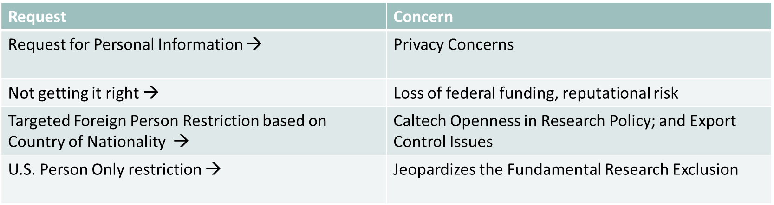
Compliance Concerns
  Fundamental Research Exclusion Protection and Concerns
  Higher vigilance will be necessary to ensure that DOE’s requirements do not result in access restrictions; restrict our ability to conduct “fundamental research”; impinge on Caltech’s openness in research policy or privacy.
  Higher campus risk

Slide 44
Potential Consequences
What are some potential consequences of nondisclosure?
Export or Restricted Party violations -- State, Commerce, or U.S. Treasury Department
Reputational Risk
Loss of future government funding
Criminal and civil violations

Slide 45
Resources
For the full text of definitions and the DOE 486.1 Order please go to:
https://www.directives.doe.gov/directives-documents/400-series/0486.1-border/@@images/file

Slide 46
Conclusion:
The slides for today’s Research Administration Forum will be posted on the Office of Research Administration website: http://researchadministration.caltech.edu/training

