Slide 1
Research Administration Forum
Wednesday, October 14, 2020

Slide 2
Agenda
New Rates for FY 2021 – David Mayo
“Quick & Dirty” Award Data for FY 2020 – David Mayo
Section 889 – David Mayo
From FastLane to Research.Gov – Dick Seligman
Students and Postdocs Conducting Research Outside the US – Adilia Koch
NSF Biosketch and Current and Pending Support – Mary Gibson

Slide 3
New Rates for FY21
David Mayo

Slide 4
FY2021 Rates
Rate Memo
http://researchadministration.caltech.edu/documents/17611/IC_Memo_FY_21.pdf
 | FY2021 | FY2020
On-campus Overhead | 67.5% | 66.5%
Off-campus Overhead | 26.0% | 26.0%
Staff Benefit | 27.2% | 28.0%
Paid Leave | 18.0% | 18.0%
GRA Tuition Remission | 66.0% | 66.0%
Minimum Overhead (less than $350K) | 20.0% | 20.0%
Minimum Overhead ($500K or more) | 30.0% | 30.0%

Slide 5
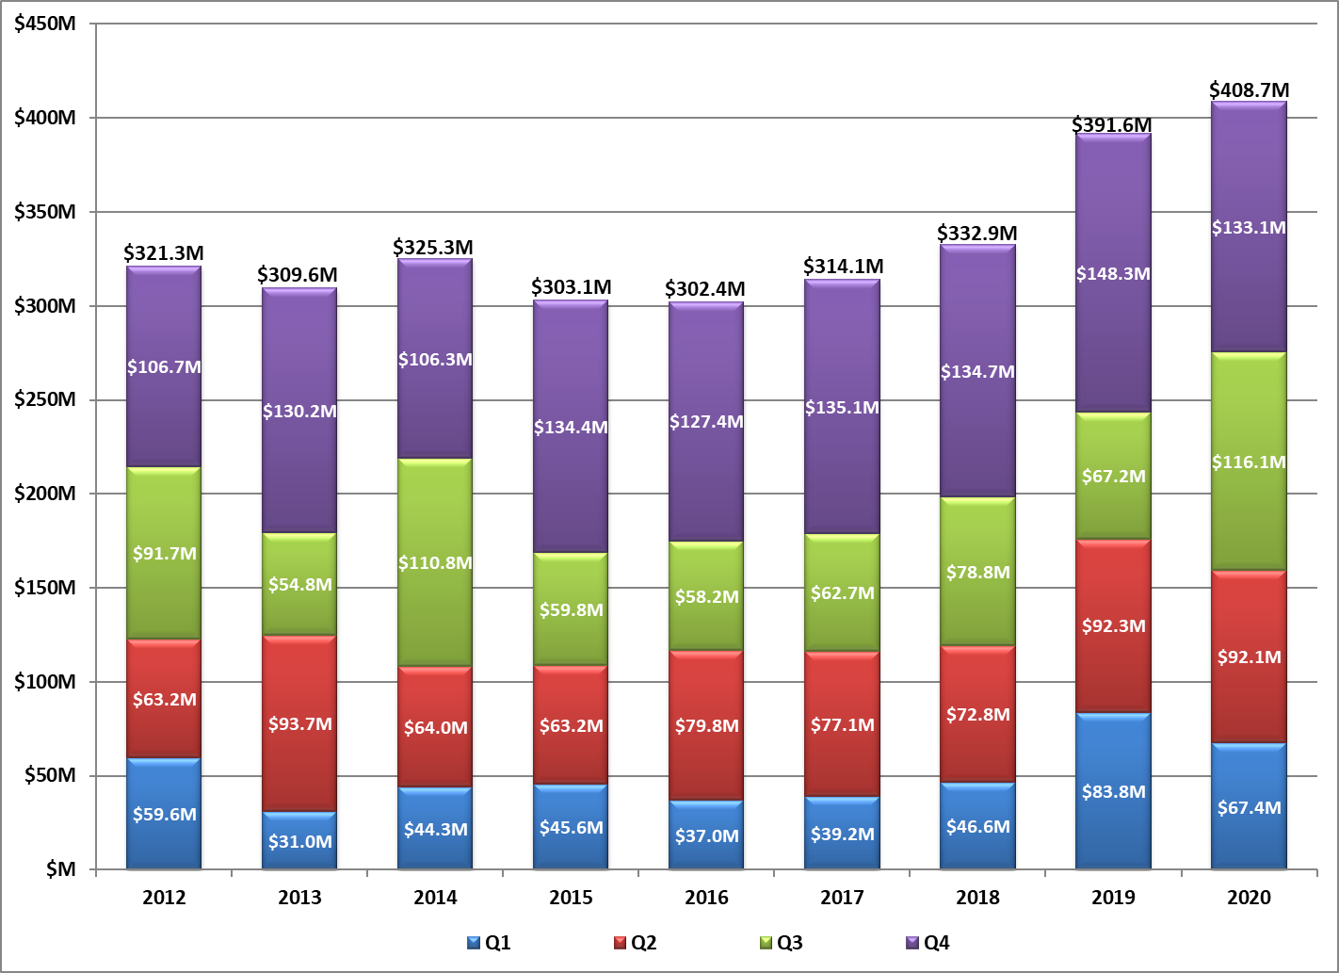
FY2020 Preliminary Numbers

Slide 6
Prohibitions on Telecommunications Equipment and Services
FY19 National Defense Authorization Act (Sec 889)
Two fundamental Requirements applied to all federal agencies (8/13/2020)
May not use federal funds to purchase equipment or services from Huawei or ZTE, or subsidiaries
May not contract with an entity that uses Huawei et al., components as a “substantial or essential component of any system”
Requires “reasonable inquiry” of existing systems
Requires reporting to government
Caltech working on implementation and guidance

Slide 7
Uniform Guidance Revisions
Uniform Guidance reviewed every 5 years (issued 12/26/2014)
Changes effective November 12, 2020, except for two requirements that are effective August 13, 2020:
200.216 Prohibition on certain telecommunication and video surveillance services or equipment (NDAA 889 requirement described in previous slide)
200.340 Termination – clarifies that the government may include termination options in an award beyond those options listed in the UG
Adds some clarification to definitions and other terms that do not impact day-to-day grant management

Slide 8
From FastLane to Research.gov – Dick
FastLane was first introduced on a limited basis in 1994.
Caltech started using FastLane in 1996.
First Federal System for the Creation and Submission of Proposals
Now Represents “Old” Technology

Slide 9
From FastLane to Research.gov (cont)
Research.gov was established in 2008
NSF is gradually moving FastLane functions to Grants.gov
Eventually, FastLane will be discontinued

Slide 10
What can Research.gov do at this time?
Preparation and Submission of Proposals
Research Proposals
Collaborative Proposals with Subawards
Collaborative Proposals, Separately Submitted
Proposal Status
Submission of Annual and Final Research Performance Progress Reports (RPPR)

Slide 11
What can Research.gov do at this time (cont)?
Notification and Requests
Increase in Funds for Participant Support
Changes in Person-Months
Pre-Award Costs in Excess of 90 Days
Salaries for Administrative or Clerical Staff
No-Cost Extensions
Changes in Scope
Significant Changes/Delays
Changes in PI
Changes in Grantee Institution
Subawarding, Transferring, or Contracting Out Part of an NSF Award
Conflicts of Interest That Cannot Be Managed

Slide 12
What can Research.gov do at this time (cont)?
Submit and Mange Payment Transactions
Report Program Income
Search NSF Awards back to 1994

Slide 13
Advisory: Foreign Person Students and Researchers Abroad Due to COVID-19
Adilia Koch

Slide 14
Students and Post-Docs Abroad
Students and post-docs conducting research or attending on-line classes outside the US will require an export license review. In some cases, a license or other government authority may be required which may delay enrollment or impact research activities.
Some software and content may be prohibited in-country including VPN services and common platforms
Countries and jurisdictions that are known to monitor, censor, and/or control access to certain online content include Eritrea, North Korea, Saudi Arabia, Ethiopia, Azerbaijan, Vietnam, Iran, China (including Hong Kong), Myanmar, and Cuba.
Guidance is currently being drafted and will be distributed to PIs soon.

Slide 15
Foreign Country Location and Country of Citizenship Matter
Licensing requirements depend on current regulations which change frequently; country where foreign person is located; foreign person's permanent residence; country of temporary residence; area of research; funding source; foreign entity affiliation, e.g., Talent Program; etc.
For example:
An Iranian foreign person student located in Iran would require an export license
An Iranian student who temporarily relocates to Canada to attend classes would require a license if Canada is not their "ordinarily country of residence“
What should you do? Submit a Foreign Person Questionnaire to the Export Office. Forms at export@caltech.edu
Export is reviewing FPQs in conjunction with HR so you might see initial request come from HR.

Slide 16
Resources: IRAN On-line study for students outside the US
Prohibitions and Guidance at a Glance

Slide 17
Iran: On-line study for students outside the US
What's prohibited under OFAC (Office of Foreign Assets Control)?
Unless authorized by OFAC, "all exportation and importation of items and services to and from an individual or entity located in Iran, or located outside of Iran but who are ordinarily resident in Iran," are prohibited.
LICENSE: A license would be required to provide educational services to an enrolled student ordinarily resident in Iran.

Slide 18
Iran: On-line study for students outside the US
What are the existing general licenses (exemptions)?:
Iran General License G – This general license authorizes individuals in Iran or ordinarily resident in Iran to participate in: 1. Undergraduate level courses in the humanities, social sciences, law, or business; 2. Undergraduate level courses that are introductory level science, technology, engineering or math courses ordinarily required for the completion of undergraduate degree programs in the humanities, social sciences, law or business.

Slide 19
Iran: On-line study for students outside the US (Cont’d)
What activities require a specific license from OFAC?: All other students online courses from Iran or students ordinarily resident in Iran would need a specific license, including: 1. Undergraduate students in degree programs other than humanities, social sciences, law or business and; 2. Graduate students. https://home.treasury.gov/system/files/126/iran_glg.pdf Other Graduate Student Engagement Allowed: Collaborating on the creation and enhancement of written publications. (§ 560.538)”

Slide 20
Other Countries Advisory
General guidance document in development and will be issued by tasked campus working group soon.
QUESTIONS?

Slide 21
NSF Biosketch and Current and Pending Support
Mary Gibson

Slide 22
Updates on NSF Biographical Sketch and Current and Pending Support
Reminder - Proposals submitted after 5 October 2020 require use of the new NSF Biographical Sketch and Current and Pending Support forms.
Resources:
NSF Proposal and Award Policies and Procedures Guide (PAPPG) (NSF 20-1) at https://nsf.gov/publications/pub_summ.jsp?ods_key=nsf20001
NSF website Biographical Sketch at https://www.nsf.gov/bfa/dias/policy/biosketch.jsp
NSF website Current and Pending Support at https://www.nsf.gov/bfa/dias/policy/cps.jsp
NSF FAQs for Fillable PDF Biographical Sketch (Updated 27-AUG-2020) at https://www.research.gov/common/attachment/Desktop/NSFPDF-FAQs.pdf
NSF FAQs on Using SciENcv (Updated 1-OCT-2020) at https://www.research.gov/common/attachment/Desktop/SciENcv-FAQs.pdf

Slide 23
Updates on NSF Current and Pending Support HOT OFF THE PRESS….The NSF RPPR has been revised with NEW Current and Pending Support QUESTIONS
Effective October 5, 2020
NSF added the following new question to the Edit Participants screen: Has there been a change in the active other support of the PI/PD(s) since the last reporting period? If Principal Investigators (PIs)/Project Directors (PDs) and co-PIs/co-PDs select “Yes,” they will be required to upload their most up-to-date Current and Pending Support document in an NSF-approved format to notify NSF that active other support has changed since the award was made or since the most recent annual report.
NSF added the following three questions to the "Impact" and "Changes/Problems" tabs:
What was the impact on teaching and educational experiences? (Impact tab);
What percentage of the award’s budget was spent in a foreign country? (Impact tab); and
Has there been a change in primary performance site location from that originally proposed? (Changes/Problems tab).
NSF-specific help text updates have been added throughout, and NSF-specific instructions have been clarified or enhanced.
To reduce administrative burden, NSF has consolidated data entry fields where possible.

Slide 24
Updates on NSF Current and Pending Support HOT OFF THE PRESS….
Revision of NSF Agency Specific Research Terms and Conditions (5-OCT-2020) https://www.nsf.gov/bfa/dias/policy/fedrtc/agencyspecifics/nsf_sigchg1020.pdf
Significant Change
Post-award Disclosure of Current Support and In-Kind Contribution Information. This entirely new article establishes a post-award disclosure requirement of undisclosed current support and in-kind contribution information. If an organization discovers that a PI or co-PI on an active NSF award failed to disclose current support or in-kind contribution information as part of the proposal submission process (see PAPPG Chapter II.C.2.h), the AOR must submit the information outlined within 30 calendar days of the identification of the undisclosed current support or in-kind contribution.
For Grants and CA-FATC: See required information listed in Article 48 for submission through use of the “Other Request" category in the Notification and Request Module in Research.gov. The requisite information must be entered into the box entitled, “Proposed Change” with the box entitled, “Justification for Change” stating, “See above”.
The post-award disclosure requirement applies to current support (including in-kind contributions) that was active as of the date the proposal was submitted to NSF.
For SBIR/STTR Phase I Subawards it is Article 42 in the SBIR Terms and Conditions.

Slide 25
Updates on NSF Biographical Sketch
NSF - Biographical Sketch Improvements to New Form:
Permit use of “et al” for publication citations in the Products section in the event that listing multiple authors makes it difficult to fit the information into the allotted space (NSF fillable format and SciENcv format);
Increased space for the Products section by removing instructional text. Links added to relevant PAPPG sections (NSF fillable format);
Removed the requirement to include the NSF ID (NSF fillable format); and
Added a version date to the document (NSF fillable format).

Slide 26
Updates on NSF Current and Pending Support
NSF - Current and Pending Support Improvements to New Form:
Increased the number of Project/Proposal entries from 10 to 15 to support the majority of proposals submitted to NSF (NSF fillable format);
Updated the Award Number field to allow entry of both numbers and letters (NSF fillable format and SciENcv format);
Replaced the “Calendar Year” label with “Year” to be consistent with PAPPG guidance (NSF fillable format and SciENcv format);
Removed the requirement to include the NSF ID (NSF fillable format); and
Added a version date to the document (NSF fillable format).

Slide 27
NSF Current and Pending Support
Reminder from April 2020 Forum:
What goes on the NSF Current & Pending Support
Internal Awards
Include only if the funds are used for a project that has a SOW, budget, effort commitment by the PI, and a period of performance.
Start-up Funds
Include only if the source is an institution other than Caltech.
Appointments
All appointments whether compensated or not
(Must be reported through Caltech COI Disclosure System – Question #5)
Research Contracts
Include all research contracts, both current and pending, whether awards through Caltech or another entity.
Consulting Agreements
Do not include
(Must be reported through Caltech COI Disclosure System – Question #5/#2)

Slide 28
NSF Current and Pending Support (cont.)
Reminder from April 2020 Forum:
What goes on the NSF Current & Pending Support
Cooperative Agreements for Research
Include only if the cooperative agreement supports the PI’s research endeavors, regardless of where conducted.
Fellowship Program
Include only if Fellowship is awarded to the PI or senior personnel.
Foreign Talent Program
Include for PI and senior personnel.
Gifts
Include if the gift is given with time comments or other expectations, including recognition in publications, required reporting, or any other conditions.
Research Grants
Include all current and pending, for Caltech and all other institutions.

Slide 29
NSF Current and Pending Support (cont.)
Reminder from April 2020 Forum:
What goes on the NSF Current & Pending Support
In-Kind Contributions
Include if not intended for use on this project/proposal if there are associated time commitments. Include if intended for use on this project/proposal.
Reminder: In-kind contributions not related to the proposed research do not need to be listed UNLESS they include effort commitments on the part of the PI or senior personnel. The in-kind contributions related to the project proposed should be listed in Facilities, Equipment, and Other Resources, not in Current and Pending Support.
Other Resources
Include if available for direct support of the PI’s research endeavors, regardless of where conducted.
Projects and Activities
Include if it supports an individual’s research, regardless of where conducted.
Prizes
Does not need to be included.

Slide 30
Thank you for attending!
Today’s slides will be available on our website:
http://researchadministration.caltech.edu/training

