Slide 1
Research Administration Forum
May 13, 2021
Grace Fisher-Adams, Chief Research Policy Officer
Ann Martin, Senior Associate General Counsel
David Mayo, Sr. Director for Research Administration

Slide 2
Agenda
Introduction and Miscellaneous Announcements
Sponsored Research Activity for FY2020
NDAA 889
Agency Disclosure Requirements

Slide 3
Introduction and Miscellaneous Announcements

Slide 4
Sponsored Research Activity for FY2020

Slide 5
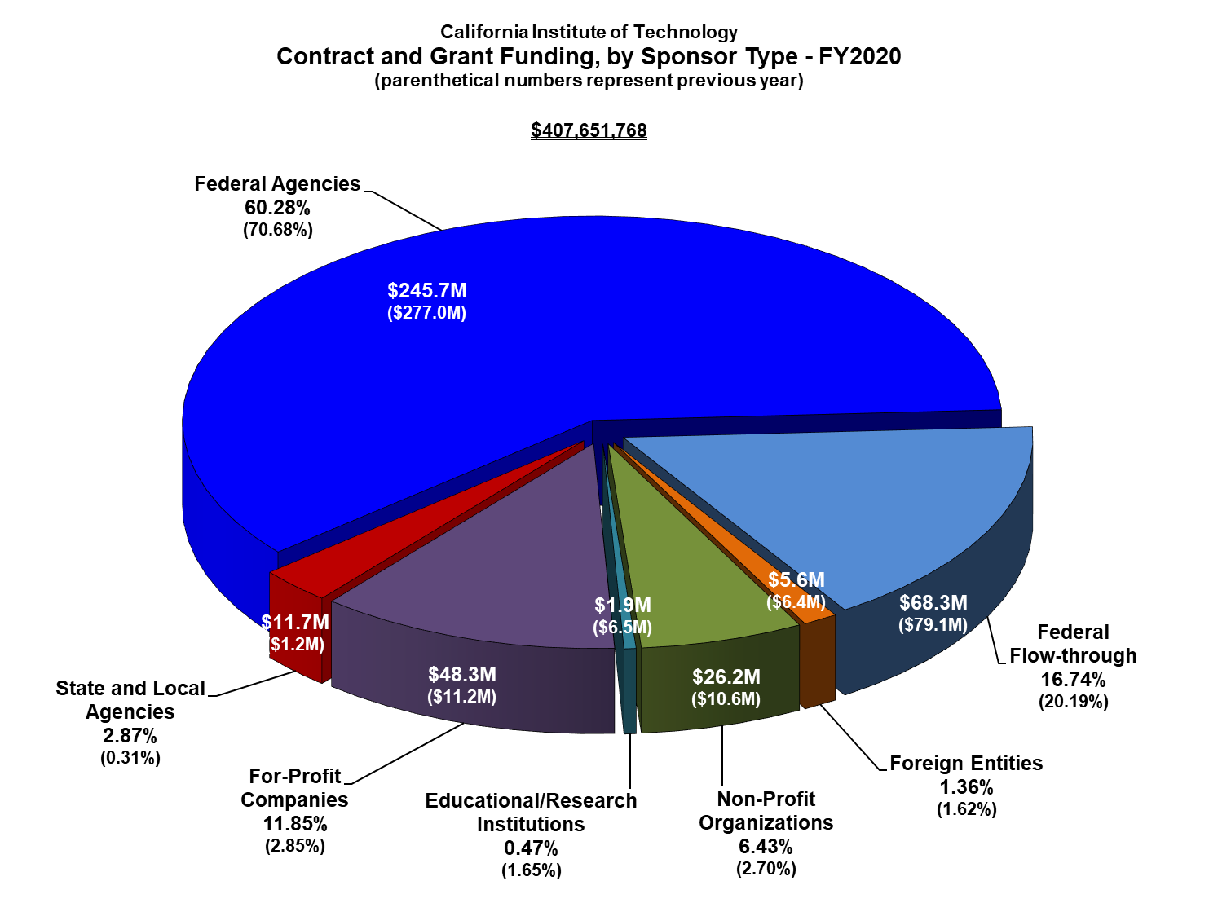

Slide 6
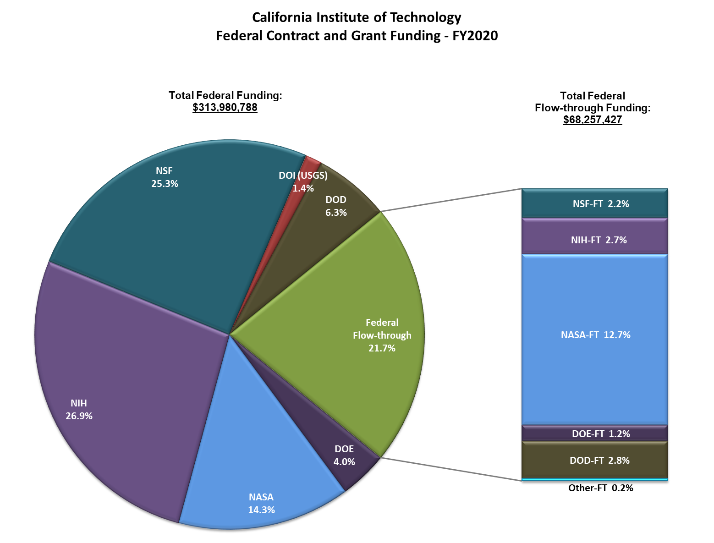

Slide 7
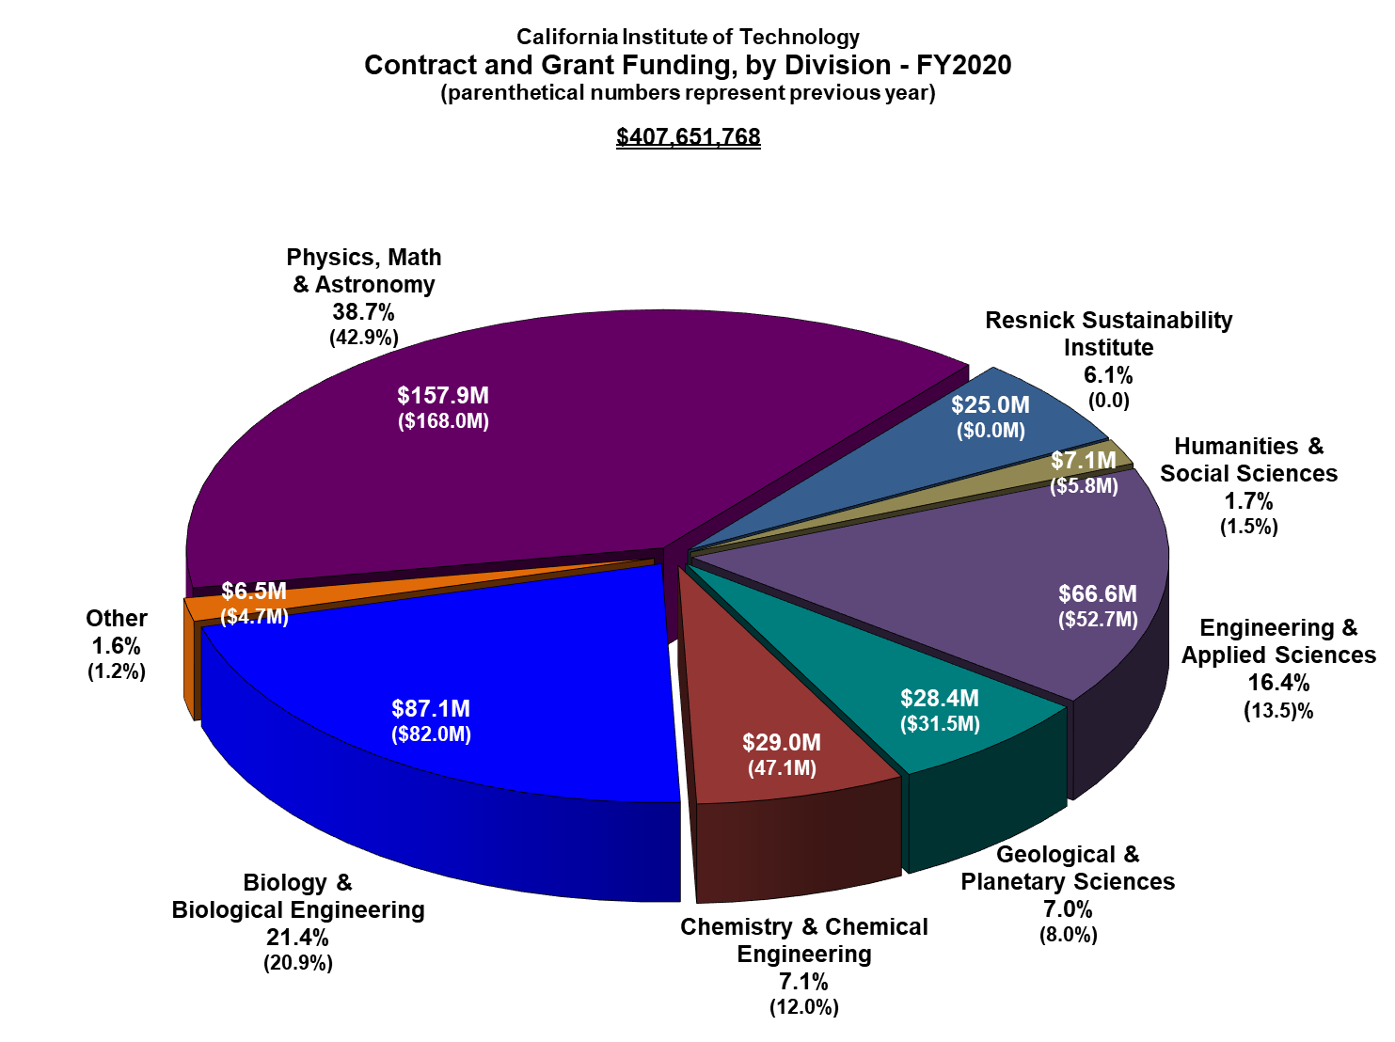

Slide 8
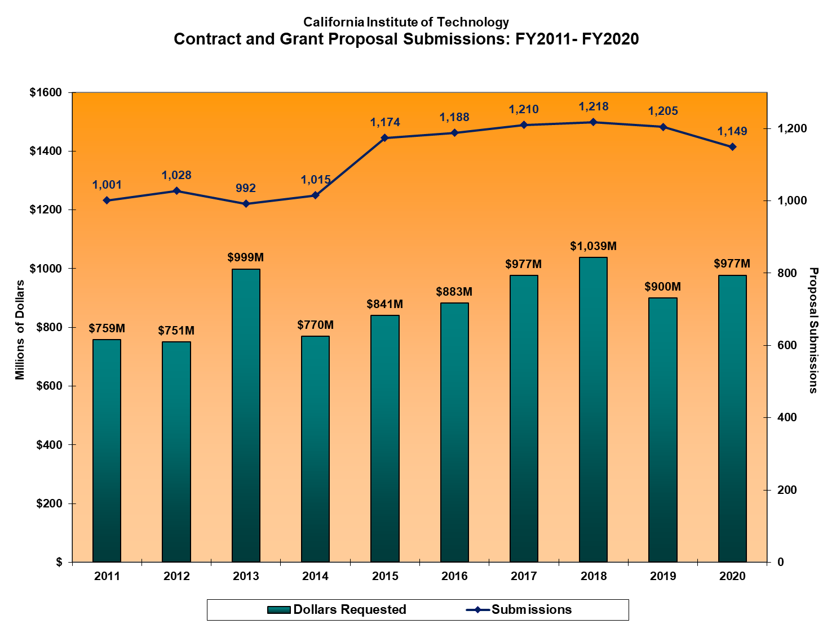

Slide 9
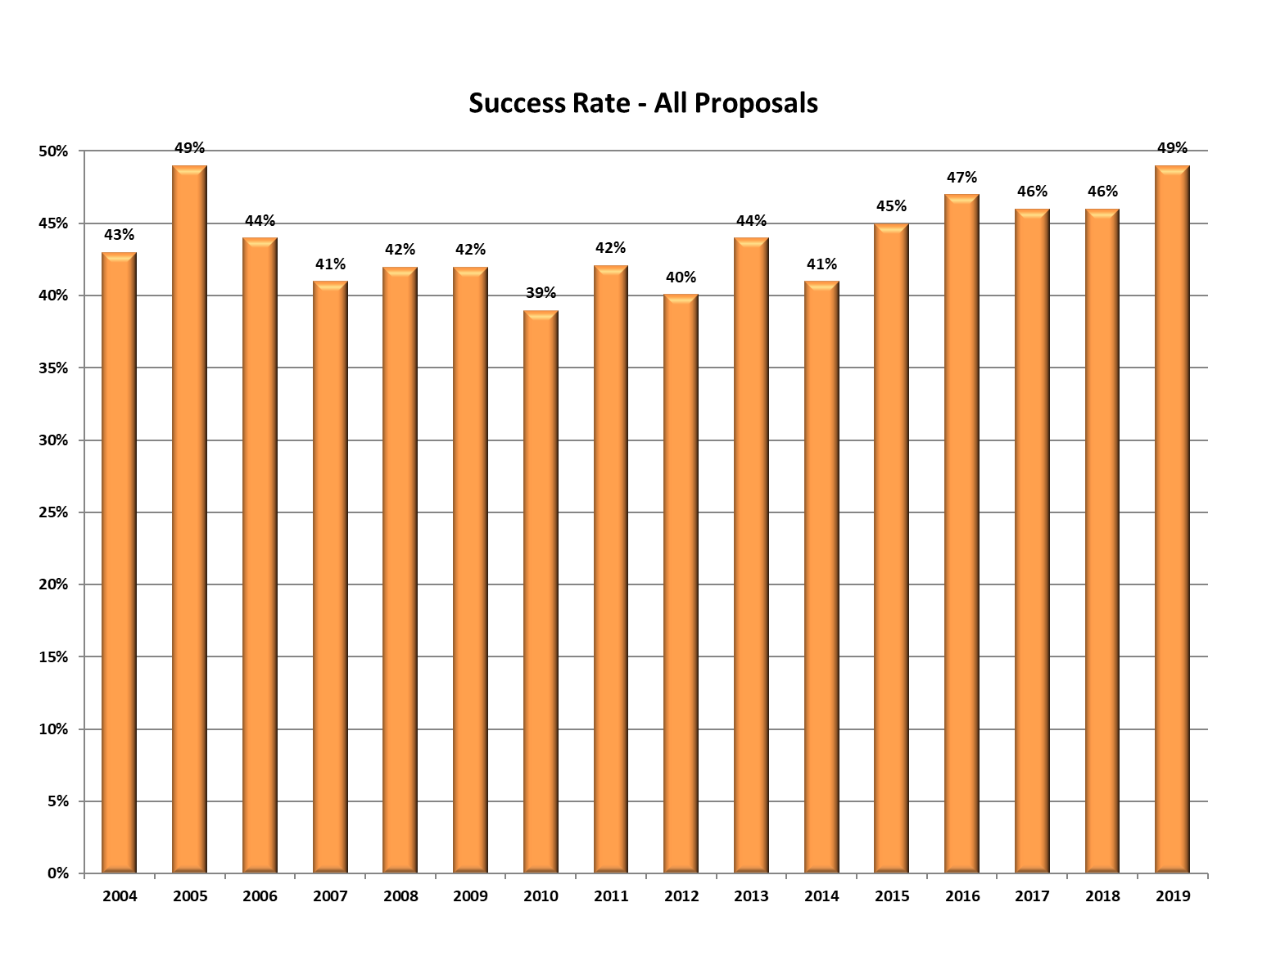
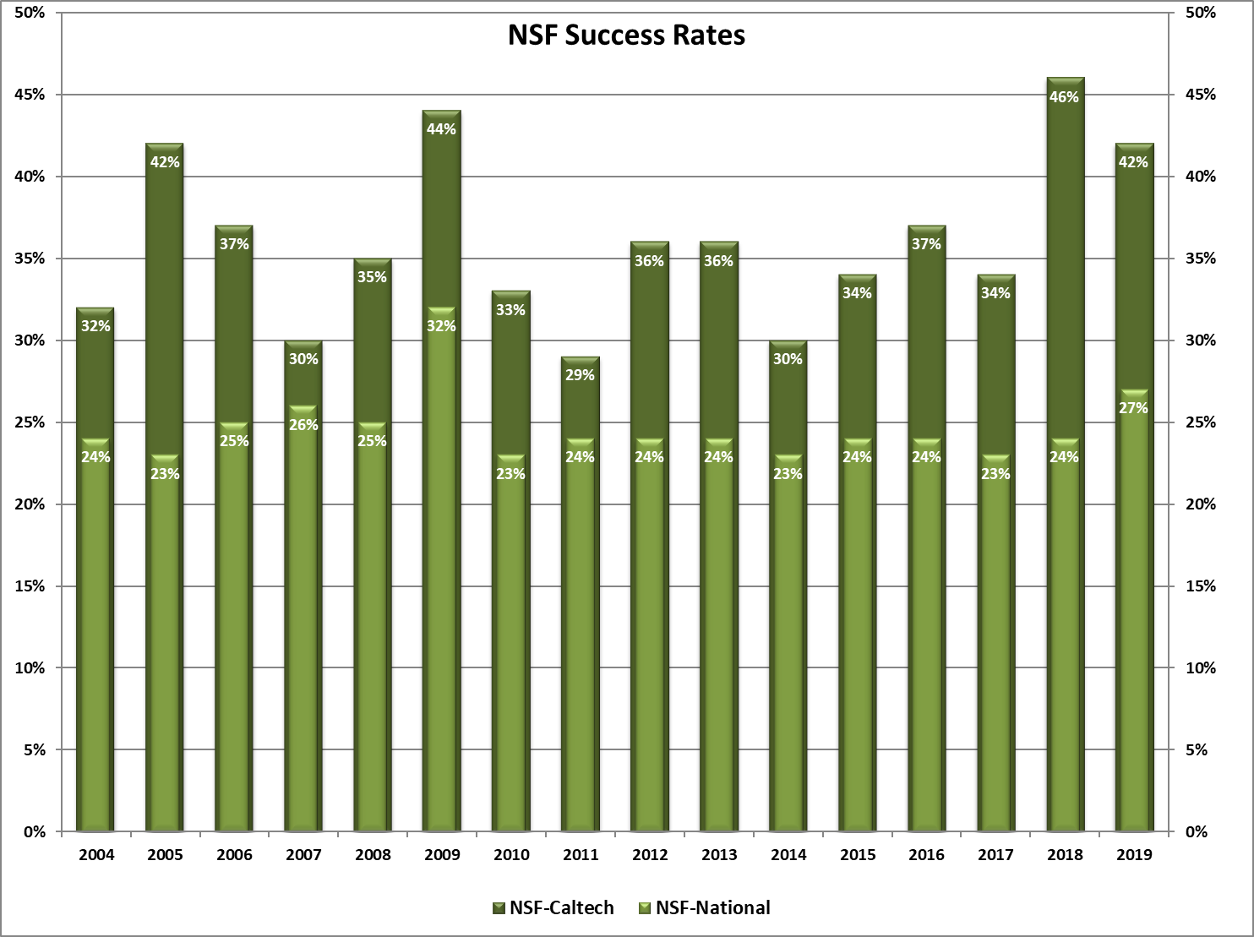
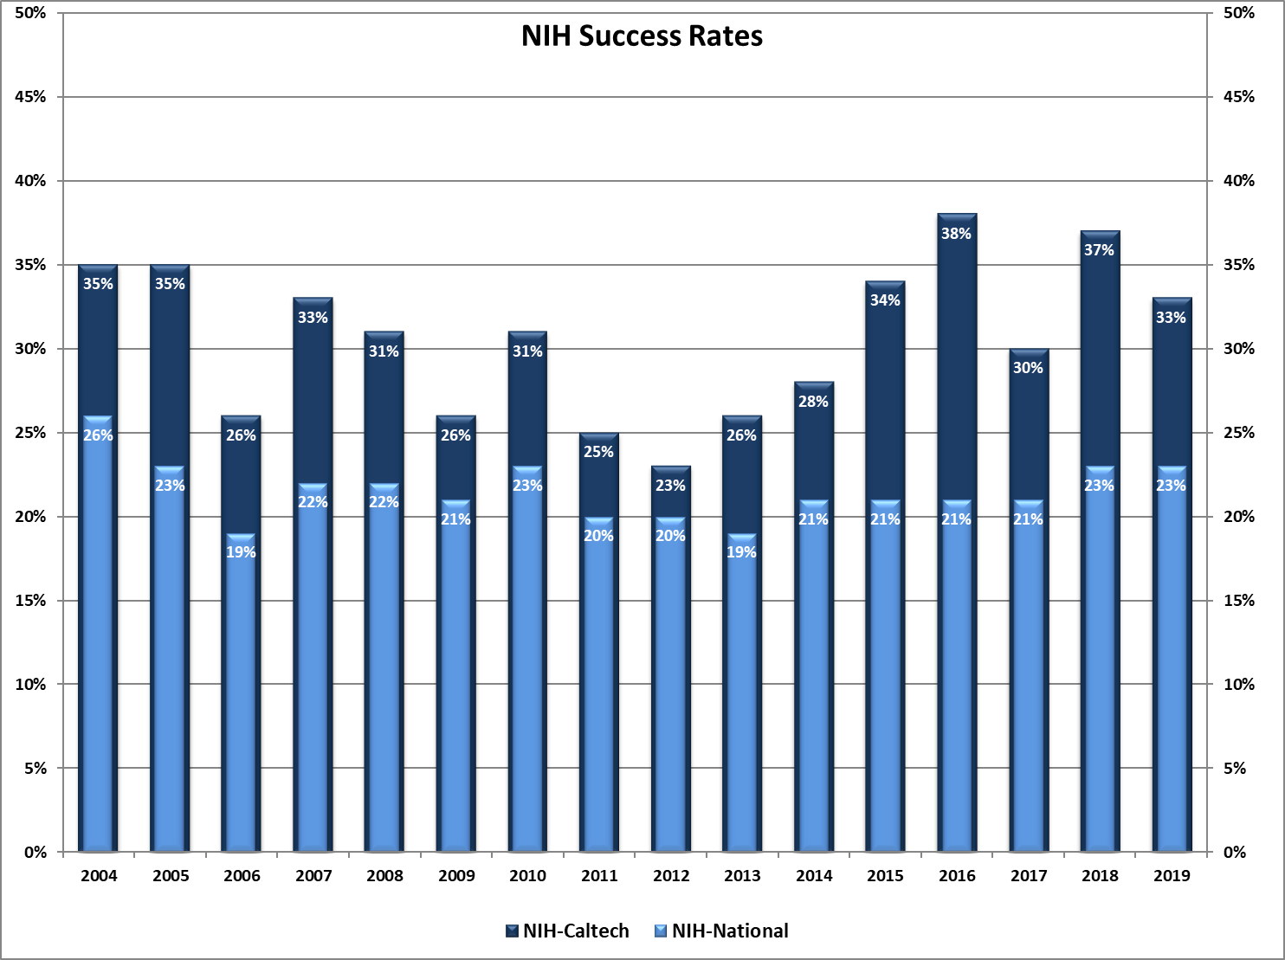

Slide 10
NDAA 889 Implementation Prohibition on Contracting with Entities Using Certain Telecommunications and Video Surveillance Services or Equipment

Slide 11
NDAA 889
Section 889, 2019 National Defense Authorization Act
Two primary requirements:
May not use federal funds to provide to the government equipment or services from Huawei, ZTE, et al, or their subsidiaries (grants and contracts)
May not contract with an entity that uses Huawei et al., components as a “substantial or essential component of any system” (contracts)
Requires “reasonable inquiry” of existing systems
Requires reporting to government of identified items
Caltech information page on NDAA 889
https://researchcompliance.caltech.edu/compliance/export/national-defense-authorization-act-ndaa-section-889

Slide 12
NDAA 889
https://researchcompliance.caltech.edu/compliance/export/national-defense-authorization-act-ndaa-section-889
Questions should be directed to the relevant office:
Procurement Services (https://procurement.caltech.edu/)
P-Card, POs, etc.
Export Compliance (export@caltech.edu)
export issues
Sponsored Research (david.mayo@caltech.edu)
award-specific questions

Slide 13
Agency Disclosure Requirements

Slide 14
Its not about “foreign”
its about full disclosure as required by the sponsor (domestic or foreign)

Slide 15
Biosketch
NSF - Senior Personnel must include
All of their academic, professional, or institutional appointments at proposing organization
All of their current academic, professional or institutional appointments at domestic or foreign entities outside of the proposing organization.
Not new - long standing requirement
Updated format required for proposals starting 10/5/2020

Slide 16
Biosketch
NIH – Senior/Key Personnel must include
All positions and scientific appointments (domestic and foreign), including affiliations with foreign entities or governments
Titled academic, professional, or institutional appointments
whether or not any payment is received
whether full-time, part-time, or voluntary (including adjunct, visiting, or honorary)
Updated format required for proposals starting 1/25/2022; SciENcv has been updated already

Slide 17
NSF Current & Pending Support
Includes all resources available to an individual in support of/related to all their research, to them individually or through Caltech, regardless of whether they have monetary value
All research contracts and awards, not just those related to the proposed research
Consulting agreements that include research activities
In-kind contributions from outside entities (e.g., office/laboratory space, equipment, supplies, employees, student), not intended for use on the proposal being submitted, must also be reported if there is an associated time commitment.

Slide 18
NSF Current & Pending Support
Excludes
Postdoctoral researchers personally funded by a foundation or other organization
In-kind contributions if not used on project and no associated time commitment
Start-up packages and faculty salaries from Caltech
Gifts given without expectation of anything in return; if there is a time commitment, it must be disclosed

Slide 19
NSF Current & Pending Support
New format required effective 10/5/2020
Retroactive Disclosure
New award term effective 10/5/2020 requiring retroactive disclosure of Current Support that was not included in proposal, but that existed at the time the proposal was submitted.
Must be submitted within 30 days of discovery via Research.gov (Other Notification option)
Award term specifies details to be included

Slide 20
NIH Other Support
NIH issued “reminders” 7/10/19 (NOT-OD-19-114) and 3/12/21 (NOT-OD-21-110) regarding longstanding requirement for full transparency of all research activities, both domestic and foreign
Includes all resources and financial support available or related to all of the individual’s research endeavors, including
from foreign or domestic entities
regardless of whether they have monetary value
based at Caltech or elsewhere

Slide 21
NIH Other Support
support for laboratory personnel (not already disclosed as other support)
high-value materials not freely available (e.g., biologics, chemical, model systems, technology, etc.)
consulting agreements that include research activities,
in-kind contributions, e.g., office/laboratory space, equipment, supplies, or students, employees, postdocs, or visitors supported by an outside source
research collaborations where the collaborator’s experiments directly benefit any of the researcher’s research endeavors

Slide 22
NIH Other Support
Excludes
training awards, prizes
gifts where there is no expectation of anything in return (e.g., time, services, specific research activities, money, etc.)
start-up packages and salaries from Caltech

Slide 23
NIH Other Support
New Requirements (effective 1/25/2022)
Other Support Format has been updated
Supporting documentation
Requires copies of supporting documents (e.g., agreements, appointment letters, etc.) for any Other Support from a foreign source;
Must be translated into English
Convert to PDF and attach to Other Support prior to upload
Requires certification wording and digital signature of the individual disclosing the Other Support
PDF must be flattened prior to upload in order to allow for digital signature

Slide 24
NIH Other Support
Immediate notification of undisclosed Other Support, when that support was not disclosed at the first available opportunity (e.g., JIT, RPPR).
If you receive a question about this from a researcher, please direct them to Ann Martin in OGC.
Ann will clarify details with them
If determination is that there is undisclosed support to report, will work with David Mayo in OSR to notify NIH
NIH is updating SciENcv to handle Other Support requirements; may not be ready by 1/25/2022
Caltech recommends that grant managers start following new requirements in order to work through any problems by 1/25/2022

Slide 25
Accountability
Recent Enforcement Action
NIH
500 NIH related cases under investigation
50 institutions have self-disclosed
NSF
Indictment issued 4/21/2021 charging a PI with wire fraud for submitting a proposal that failed to disclose his affiliation with ShenZhen University
PIs/faculty/researchers are ultimately responsible for accurate and complete disclosure, and will be held accountable

Slide 26
Accountability
Charges include:
Wire fraud, making false statements. conspiracy to defraud the US, obstruction by falsification, income tax evasion, visa fraud, failing to file a foreign bank account report, false claims, fraud
Full disclosure is essential!
When in doubt - disclose

Slide 27
Caltech Tools and Actions
Financial Interest and Commitment Disclosure Tool
New “smart” disclosure system based on Entity by Entity disclosure
“Optional” question to help you identify and share possible personal “other support” or biographical information to include in your biosketch
New International Collaboration Website
New Things “In the Works”
Training
Conflict of Commitment Policy
Possible Rider/Addendum for Consulting Agreements
Visitor Process Updates
Notes:
GRACE: You have heard about these agency requirements.
Based on the CIC recommendations and our analysis of these requirements we are trying to develop tools to facilitate your compliance.

Slide 28
New Financial Interests and Commitments Disclosure System¹ 2021 (¹aka COI Disclosure System)
Consider all organizations, companies, universities or people (Entities), with whom you have a professional relationship or in which you have a financial interest. If you have a commitment to, financial interest in, or gifts from an Entity², add each Entity to the system.
²Detailed Criteria will be provided
Required Updates:
At least annually or within 30 days of acquiring an interest.
Entity will be there to update!
Notes:
GRACE
Even if an Entity meets more than one of the Detailed Criteria, enter it only once.
You can add all entities first and then complete your disclosure for each or you can add them one at a time and do each sequentially.

Slide 29
Other Support and Biosketch Option added to Disclosure System
OPTIONAL (Recommended FOR PIS WITH OR ANTICIPATING FEDERAL FUNDING ONLY).
This question provides you with a list of entities disclosed that could be included in your biosketch or other support for federal awards. You will be given an option to share this list with a grants manager or other Caltech personnel.
Would you like the list of the entities you disclosed to be available to your grant manager or other administrative personnel to help you complete your Biosketch/SciENcv, or Other Support for Federal Sponsor Proposals or Annual Reports? No financial interest information will be disclosed to your designee.
Compiles Commitments to Entities
Organizes Entities that might be providing Other Support
Allows you to “share” with a delegate without providing financial details
Notes:
GRACE

Slide 30
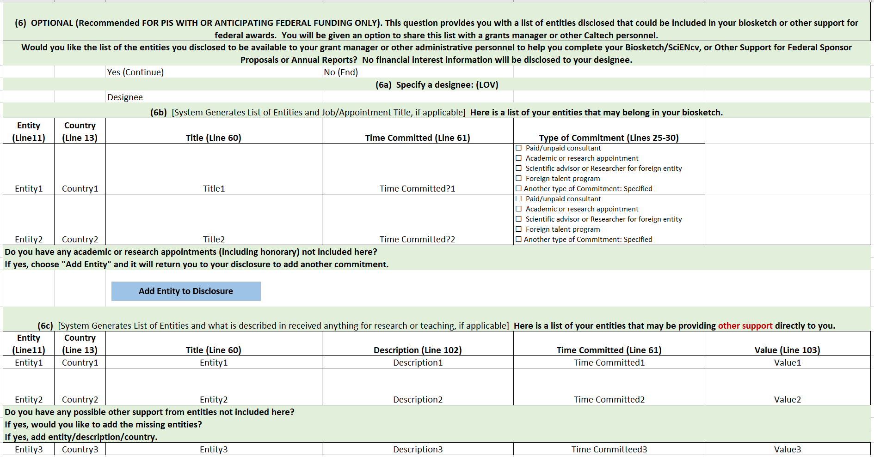
Other Support and Biosketch Option added to Disclosure System
Compiles Commitments to Entities
Organizes Entities that might be providing Other Support
Allows you to “share” with a delegate without providing financial details
Allows you to add attachments (contracts)
Access from inside and outside of Disclosure System
Notes:
GRACE

Slide 31
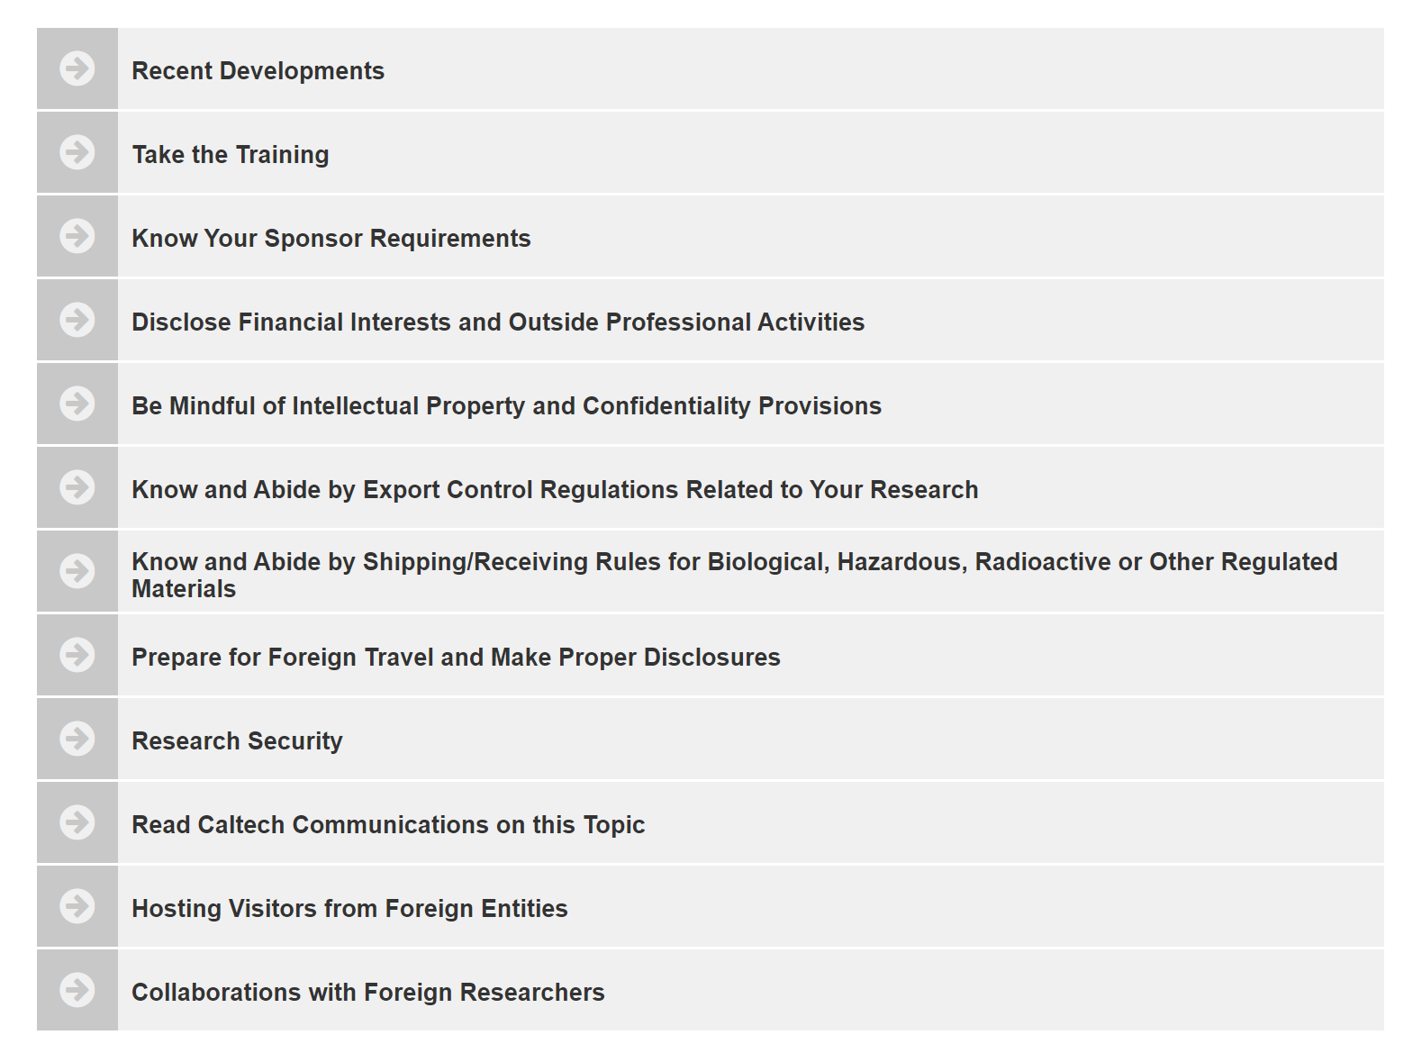
Website and Resources
Website: Now Live! https://researchcompliance.caltech.edu/compliance/international_collaboration
Notes:
GRACE: Walk through some of these important links.

